Slide 1


ESA Regional
Meeting
nutritioncluster.net
East and South Africa Regional Nutrition Consultation Meeting
Day 1
Movenpick Hotel, Nairobi
30-31 January 2024

Slide 2
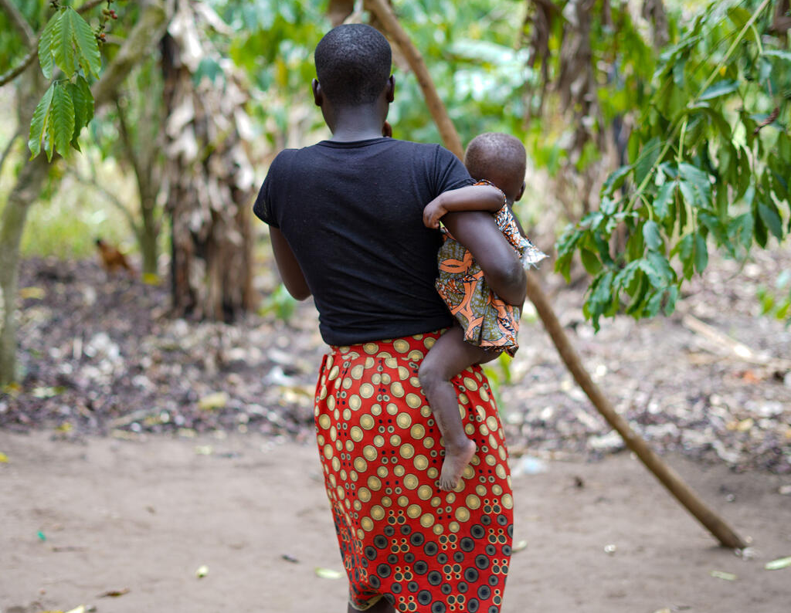
Part 1
Global and Regional Level Overview
ESA Regional
Meeting

Slide 3
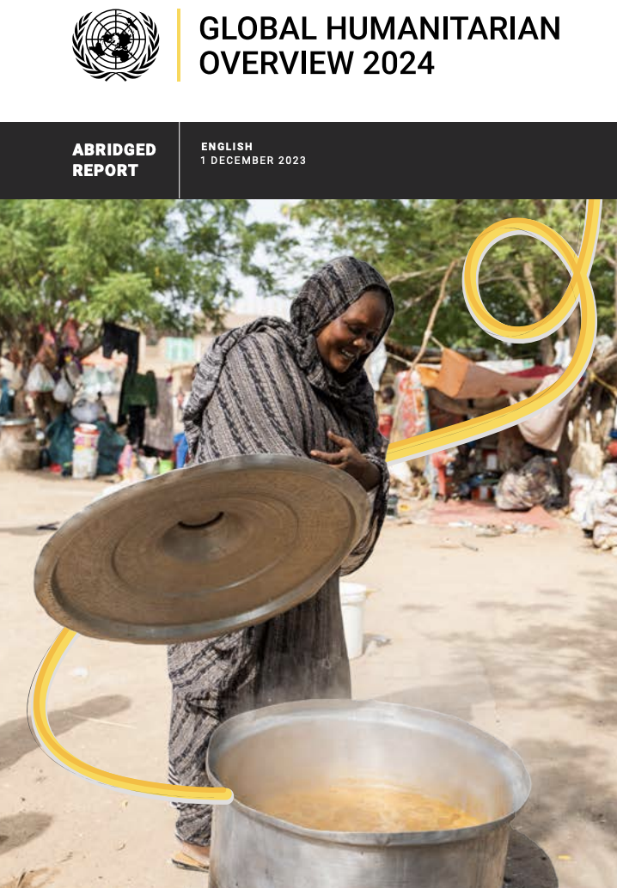

Global Nutrition Landscape
Stevano Fedele
Global Nutrition Cluster Coordinator
Notes:
Introduce yourself (again)
The 2024 Global Humanitarian Overview is produced yearly and is a coordinated and comprehensive plan to address the growing humanitarian needs of people affected by crises globally. Each year we witness a growing number of affected people due to impacts from climate change to conflict, pandemics to epidemics.
The GHO assesses and analyzes those needs to help guide humanitarian response efforts. It helps in the coordination of respone efforts by providing a common understanding of the crisis including the funding needed to adequately address humanitarian needs. All of which are criticial components in our work in nutrition in emergencies.
In addition to identifiying the needs, the GHO also identifies ways forward and what we must implement at all levels into our response efforts.

Slide 4
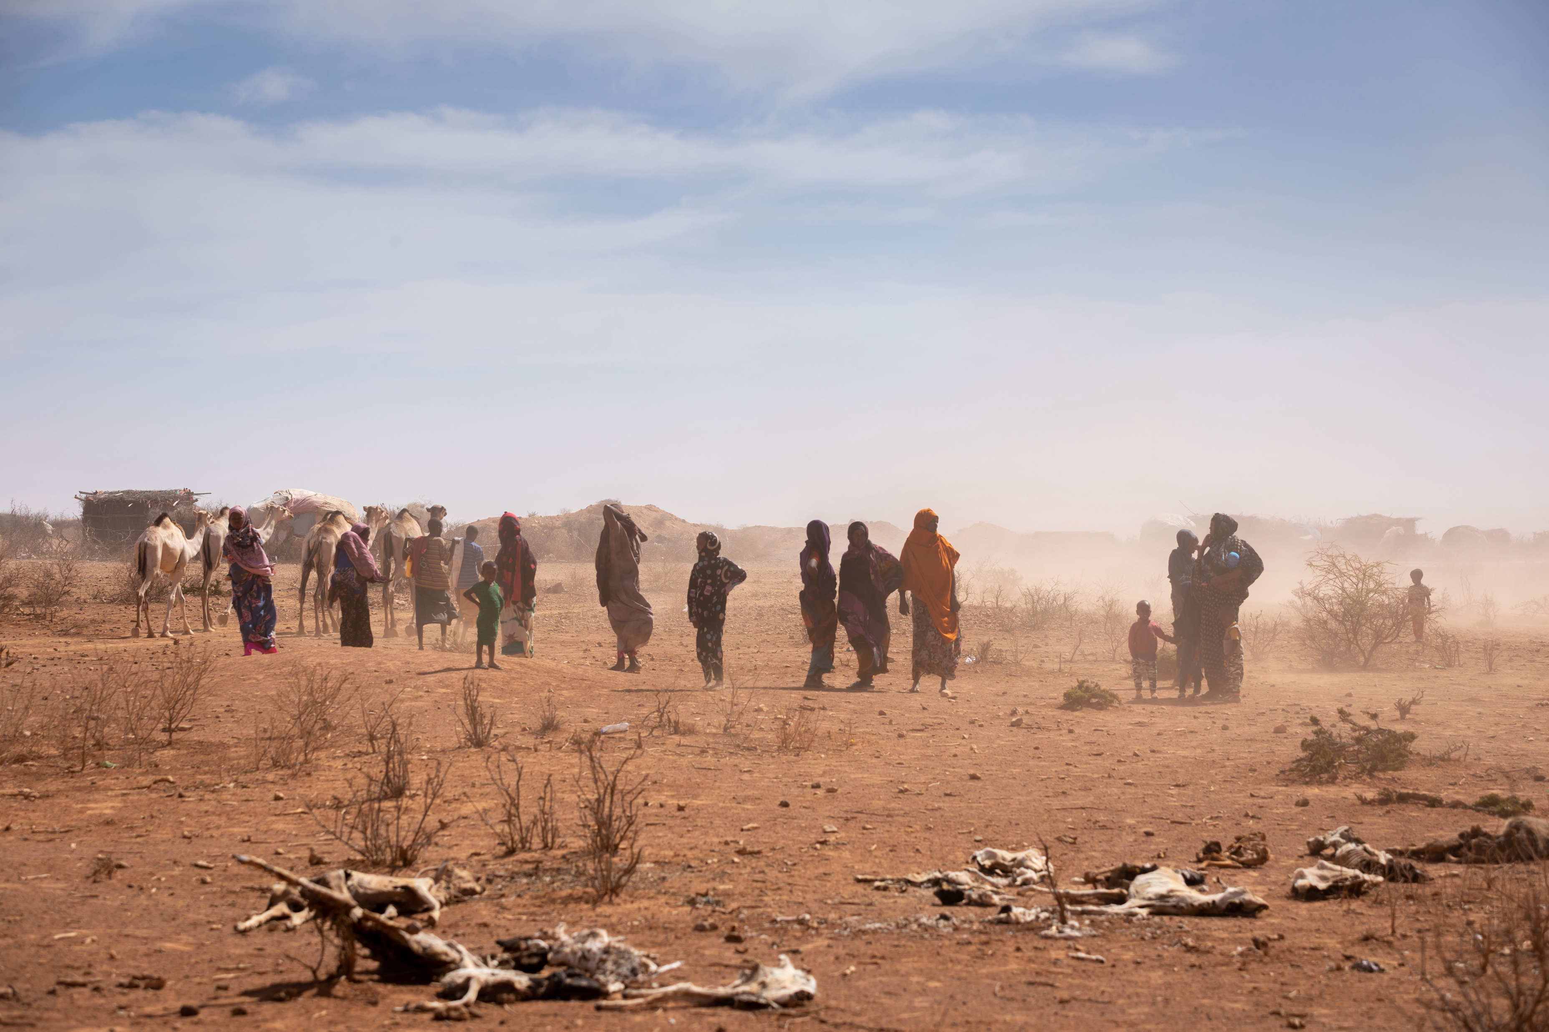
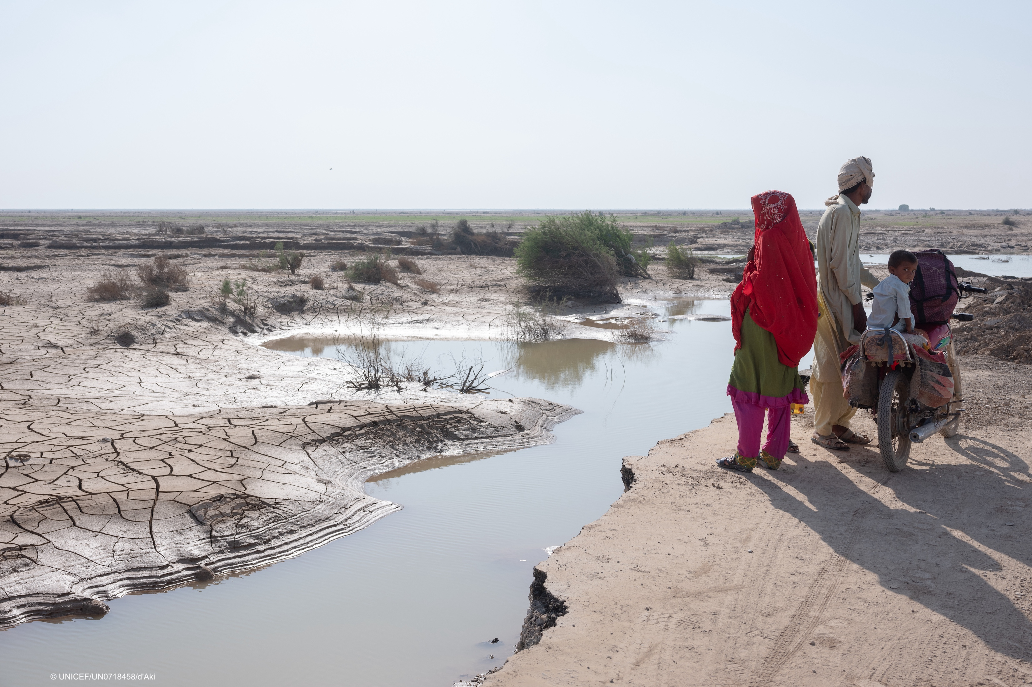
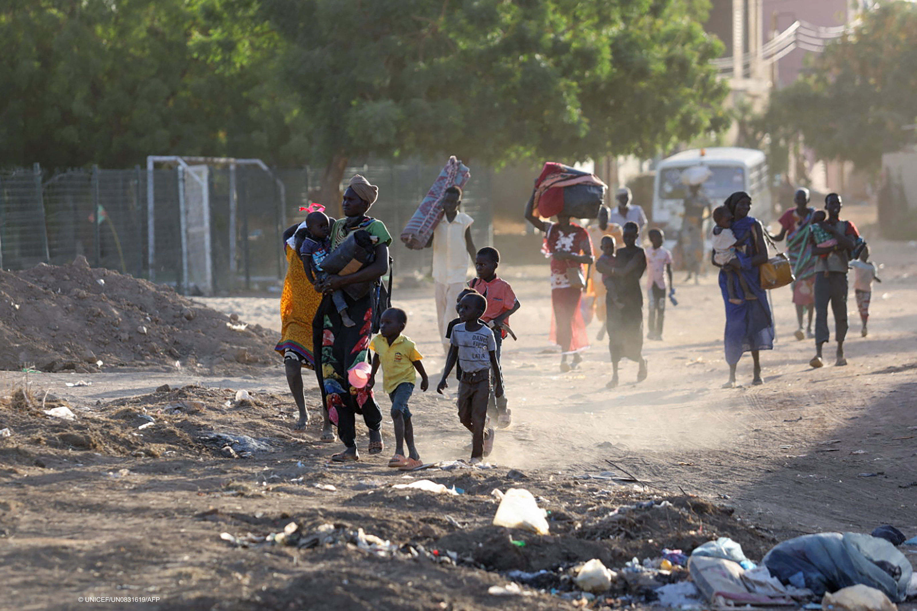
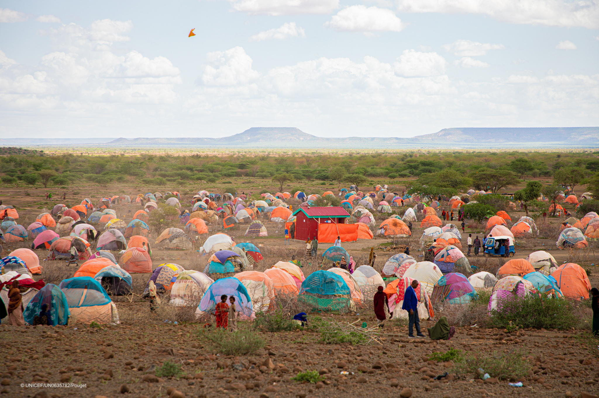
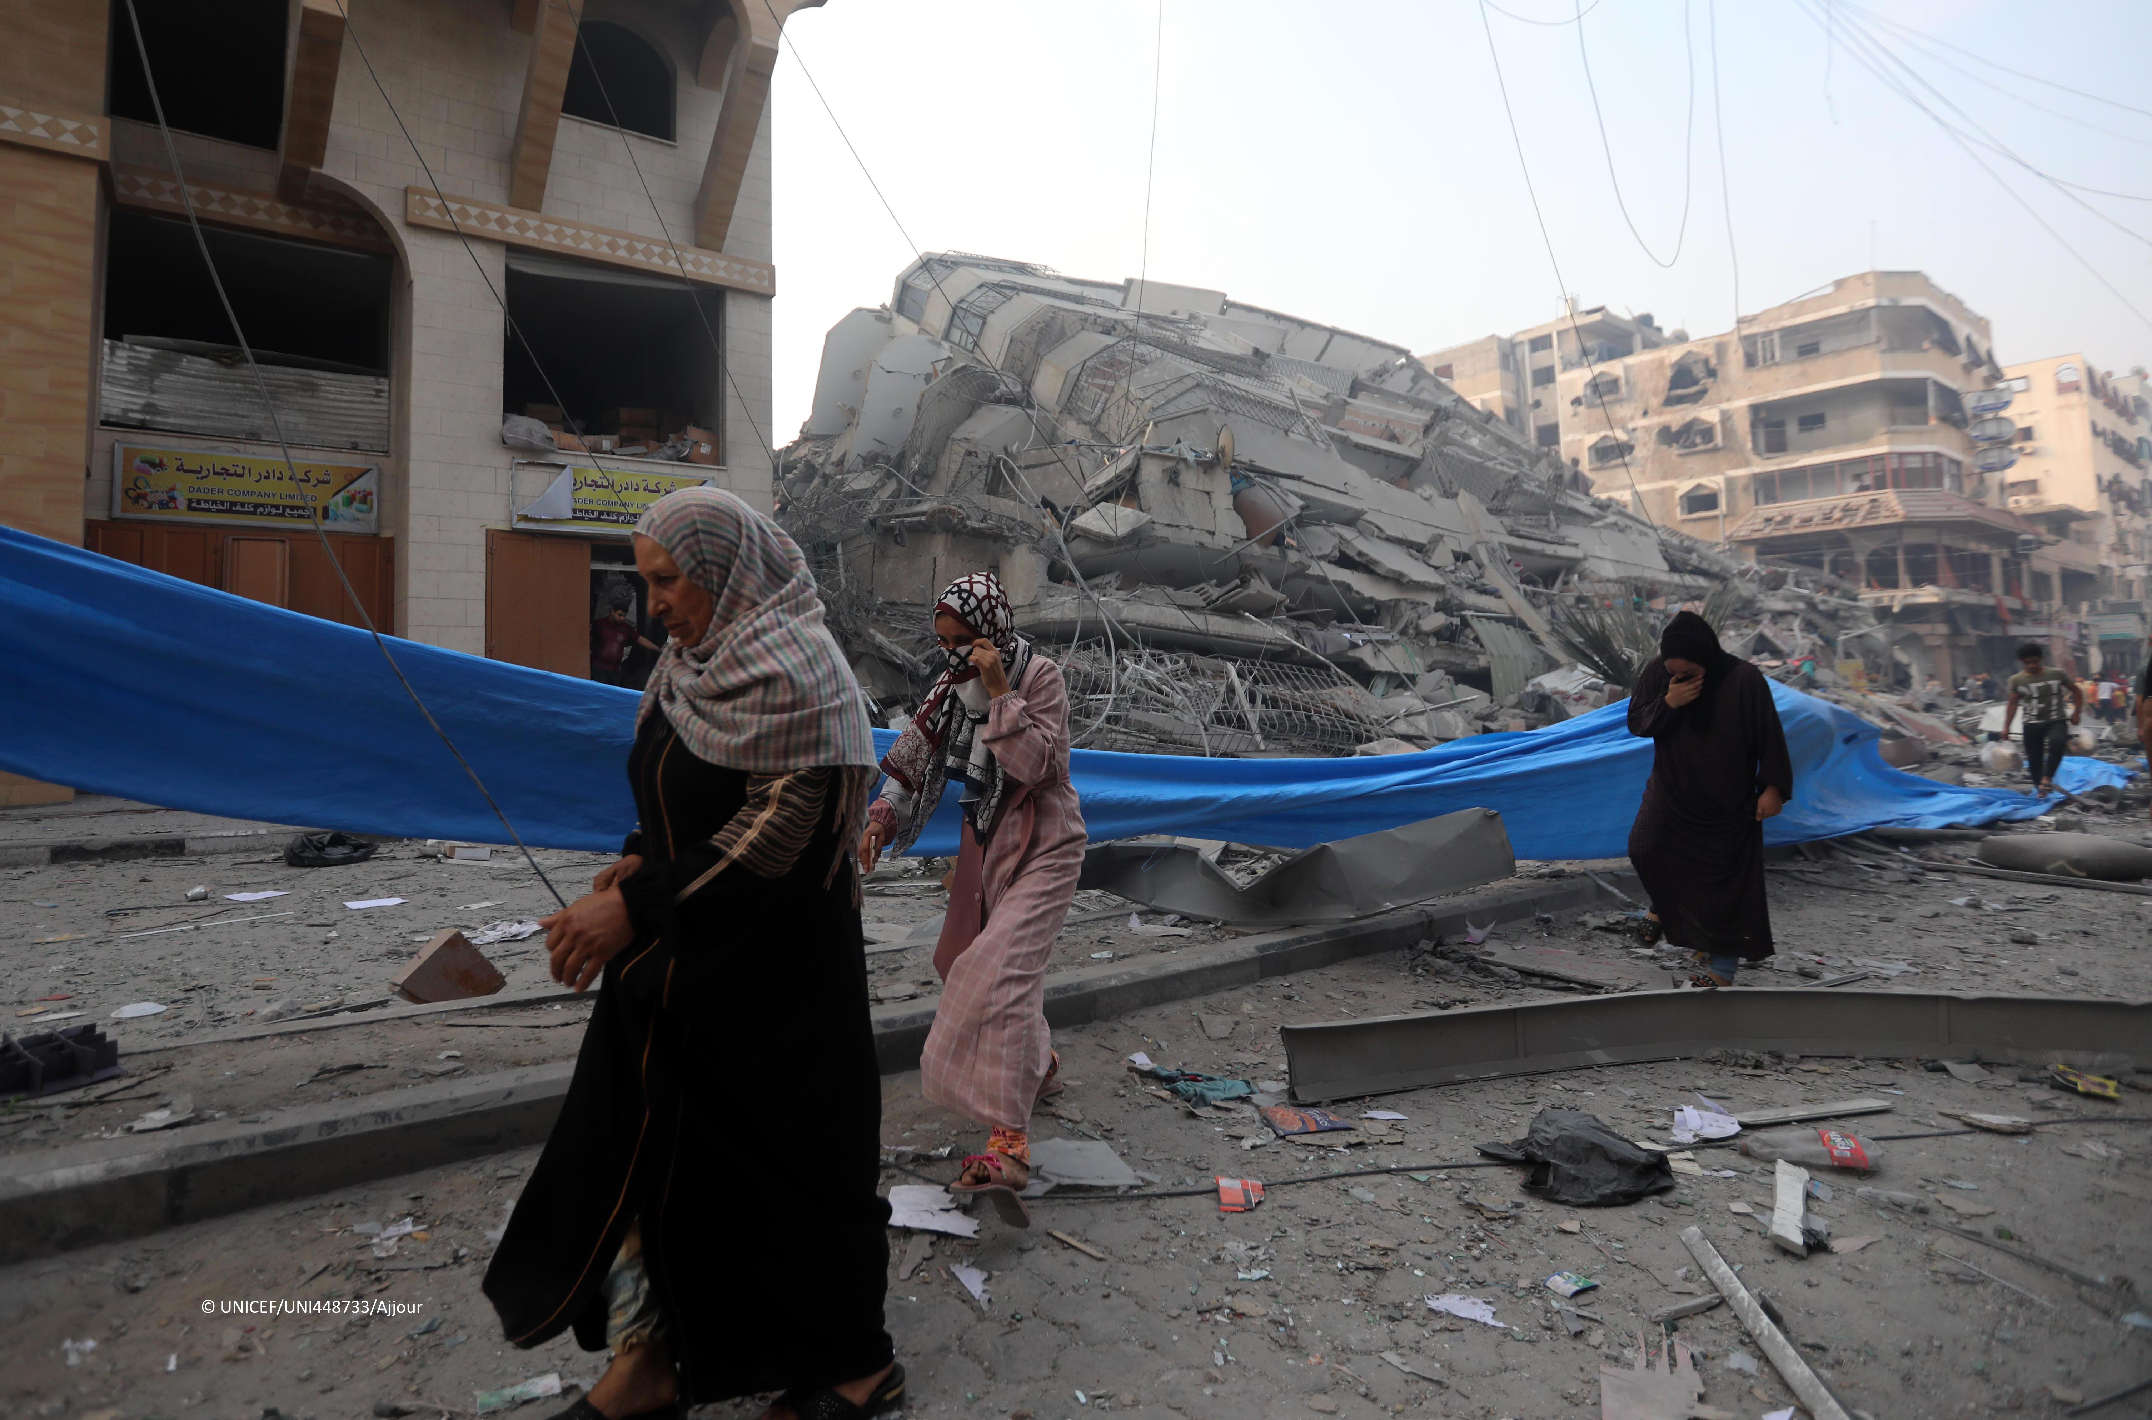



Year in review
Global Nutrition Landscape – Stefano Fedele, GNCC
30 January
ESA Regional
Meeting
Notes:
As we all are very aware, 2023 was another immensely challenging year that saw an increase in displacement, rise in acute food insecurity and malnutrition that reached very high levels with children, women, and girls suffering a disproportionate burden.
Additionally, the increase in global conflicts put millions in harms way and rising challenges due to climate change forced many to make strategic shifts away from usual ways of working and this will continue into 2024.
Other challenges in 2023 included a funding pitfall where less than 1/3 of the required amount was received. However, as we will undoubtedly continue to face increasing challenges, we need funding so we can provide the life saving assistance so desperately needed now and in the future.

Slide 5
2024 Global Needs
PEOPLE IN NEED
299.4M
PEOPLE TARGETED
180.5M
REQUIREMENTS (US$)
$46.4B
74.1 million people will need humanitarian assistance in East and Southern Africa alone
$10.9 Billion
Drivers
Conflict
Climage Change
Economic factors
Global Nutrition Landscape – Stefano Fedele, GNCC
30 January
ESA Regional
Meeting
Notes:
Globally, almost 300 Million people are and will be in need of humanitarian assistance in 2024, with 180.5 million targeted and $46.4billion required in total humanitarian assistance.
74.1 million people will need humanitarian assistance in East and Southern Africa alone, with the crisis in Sudan at the center, making up nearly 40% of this. $10.9 billion is required in ESA to address the millions in need.
2024 Global priority of needs have been and are driven by three key, overarching determinants:
1) conflict – the world is witness to more devasting conflicts. From the ongoing conflict in Ukraine to the more recent ones in Sudan and SoP, the consequences for civilians has been widespread with 1 in 5 children living in or fleeing from conflict afflicted areas.
2) Climate emergencies are forcing and increasing number of people to flee their homes due to extreme drought and food shortages.
3) economic downturn, including the persistent effect of COVID, in combination with the above, further drive up the humanitarian needs
Acute food insecurity is a reality for 258 million people in 58 countries
Wasting threatens the lives of 45 million children under 5. Of this, 13.6 million are already suffering from severe wasting, placing them at imminent risk of death.
Without concerted international efforts, nutrition insecurity will deteriorate further in 2024 with Burkina Faso, Mali, SoP, South Sudan and Sudan at the highest level of concern.
As the Global Nutrition Cluster, we aim to strenghten national capacity for a coordinated nutrition response before, during, and after emergencies and ensure a response that preserves the nutritional status and saves the most lives. Our collective role is to ensure that this support is provided where it is most needed in a coherent, consistent and predictable manner to maximise its efficiency and effectiveness.

Slide 6
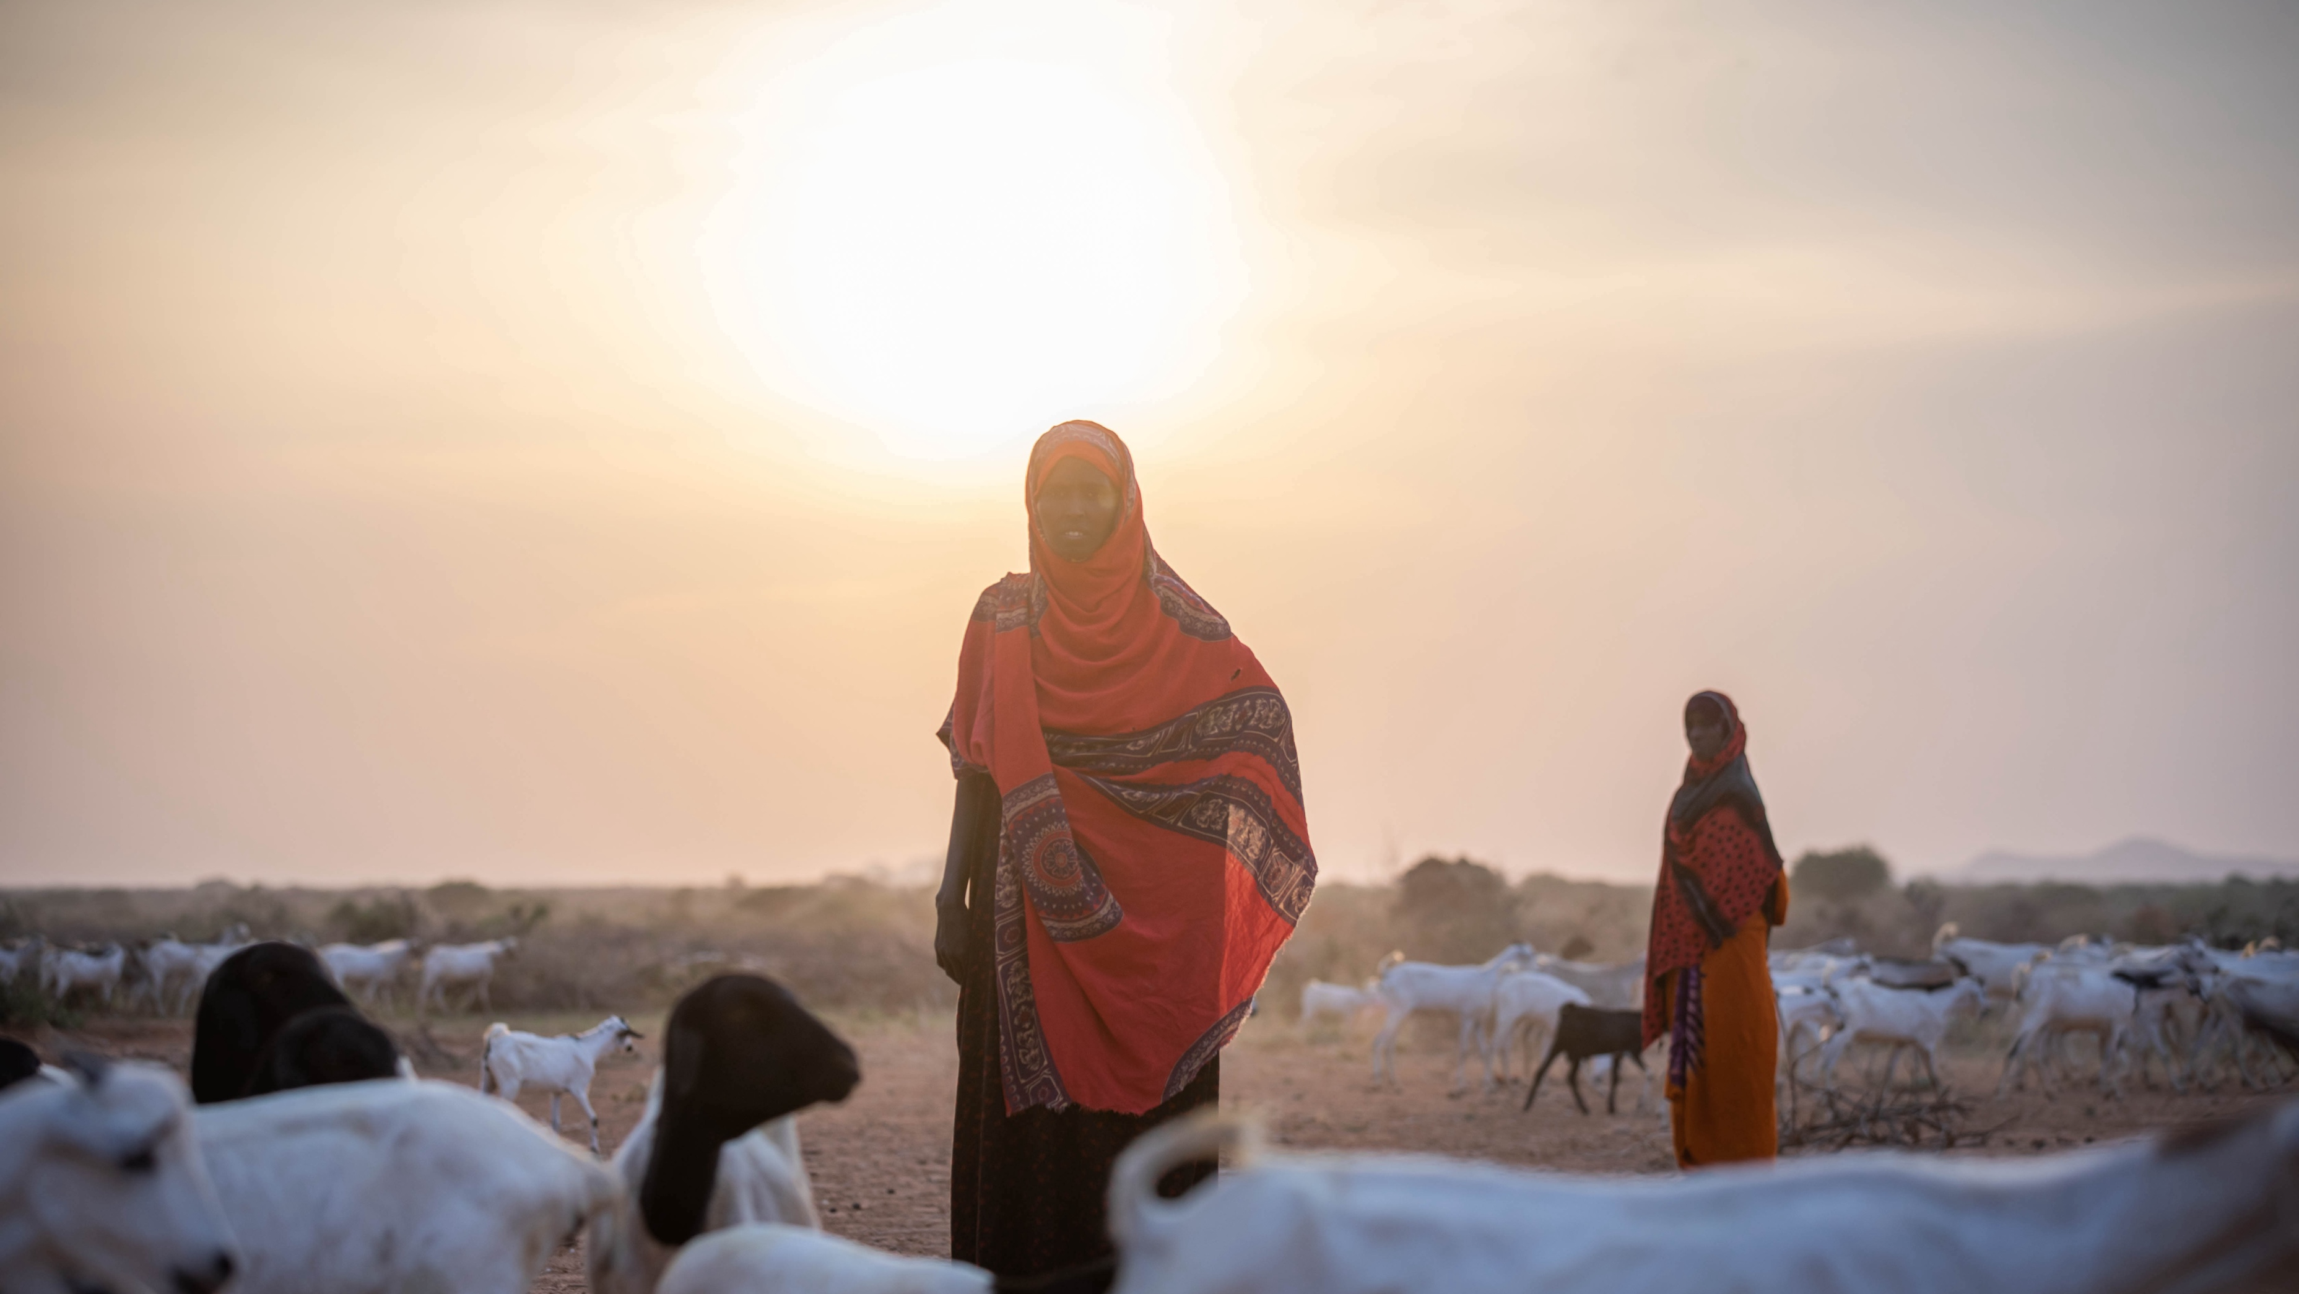
Key strategic changes
Notes:
To address these increasing challenges and needs, we must constantly evolve the ways in which we work and shift priorities to align with the needs of the most affected people.
In particular over the year ahead we aim to have more consistent progress on Localization and Climate Change

Slide 7
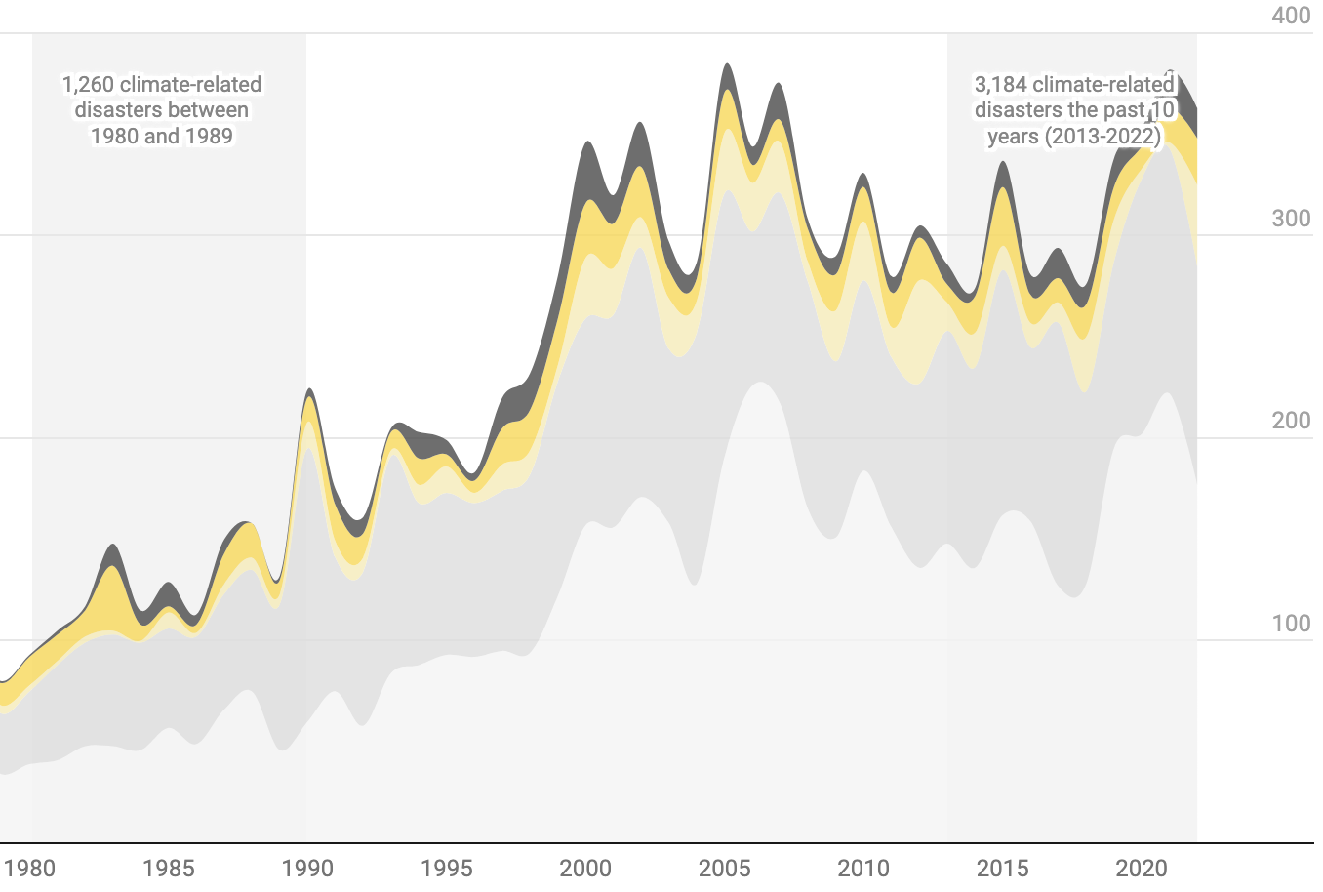
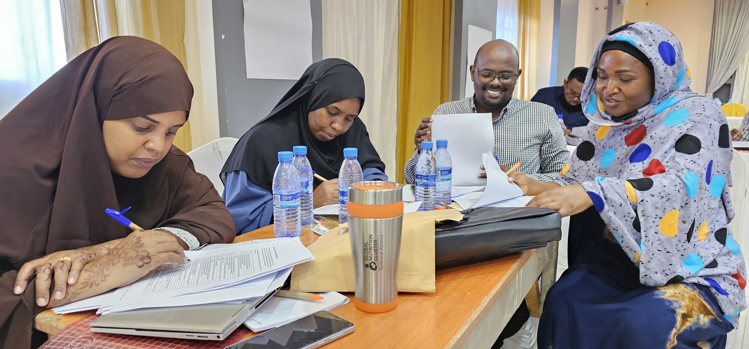
Localisation
Climate Change
Locally-driven, locally-led, and locally-owned response
Climate-related disasters increased by 2.5 times in current decade compared to 1980s
Martha the GNC CMAM Advisor is training future facilitators in Somalia on in-patient Management of SAM
Global Nutrition Landscape – Stefano Fedele, GNCC
30 January
ESA Regional
Meeting
Notes:
One is to ensure a more localized approach in the response supporting national and subnational leadership and acknowledging and centering the work of local and national NGOs. Here,
Martha the GNC CMAM Advisor is training future facilitators in Somalia on In-patient Management of SAM. LNAs are the first responders in every emergency and the heart of the response. They can often mobilize resources and networks quickly and have greater access to crisis affected populations. This creates and contributes to a more sustainable, effective and efficient response. .
We need greater clarity on how best we can contribute to the Climate Change agenda, ensuring that response efforts are considered through a climate change lens. The spiraling climate crisis is exposing more and more people to vulnerabilities and increasing needs.

Slide 8
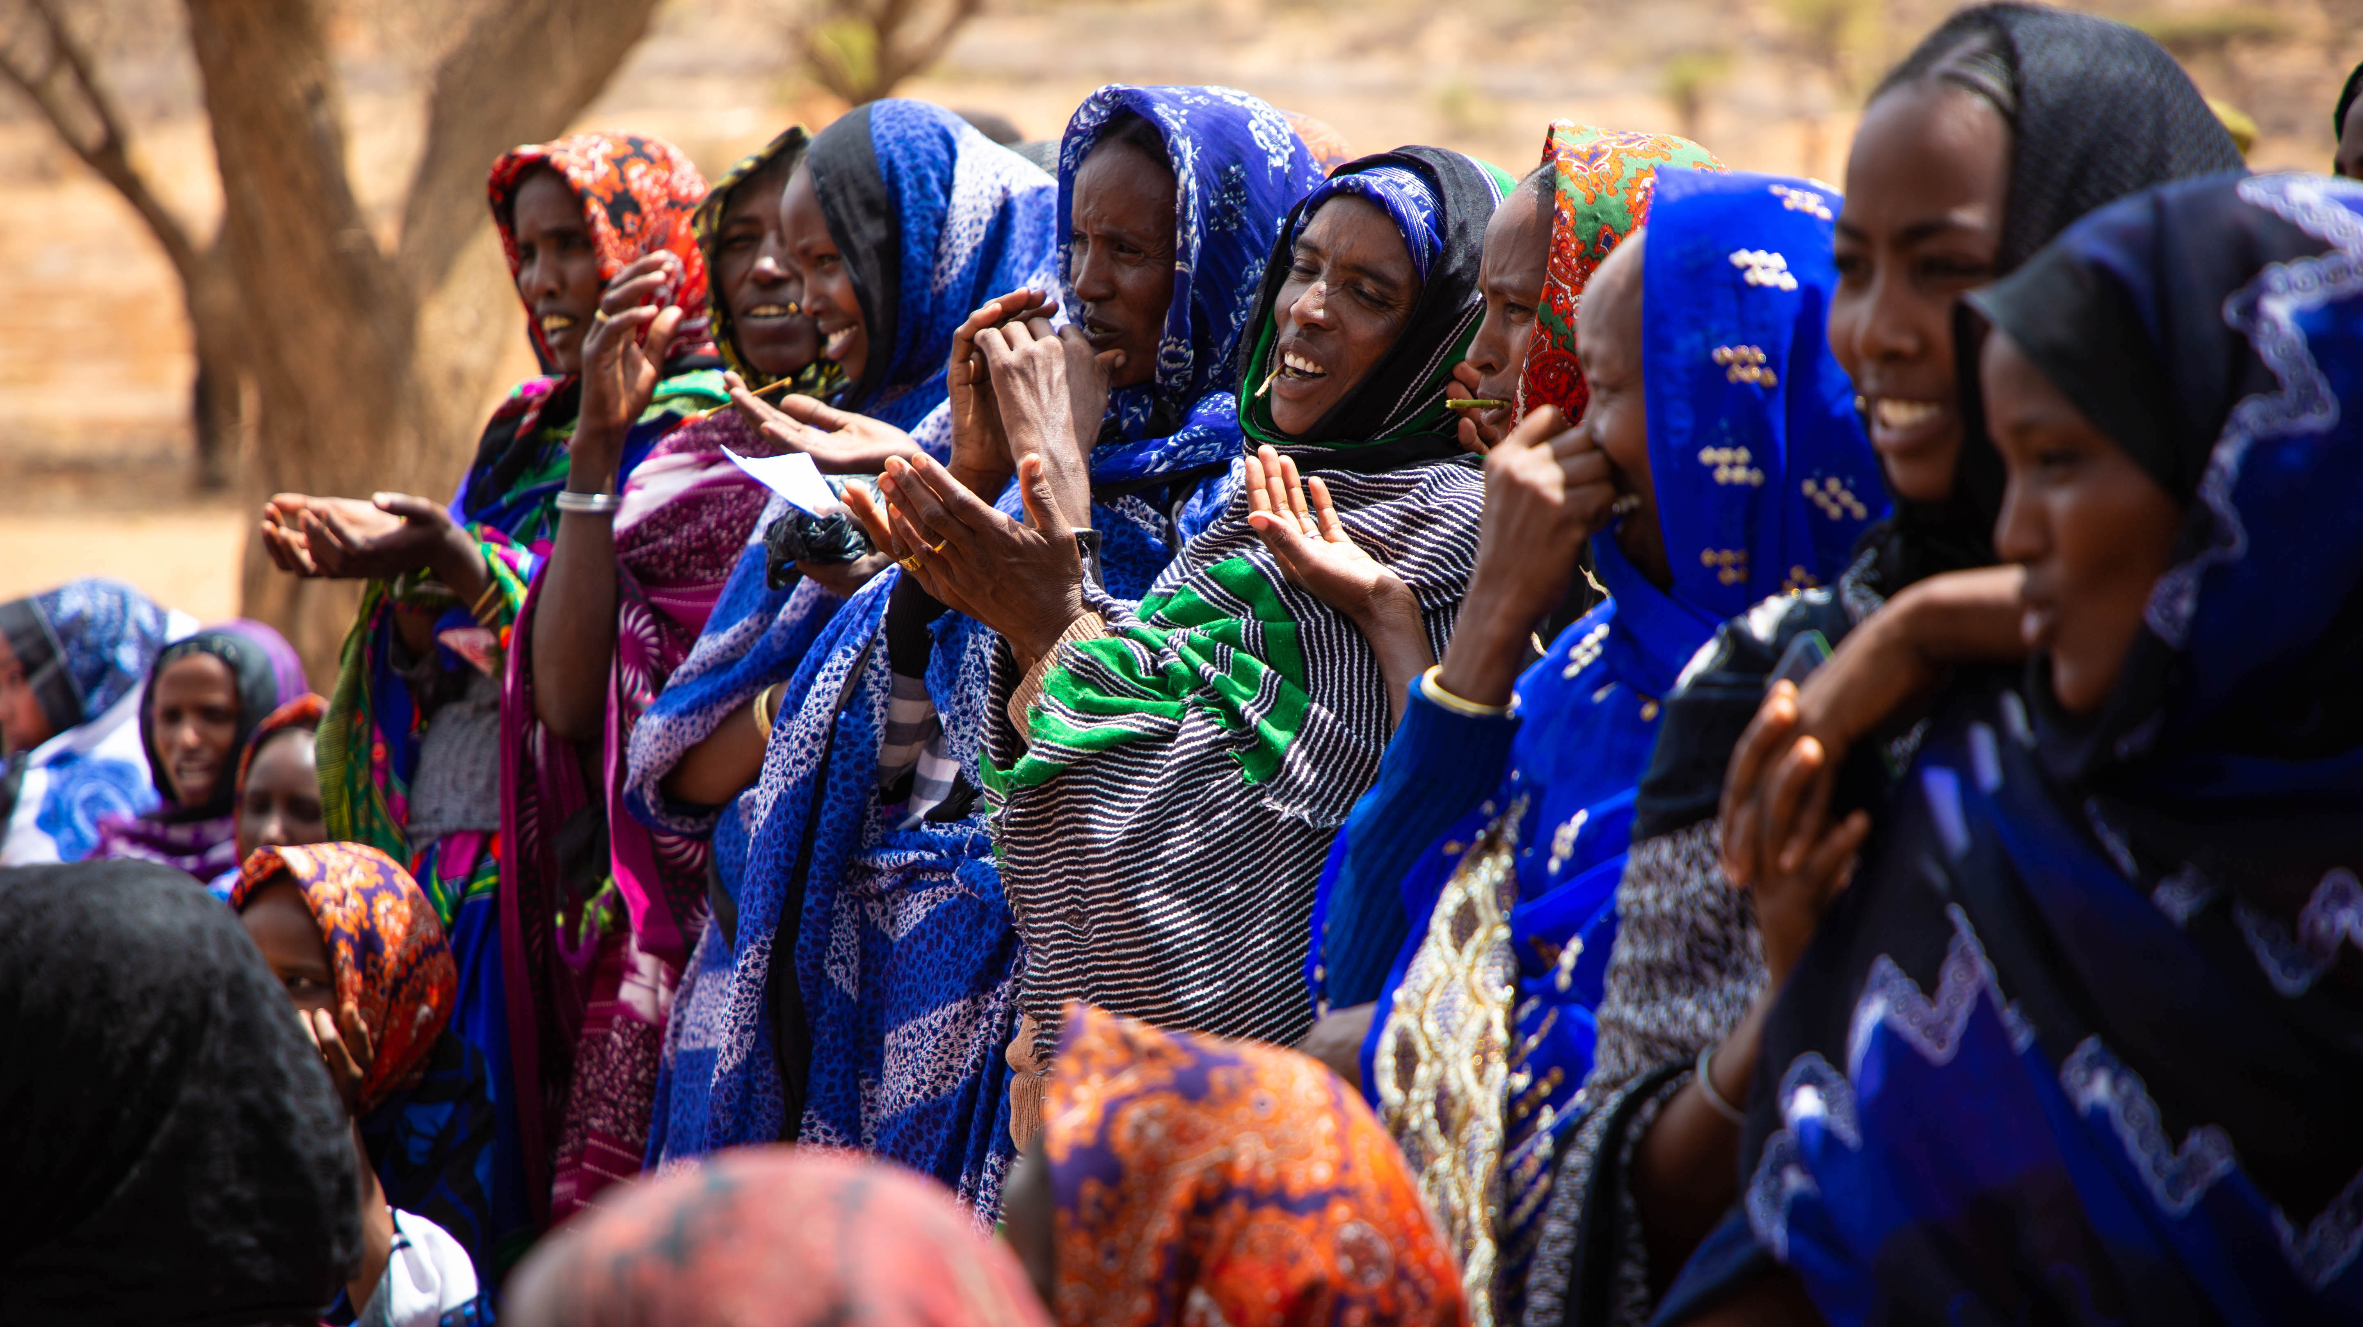
GNC New Ways of Working

Slide 9


GLOBAL NUTRITION CLUSTER
SUPPORT
Coordination, Information Management & NiE
Technical
Learning & Resources
Working
Groups
Virtual
Helpdesk
Consultant Roster
Resource
Library
Capacity
Strengthening
Deployed
Advisors
News & Events
ESA Regional
Meeting
Notes:
Over the last year the GNC Coordination Team and the GNC Technical Alliance have been working closely to ensure that the provision of support for Coordination, Information Management and technical support for Programme delivery are easier than ever to identify and access by all, through a more holistic GNC support platform. We believe this will help us to communicate our support and services more clearly and improve your experience with us. Nothing will change for you. We are still offering the same support, through the same channels but in a more unified and clear way.
We also believe this approach will foster more synergy between our two arms of support, which already overlap significantly. With one shared vision and purpose – to provide timely and comprehensive nutrition coordination, information management, and Nutrition in Emergencies technical support – we believe we can utilize our collective resources more efficiently and ultimately serve nutrition actors, like you, better.
Scan the QR code at the end of this presentation to visit the GNC site to request any support you need.

Slide 10
Q&A
Global Nutrition Landscape – Stefano Fedele, GNCC
30 January
ESA Regional
Meeting

Slide 11

ESA Regional
Meeting
Thank you

Slide 12
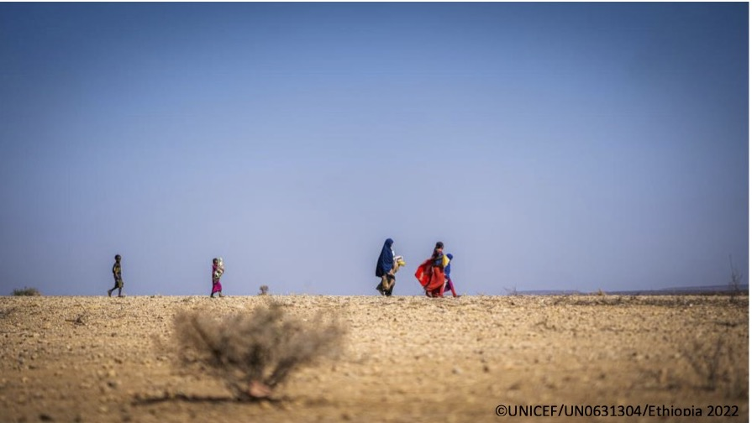
Regional Nutrition Landscape

Slide 13
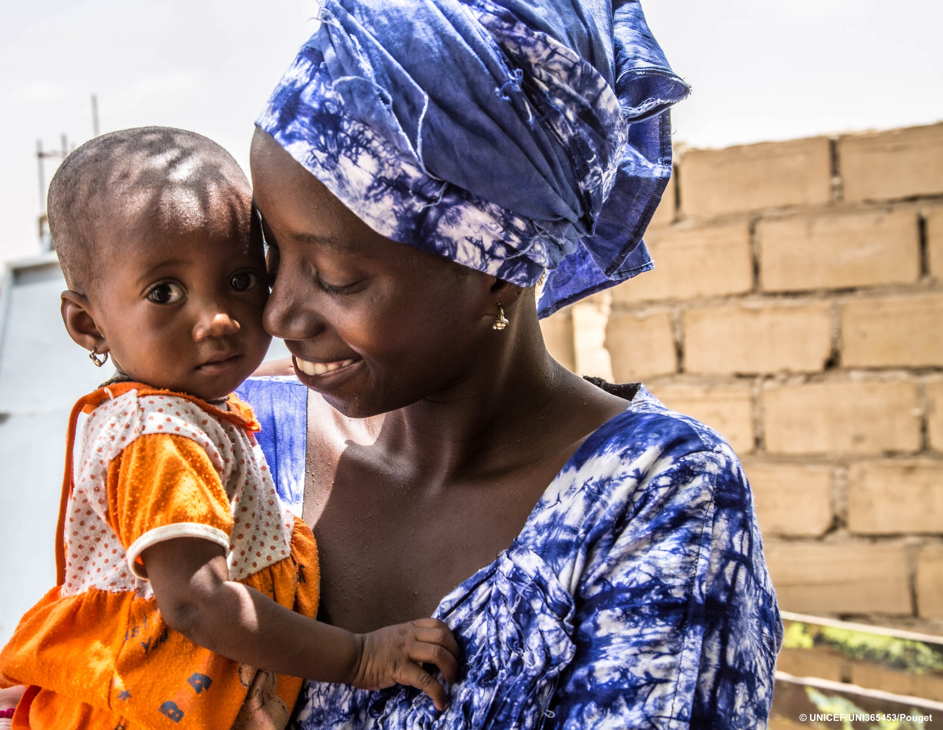
Regional nutrition landscape and NIE priorities
Christiane Rudert
UNICEF Regional Advisor Nutrition
30 January 2024

Slide 14
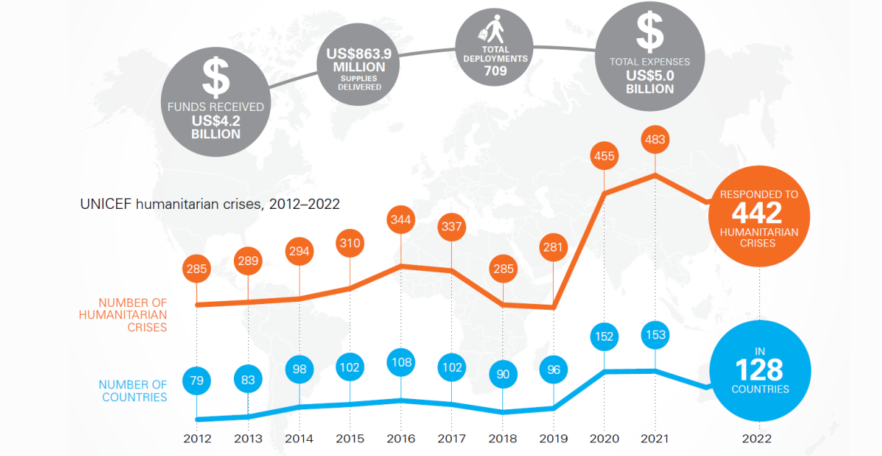
Increasing number of emergencies globally
The number of humanitarian crises have increased over time
ESA accounts for 1/3 of all emergencies
2023 Annual report on UNICEF humanitarian action

Slide 15
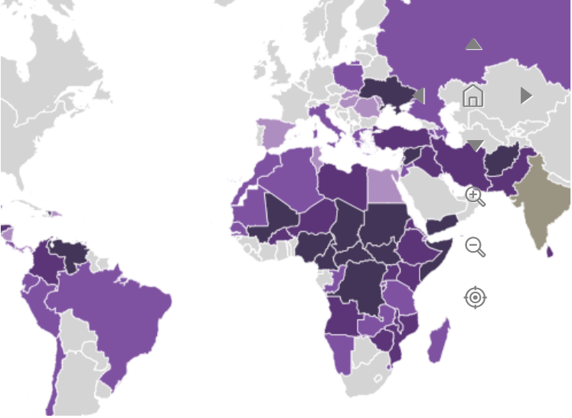
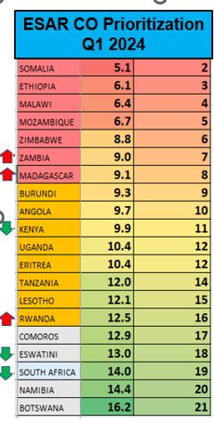
Humanitarian crises severity: Nutrition Outlook
Nutrition 2024 Priority countries-Ethiopia, Somalia, ASAL of Kenya, South Sudan, Mozambique, Malawi, Angola, Madagascar, Burundi, Zimbabwe, Zambia
Food insecurity and Climate risk (drought, Floods)
Conflict and displacement
Northern Ethiopia, Mozambique, parts of South Sudan, and Somalia
Diseases
AWD, Cholera
Microeconomic conditions leading to Low food stocks/crop failure
unfavorable terms of trade
Livestock diseases
Increasing IDPs influx
Food insecurity Increasing food prices
Malaria/Measles
2024 INFORM
2024 UNICEF CO Prioritization

Slide 16



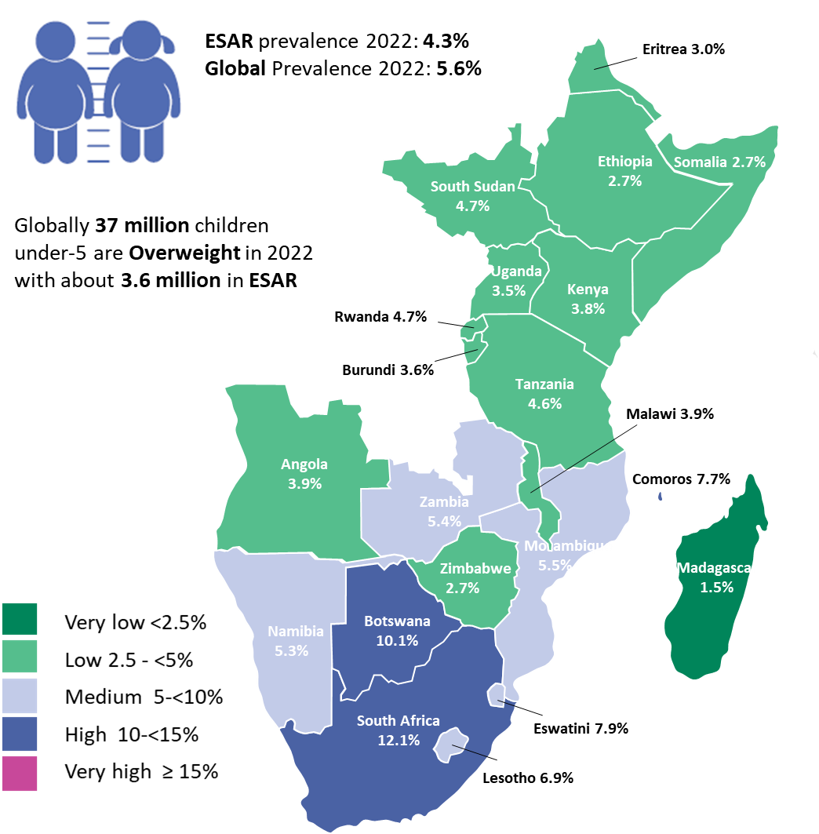
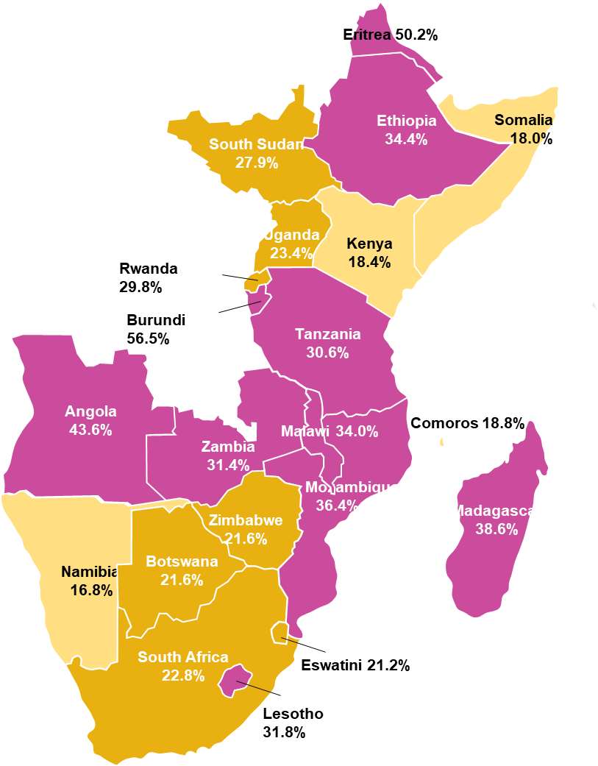
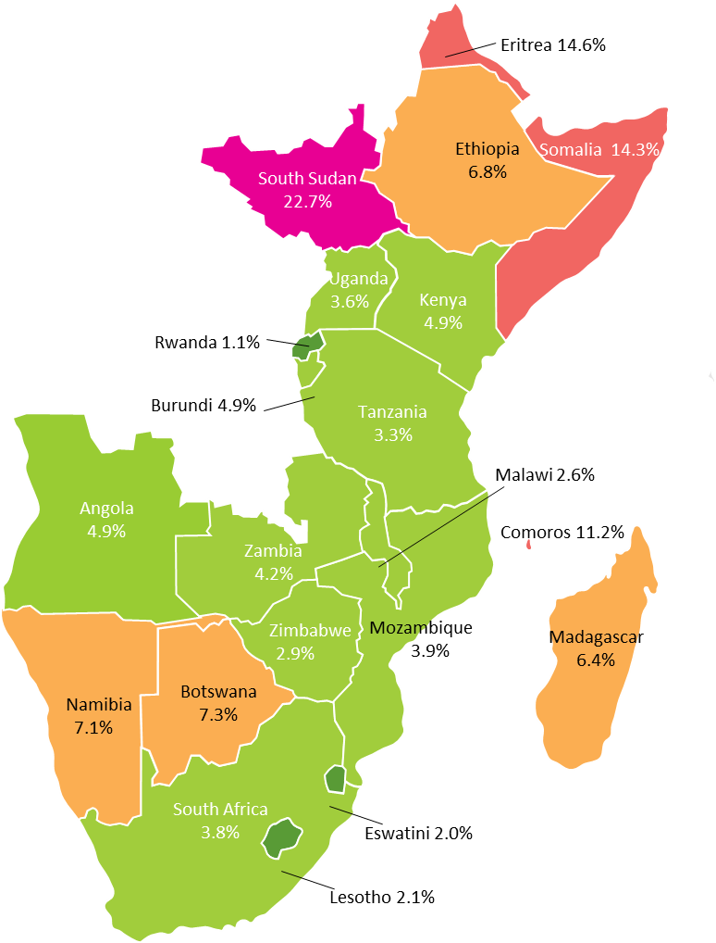
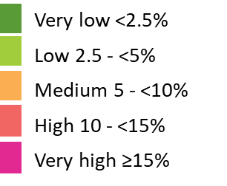
Emergencies happened on top of the Triple burden of malnutrition
Stunting
Wasting
Overweight
ESAR prevalence: 30.9%
Global prevalence: 22.3%
ESAR Prevalence: 5.4%
Global Prevalence: 6.8%
ESAR Prevalence: 4.3%
Global Prevalence: 5.6%
26 million
Children <5
4 million
Severely wasted children <5 needing treatment in 2023
8.7m children with MAM
3.6 million
children <5
Very low <2.5%
Low 2.5 - <10%
Medium 10-<20%
High 20-<30%
Very high ≥ 30%
(JME 2023)
Notes:
There is vast cross-country heterogeneity in the prevalence of malnutrition in Eastern and Southern Africa (ESAR) and Western and Central Africa (WCAR)
Low- and middle-income countries have different prevalence rates of stunting.
Most of the low-income countries with high malnutrition prevalence rates tend to be highly donor-dependent in nutrition and health financing in general.
There is a positive correlation between countries with high political instability and conflict and the prevalence of malnutrition. For example, countries such Somalia, South Sudan, Ethiopia, and Mozambique in ESAR that have persistent political instability and violent conflict have higher malnutrition rates.

Slide 17
Children in need of treatment for
severe wasting,
ESAR 2024
Eritrea 39,600
Ethiopia
961,898
South Sudan
366,039
Somalia 24 353,606
Uganda
129,100
Kenya
236,141
Rwanda 10,057
Total: 3.4 million
(> 60% in greater HOA)
Tanzania
221,930
Burundi 84,000
Angola
243,504
Malawi 62,067
Zambia
140,515
Mozambique
2 96,705
Comoros 14,890
Madagascar
121,173
Key:
Number of children in need of treatment for severe wasting
Zimbabwe 19,775
Namibia
4,809
Botswana
23,093
>1,000,000
>200,000 – 999,999
100,000 – 199,999
<100,000
South Africa
287,443
eSwatini 1,442
Lesotho 5,714
*countries with 2023 estimates

Slide 18
ESAR severe wasting admissions vs burden (children 6-59 months, 2017-2023)
Between Jan – October 2023 more children are being admitted in comparison to the same period in 2022. +24% (+368,440)
Admissions (number of children affected by severe wasting) Jan – Oct 2023: 1,989,692
Estimated coverage (admissions vs. burden), Jan – Oct 2023: 58.4%
This implies that a high number of the children will remain untreated in 2023.
Over 98% of the 2023 supplies needs met for the HAC countries – huge supplies gaps noted for Zimbabwe, Angola and Eritrea

Slide 19
SAM burden and admissions in ESA Region (Jan-Oct 2023)
ESAR burden (2023):
4,030,000
ESAR admissions Jan-Oct 2023:
1,989,692
ESAR admissions vs burden:
58.4%
Only 3 countries (Somalia, Madagascar and Namibia) are on track (>75% of the burden) to reach high coverage of the 2023 estimated burden

Slide 20
Admission trends in ESAR 2017-2023 by month

Slide 21
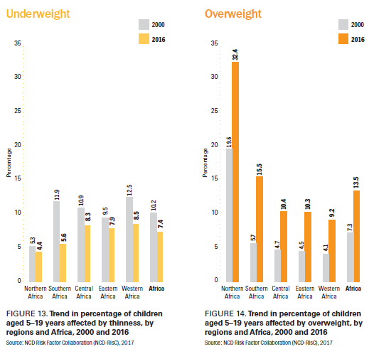
Nutrition of adolescents and school age children
Over 12 million children aged 5-19 are
estimated to be underweight
Over 20 million children aged 5-19 are
estimated to be overweight
Notes:
Undernutrition has declined a bit, halved in Southern African and a little in Eastern, while overweight has increased significantly: tripled in Southern Africa and more than doubled in Easteern

Slide 22

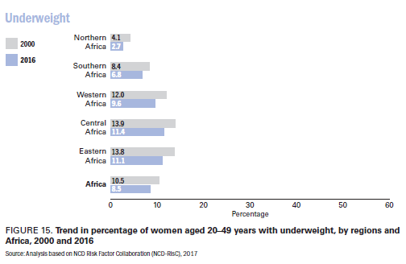
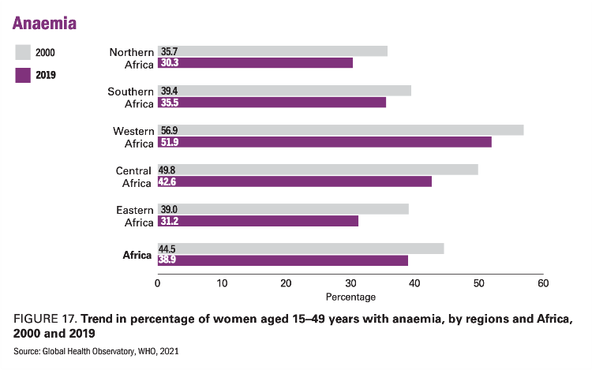
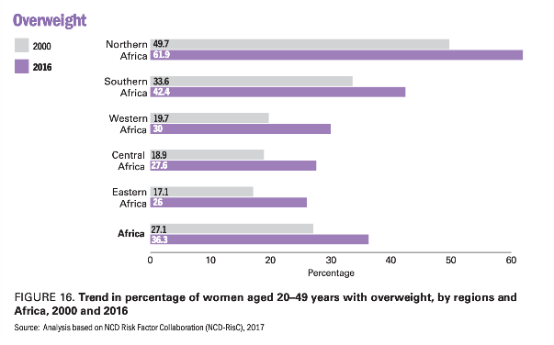
Nutrition of women
Underweight
Anemia
Overweight

Slide 23
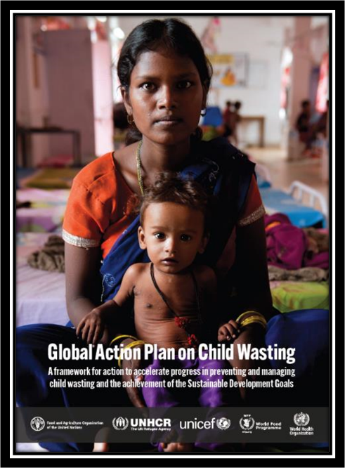
GLOBAL ACTION PLAN ON CHILD WASTING
A Framework for action to accelerate progress in preventing and managing child wasting and the achievements of the Sustainable Development Goals
The GAP was commissioned by the UN Secretary-General in the summer of 2019, and it includes costed, operational roadmaps to prevent, detect and treat child wasting in over 20 countries around the world.
The plan aims to respond to the slow progress towards achieving the Sustainable Development Goal (SDG) on reducing childhood wasting, and to growing calls for a more coordinated and streamlined UN approach to addressing this challenge.
ESAR has 7 GAP countries and its hope that these number will increase as more countries with a high burden of wasting join

Slide 24

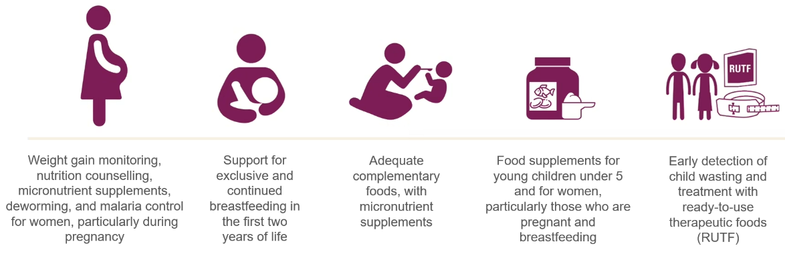
WHAT IS THE CHILD NUTRITION FUND? The Child Nutrition Fund (CNF) is a new financing mechanism designed to accelerate the scale-up of sustainable policies, programmes and supplies to end child wasting.
WHO IS THE CHILD NUTRITION FUND FOR? To support government-led efforts in countries that carry some of the highest numbers and/or proportion of children under 5 years of age with wasting that have developed operational roadmaps as part of the GAP
WHAT ACTIONS WILL THE CHILD NUTRITION FUND SCALE UP?
WHAT ARE THE WINDOWS OF THE CNF?
Program window
Match window for essential nutrition services and supplies
Supplier window
Notes:
Afghanistan, Bangladesh, Burkina Faso, Burundi, Cambodia, Democratic Republic of the Congo, Ethiopia, Haiti, Indonesia, Kenya, Madagascar, Malawi, Mali, Niger, Nigeria, Pakistan, Papua New Guinea, Philippines, Somalia, South Sudan, Sudan, Timor-Leste and Yemen.

Slide 25
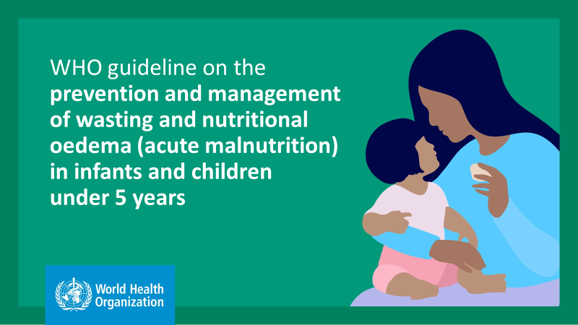
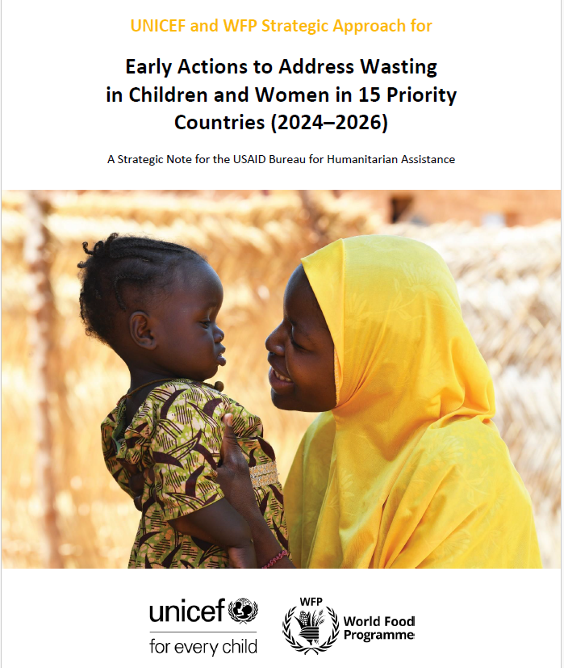
2024 –2026 Transition Plan to 2023 WHO Guidelines
Somalia, Afghanistan and Yemen
2024
Kenya, Madagascar, South Sudan
Full guidelines
2025
Ethiopia
2026
Somalia
2024 to 2026
Documentation of lesson learnt Support COs in updating National guidelines to the New WHO Guidelines recommendations
Notes:
Britta
The 15 priority countries have been allocated to three phases.
Implication: Means that these countries are being prioritized for global/regional level support including fundraising efforts, does not mean that country teams cannot move faster than this if they want.
Decision making : determined (with UNCIEF/WFP country teams) to be more ready and more suitable for the transition, based on several factors.
Phase 1: Joint preparation and planning will start in 2023, and programme shifts in 2024. This includes ensuring government agreement and all necessary steps are taken, such as building partner buy-in, identifying target regions, and developing a comprehensive plan for 2024, including costing, funding, development of tools and trainings.
Target areas
Learnings from phase 1 countries will be used to inform transition of other countries.
Phase 2: Detailed consultations with national level partners to start in 2023, with agreement on transition expected end of 2024. Programmatic shifts to start in 2025.
Phase 3: Discussions to start in 2023, programmatic shifts to starts towards the end of 2025 and expansion towards the end of 2026.
Parameters considered for overall readiness and pace for transition:
Operating/programming environment
Government readiness and policy environment
UNICEF and WFP readiness at CO level
System capacity
Supplies and Supply chain readiness
Funding

Slide 26
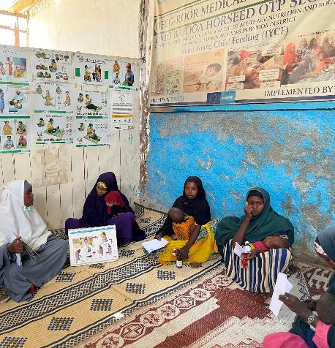
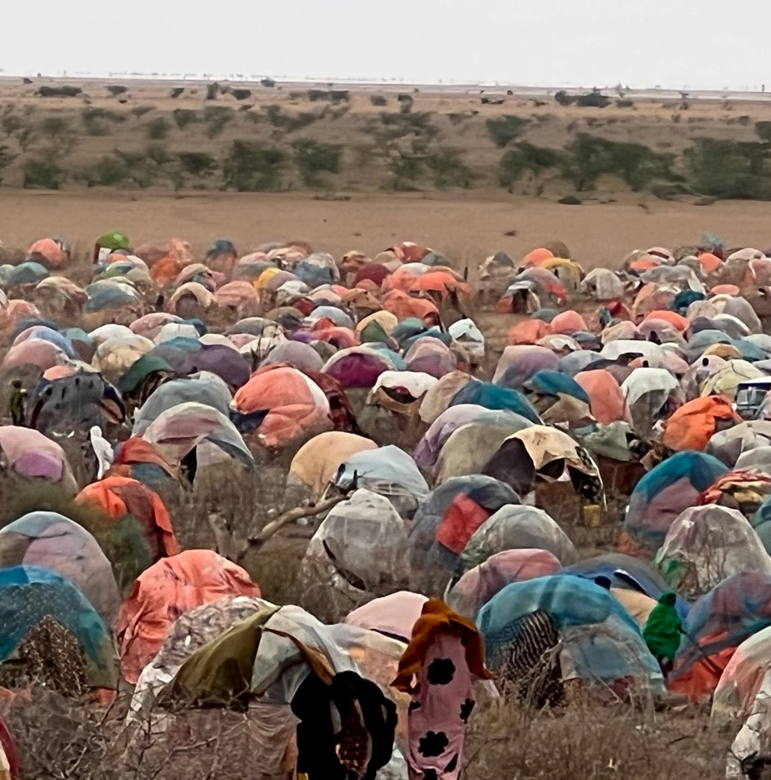
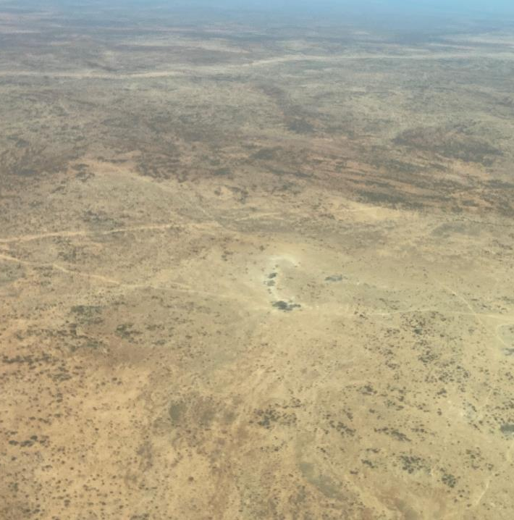
IYCF + counselling in emergencies
Priorities and progress
Capacity assessment
Capacity development
Programming guidance
Operational Guidance
Regional and Country training –IYCF-E
Knowledge management
Webinars/
Regional/
IYCF-Statement
Country assessment
Management of BMS
learning papers
country guidance on IYCF
Country level support priorities
Awareness creation
IYCF counselling: with better adaptation to emergency contexts
IYCF in disease outbreaks - cholera, EVD etc

Slide 27


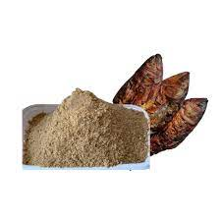

Food systems for children in emergencies
Improved “first foods” for children:
Tailored Food undertaking a mapping of initiatives and opportunities for innovations, local commercially produced complementary foods and local production of nutrient dense foods and ingredients and will develop roadmaps and investment cases.
15 countries interested so far: Angola, Burundi, Eritrea, Ethiopia, Kenya, Malawi, Madagascar, Mozambique, Rwanda, Somalia, South Sudan, Tanzania, Uganda, Zambia and Zimbabwe.

Slide 28

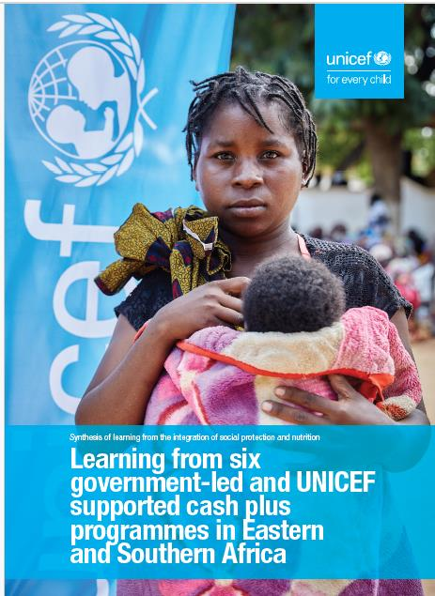

Nutrition and social protection
  Six country case studies and lessons learned on nutrition-responsive social protection completed
(BUR, ETH, KEN, MOZ, RWA,TAN).
Programme Guidance on Child Nutrition and Social Protection

Slide 29
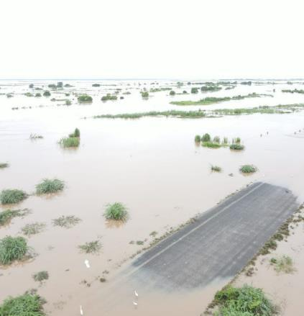
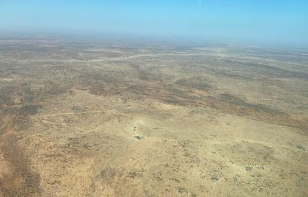

Climate and nutrition
Multi-disciplinary contract with NutritionWorks – documenting impact, scoping of strategies and development of a framework and a narrative on pitching child food and nutrition security for climate financing - aiming to elevate the profile of nutrition in the climate agenda including climate financing.
9 ESAR focus countries most affected by climate change:
  Angola, Eritrea, Ethiopia, Kenya, Madagascar, Malawi, Mozambique, Somalia, South Sudan
UNICEF Global Technical Team on climate and nutrition developed a brief on UNICEF’s vision and leadership on Child Nutrition and the Climate Crisis with focus on shock response, adaptation, mitigation, measurement, and financing

Slide 30
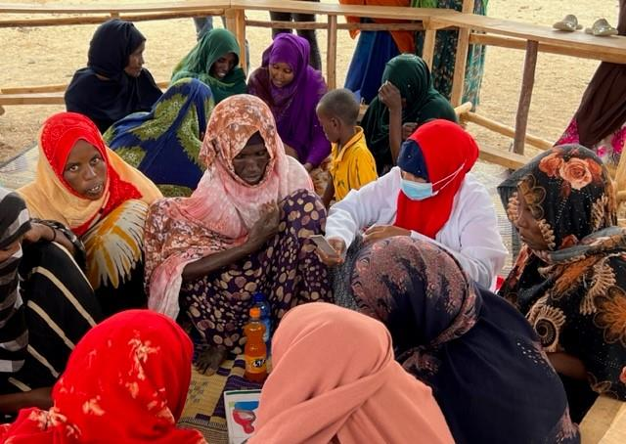
Maternal nutrition in emergencies
  Regional maternal nutrition framework
  Draft global guidance on maternal nutrition in humanitarian settings
  Field testing of guidance

Slide 31
UNICEF Nutrition in emergencies priorities
Leadership /coordination
Surveillance Systems and Nutritional Assessments
Prevention of undernutrition (stunting, wasting and MND) in U5, SAC-A, PBW
Care for Children with Wasting
Systems Strengthening
Community Engagement and Social Mobilization
Support mitigation of unintended consequences of emergencies on nutrition
Sustain and adapt existing services-address demand and enhance continuity of essential services – Life savings and prevention
Support implementation of minimum nutrition interventions in line with the CCCs
Strengthening cluster leadership and accountability
Fostering gender equity and inclusion in humanitarian preparedness, response and recovery actions
Enhancing partnerships to maximize synergies and complementarities
Programming to strengthen the humanitarian– development–peace nexus and localization

Slide 32
Challenges and next steps
Key challenges
Limited humanitarian access. Capacity-building initiatives and development of access strategies to tackle extreme access constraints
Rapidly expanding needs. Strategy on accountability to affected populations, a more localized humanitarian response and optimization of warehouse operations
Cyclic emergencies
Next steps
Addressing humanitarian needs sustainably
Strengthening the resilience of communities and other systems- health, food systems, social protection, education
Climate-adaptive anticipatory action and preparedness efforts in humanitarian action
Multisectoral response to famine prevention

Slide 33
Coordination of NIE in ESAR
Coordination overview
Country level: coordination capacity in 19 ESAR countries
Regional level:
UNICEF Country office call, ESAR Partners call, HOA, ESAR call.
Contribution to a) WHO Health partners b) FSNWG Working group for Eastern and Central Africa and the FNSWG for Southern Africa, RIASCO, IGAD, and SADC meetings c) AU regional meetings on food security and nutrition, school feeding, and nutrition.
What's working
Joint approach/resource mobilization
Joint planning and strategy development
Centralized information systems
Application of standards
Training and capacity building
Continuous information analysis
Specific collaboration with GNC - to date
Capacity development
Joint TA support to COs-
Regional coordination- HOA, ESAR
IYCF-E capacity mapping
Information management- support for regional dashboard
NuVAC
Guidelines on Nutrition Programme C19 adaptation for COs
Next step and areas of engagement
Technical Working Groups (CMAM TWG)
Support on the roll out of new WHO Guidelines

Slide 34

ESA Regional
Meeting
Thank you

Slide 35

Coffee Break

Slide 36

Part 2
THEMATIC SESSIONS
ESA Regional
Meeting

Slide 37
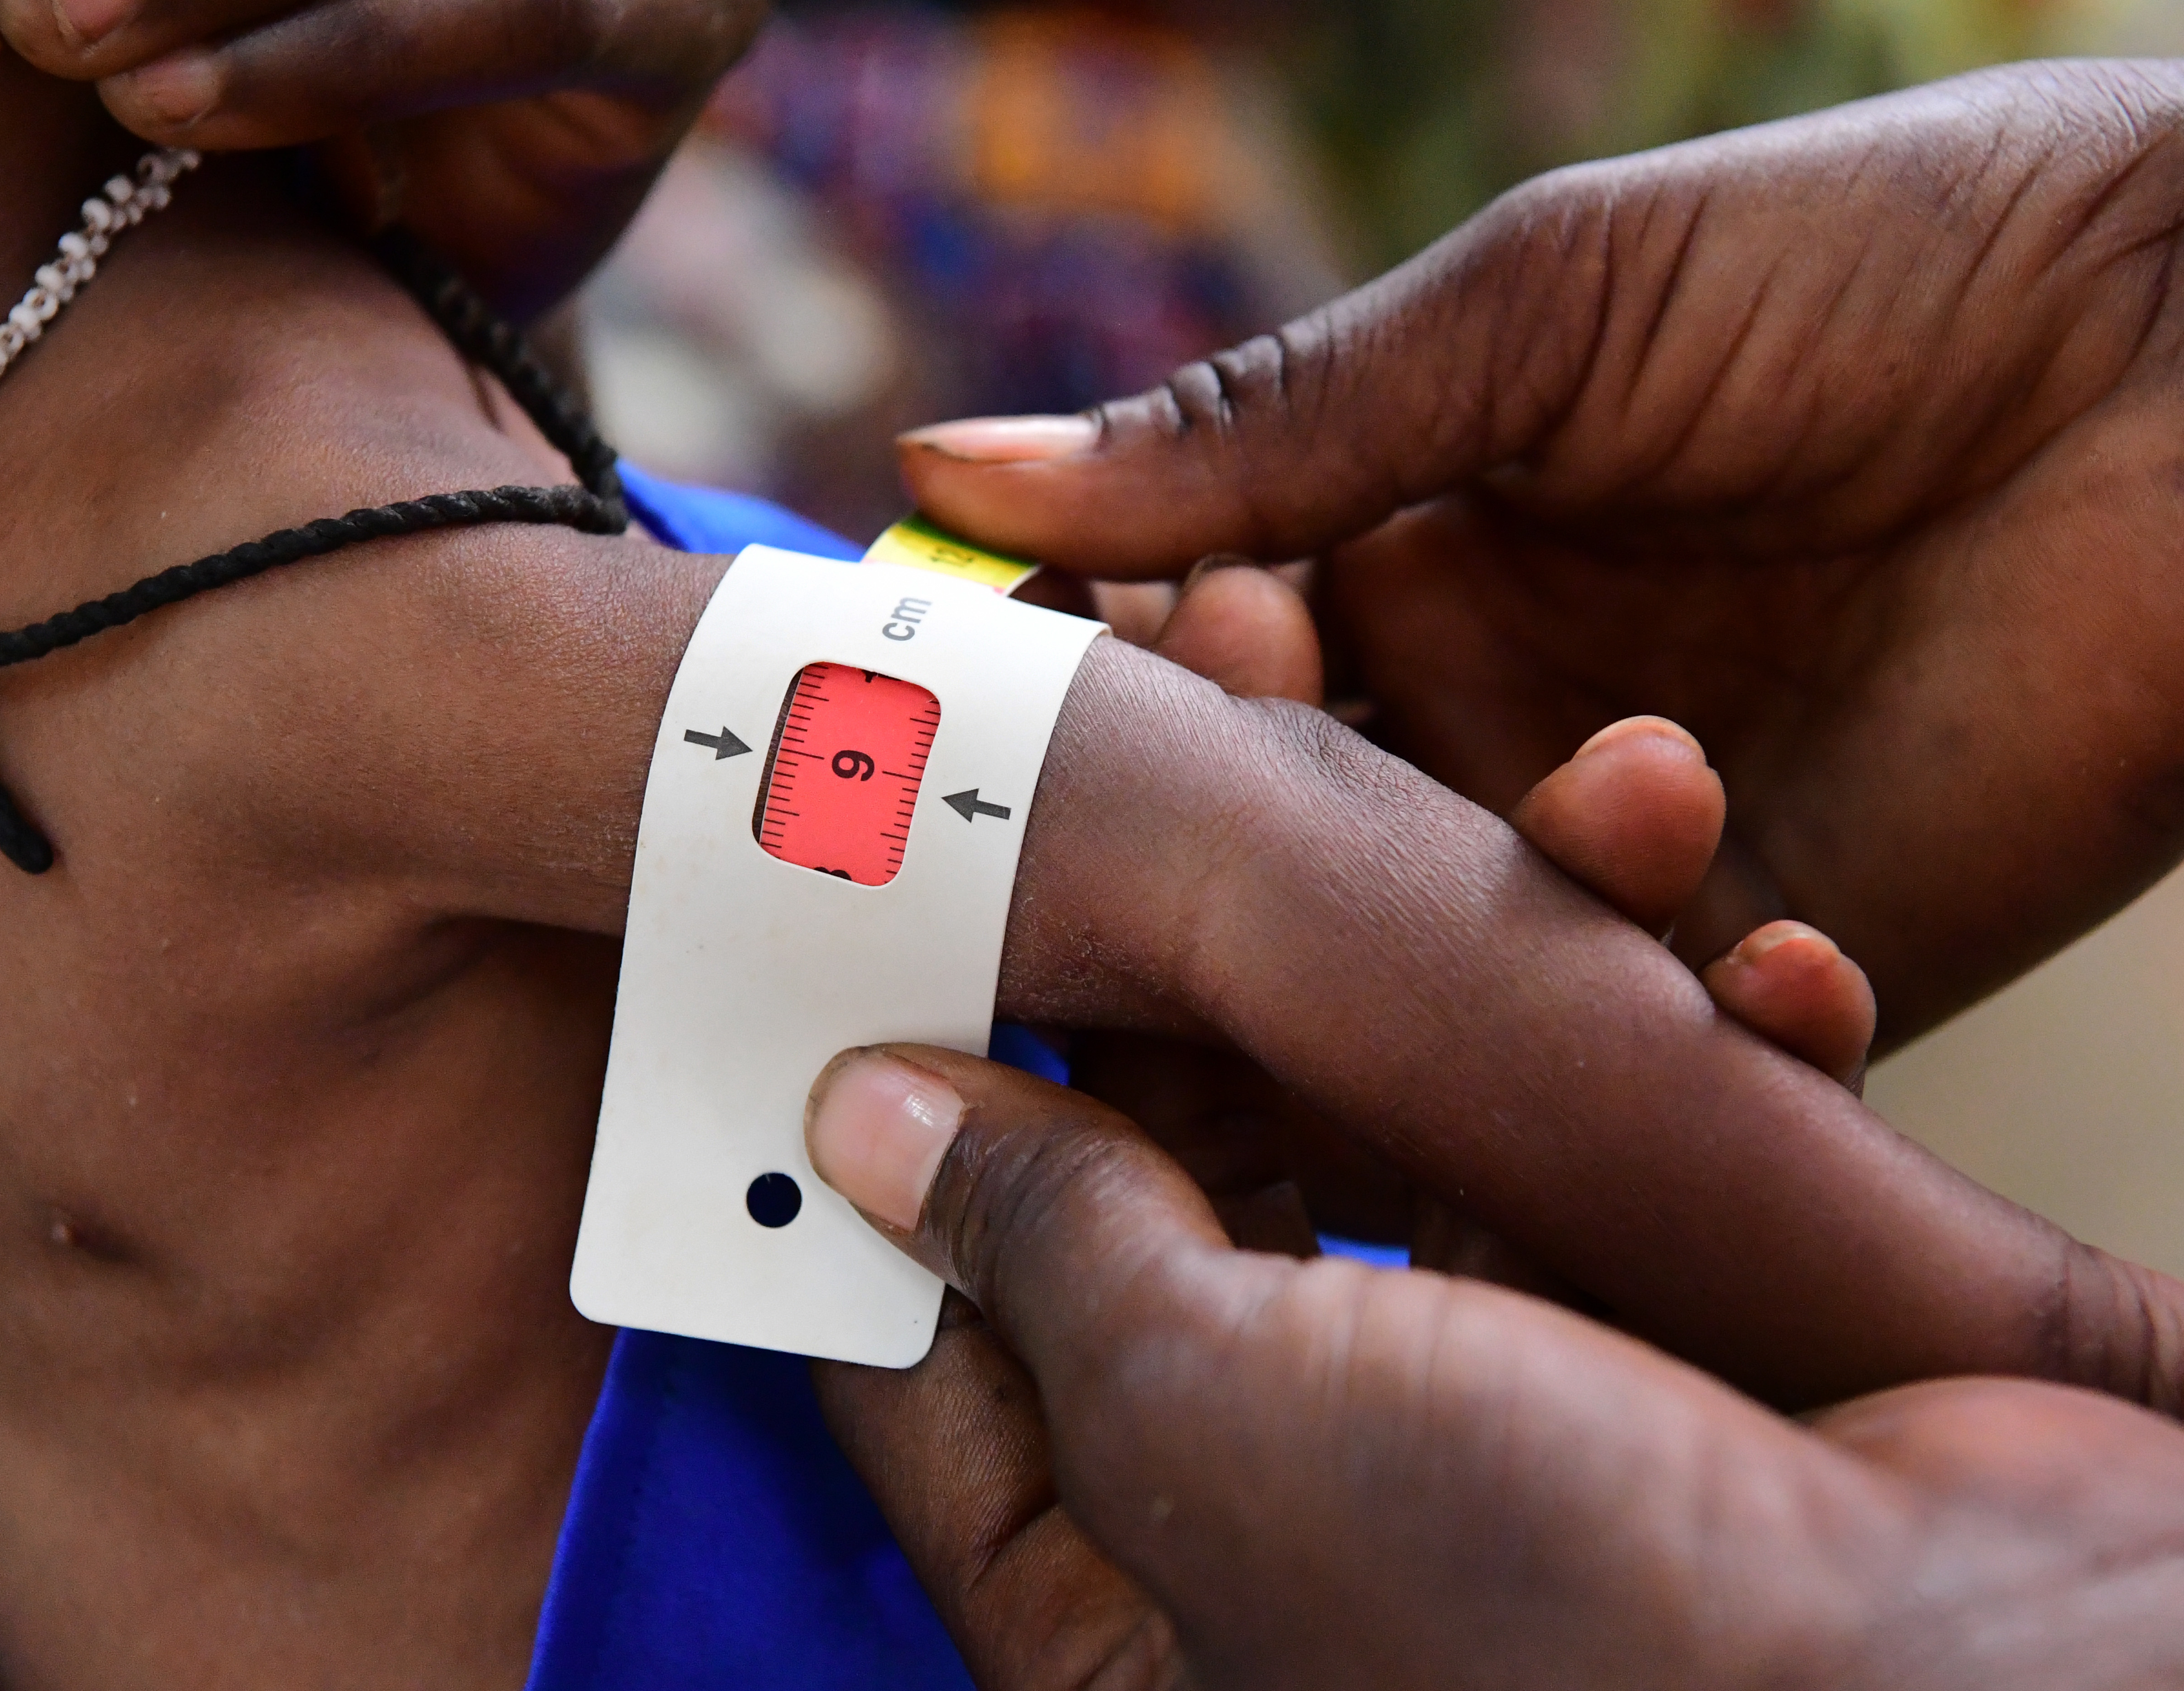
Strategic Approach to address Wasting in Children and Women in humanitarian contexts: a reflection on the achievements, successes, and challenges
Laura Courbis-Ibiliabo (WFP)
Jasinta Hyachits Achen (UNICEF)
30th January 2024
Notes:
Jasinta

Slide 38
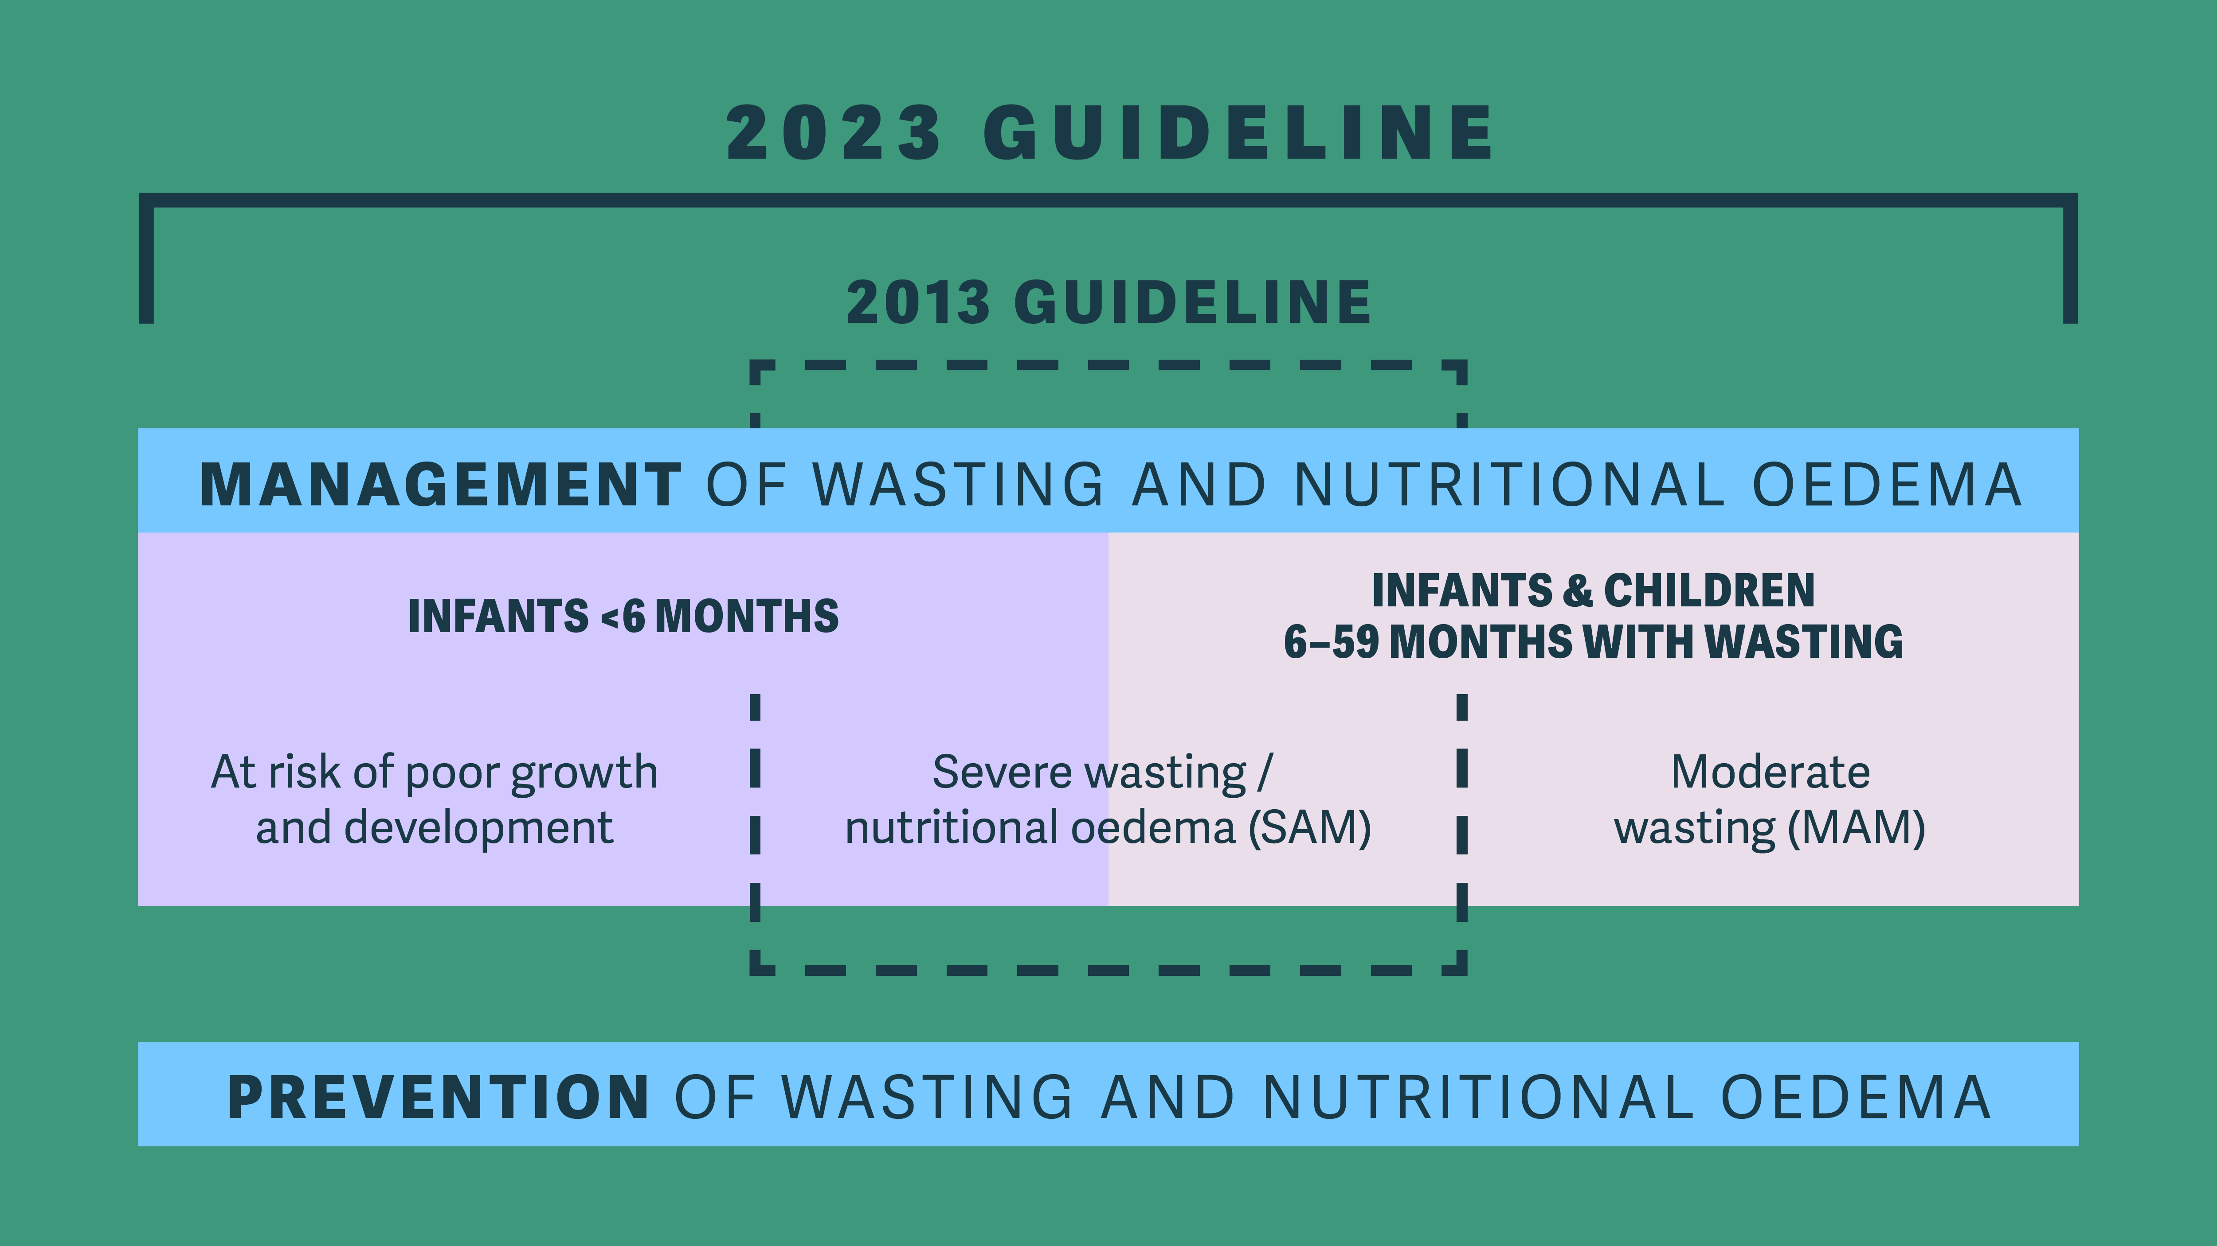
Notes:
Jasinta – 2 minutes
Four key areas of the new 2023 WHO Guidelines
Infants less than 6 months of age at risk of poor growth and development,
Moderate wasting in infants and children 6-59 months of age
Severe wasting and nutritional oedema in infants and children 6-59 months of age, and
Prevention of wasting and nutritional oedema from a child health perspective.

Slide 39

How to operationalize the new WHO recommendations?
ESA Regional
Meeting
Notes:
Laura – 3 minutes
Let’s first go back on the “Why now?”
In 2023, an estimated 28 million children will suffer from wasting in 15 of the worst-affected countries,1 and over 8 million children will suffer from severe wasting, the most life-threatening form of malnutrition2. In the same countries, 164 million3 people are estimated to be at risk of severe or crises level of acute food insecurity.
In these humanitarian contexts, continued efforts for the early detection of children with wasting, and their management remain critical; equally essential are actions to reduce the incidence of children whose nutrition situation could deteriorate into wasting
Funding: 2022-23 – remarkable funding and response (coverage, number of children treated, scale up of prevention activities, etc.) for UNICEF and WFP for child wasting. 2024 will be much more difficult
In the face of increasing number of children and women becoming vulnerable, and declining financial resources in hardest-hit countries, cost-effective programmatic choices to support programs that address child wasting remains critical.
Context
The GAP was commissioned by the UN Secretary-General in the summer of 2019, and it includes costed, operational roadmaps to prevent, detect and treat child wasting in 22 countries around the world. Four critical outcomes were identified to achieve the Sustainable Development Goal targets on child wasting:
Reduced incidence of low birthweight
Improved infant and young child feeding
Improved child health
Improved early detection and treatment of child wasting
GAP Call to Action released in January 2023 to call for a multi-sectoral approach to maternal and child nutrition through the food, health, water and sanitation, and social protection systems in response to the current global food and nutrition crisis. The WHO guidelines are part of the overall GAP initiative through the update of normative guidance for the prevention and management of child wasting.
The 15 priority countries have been allocated to three phases:
Priority 1 (2024) = Haiti, Kenya, Madagascar, Nigeria, South Sudan
Priority 2 (2025) = Burkina Faso, Chad, DRC, Mali, Niger, Ethiopia, Sudan
Priority 3 (2026) = Afghanistan, Somalia, Yemen
Implication: Means that these countries are being prioritized for global/regional level support including fundraising efforts, does not mean that country teams cannot move faster than this if they want.
Decision making: determined (with UNICEF/WFP country teams) to be more ready and more suitable for the transition, based on several factors.
Phase 1: Joint preparation and planning will start in 2023, and programme shifts in 2024. This includes ensuring government agreement and all necessary steps are taken, such as building partner buy-in, identifying target regions, and developing a comprehensive plan for 2024, including costing, funding, development of tools and trainings.
Phase 2: Detailed consultations with national level partners to start in 2023, with agreement on transition expected end of 2024. Programmatic shifts to start in 2025.
Phase 3: Discussions to start in 2023/2024, programmatic shifts to starts towards the end of 2025 and expansion towards the end of 2026.
Parameters considered for overall readiness and pace for transition:
Operating/programming environment
Government readiness and policy environment
UNICEF and WFP readiness at CO level
Implementing partners readiness
System capacity
Supplies and Supply chain readiness
Funding

Slide 40

A new opportunity
WHO Guideline – an opportunity to foster programmatic shifts for wasting, under Government leadership
Targeting the most vulnerable groups – increased needs and decreased resources
Prevention – strengthened preventative nutrition programming linked with wasting management
Learning Opportunities – from the Phase 1 front runner countries (Kenya, South Sudan & Madagascar)
Notes:
Jasinta -2 minutes
Re-setting the way we have been working
15 priority countries but implications for all GAP and other countries with wasting programming
Will take time to change – and will need support of donor agencies, senior management at WFP/UNICEF, governments and overall all implementing partners
Learnings from phase 1 countries will be used to inform transition of other countries.
to ensure that as many children as possible benefit from coordinated early actions to address and prevent wasting in humanitarian settings

Slide 41
Main shifts in programming
Prevention and management as standard package
Complementary set of preventive actions for young children and pregnant and breastfeeding women
Use of RUTF for children with severe wasting and with moderate wasting at higher risk of mortality
Diverse range of interventions to supplement other children with moderate wasting - RUSF or local nutrient dense foods
Support access to nutritious family foods through food assistance
Management of wasting by adequately trained Community Health Workers
Notes:
Laura – 3 minutes
Prevention and management of wasting as a standard package in food insecure humanitarian settings
UNICEF, WFP and partners will ensure a complementary set of preventive actions for young children and pregnant and breastfeeding women
UNICEF will lead on supporting national governments to provide services to enable children with severe wasting and children with moderate wasting at higher risk of mortality recover using RUTF
WFP will use a diverse range of interventions to supplement other children with moderate wasting to ensure their additional dietary needs for recovery (RUSF or local nutrient dense foods)
WFP will lead on supporting communities to ensure access to nutritious family foods through food assistance to vulnerable households
Adequately trained Community Health Workers can manage wasting and nutritional oedema at community level
Context-specific approach: co-created with government
Prioritization of needs: IPC, GAM, hotspots, other aggravating factors
Transfer modalities: informed-by market functionality and other assessments
Not forgetting hard to reach populations
Multisectoral approach and platforms
Will go into further detail on prevention and management on following slides.
UNICEF/WFP’s Strategic Approach to supporting government and partners, to move towards new ways of working prevention/management of wasting, that includes aligning to the new WHO guidelines.
So it serves to guide agency teams on how both agencies are going to work together on wasting – in humanitarian contexts – of course, part of this is working closely with government, UN and NGO partners….
RUTF for HR MAM only a supplementation, other portion of diet will need to be met with strong referral/links to other interventions (e.g. cash, SBC, GFA)
Other MAM also need medical assessment and will be provided where possible – health services or community platforms can provide – not be overwhelmed.
Accessing nutritious family foods at WFP means including top up support (cash or food, including specialized nutritious foods when necessary) for children and women to meet their specific nutrient requirements.
CHW management of wasting: This includes nutritional supplementation or treatment and medical care as appropriate to the context.

Slide 42
Panellists
South Sudan
Khamisa Ayoub, Director of Nutrition, Ministry of Health
Naema Hirad, WFP (Online)
Ruth Situma, UNICEF (Online)
Kenya
Grace Gichohi, Program Manager, Ministry of Health
Robert Ackatia-Armah, WFP
Francis Wambua, UNICEF
ESA Regional
Meeting
Notes:
3 minutes - Jasinta

Slide 43
Question 1
Following the launch of the WHO guidelines, could you tell us which steps have you taken to ensure and plan a smooth transition?
ESA Regional
Meeting
Notes:
15 minutes – Jasinta
Under this question we expect you to take us through:
The planning process
Engagement you have taken with partners (who)
Critical steps (selection of criteria, which recommendations to follow that are adapted to the country, funding, possible locations and why you selected them)
Etc.
UNICEF South Sudan and Kenya

Slide 44
Question 2
What are the challenges and successes that you have encountered in the first steps of the operationalization of the transition plans?
ESA Regional
Meeting
Notes:
15 minutes - Laura
Under this question we expect you to take us through:
Challenges encountered and how they were solved
Successes
Recommendations you would give to other countries which are now going through the same process
Any context specific recommendations? Refugee, emergency, stable context, etc.
Maybe things that were realized and adapted when drafting the roadmaps
Etc.
WFP South Sudan and Kenya

Slide 45
Question 3
How do you think this shift in programming will enhance and improve the nutritional support to communities in your respective countries?
ESA Regional
Meeting
Notes:
15 minutes - Laura
Under this question we expect you to take us through:
In terms of efficacy of the programme?
Cost-efficiency?
Improved coverage?
Allocations of resources?
Having high-risk MAM with the SAM
Inclusion of the prevention part but also MAM supplementation for the first time in WHO guidelines
Focus on home foods
Etc.
MoH SSUD and Kenya

Slide 46





Integrated package of services to address wasting in children and women
Acute food insecurity : IPC 5,4 or 3 or equivalent
Global Acute Malnutrition : > 10%
Aggravating factors : Displacement, conflict, disease outbreak, childcare practices, WASH, others
Context
Treatment
Treat children with SAM using RUTF in health platforms (Community & facility)
Supplement High Risk MAM children with RUTF through health platforms (Community & facility)
Multisectoral collaboration
Supplementation
Supplement other MAM children with SFF or local food + MNP through community platforms
Supplement undernourished Pregnant and Breastfeeding Women and Girls with Fortified Blended Foods (or other BEP) through community platforms
Food
SBCC
Health
Prevention
Children < 24 months: Top ups (LNS, FBF, local food or cash), breastfeeding, complementary feeding & other IYCF care
Children 6- 23-months: complementary feeding promotion & other IYCF care, Micronutrient supplementation, as needed
Pregnant and breastfeeding Women and Girls : Top ups (FBFs /BEP or cash), MMS, antenatal and postnatal care
Social protection
And
protection
Food assistance
Nutritionally adequate household assistance for food insecure HHs (food or cash)
WASH
Notes:
Takeaways
Summary of the Package of services t]link to the new WHO Guidelines –Jasinta – 5 minutes

Slide 47
Any questions?
ESA Regional
Meeting
Notes:
Laura – 10 minutes

Slide 48
ESA Regional
Meeting
Thank you

Slide 49
Nutrition information systems in emergencies
Alina Michalska
UNICEF ESARO
Nutrition Specialist
30 January 2024

Slide 50
Nutrition information systems in emergencies
Objective: To understand how we can strengthen nutrition information systems in emergencies for better accountability and decision making
Outline:
Implications of the updated WHO wasting guideline for indicators
Information on new global guidance on monitoring the prevention, early detection and treatment of child wasting through the wasting cascade
Updates on SMART(+)
Introduction to a system strengthening approach for NIS in fragile and conflict situations through NuVAC

Slide 51
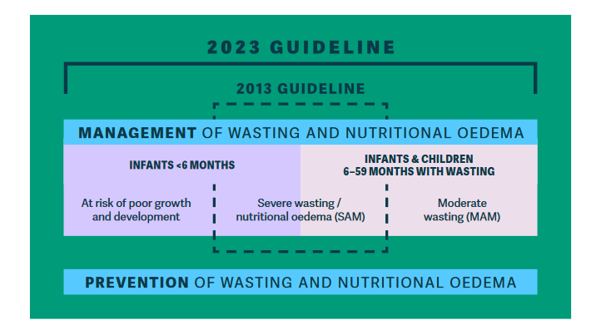
New areas of the WHO updated guideline
Growth faltering/failure in infants below 6 months
        2013 WHO guideline included limited recommendations for SAM <6 months
        2023 guideline expanded to infants with growth faltering/failure more broadly
Moderate wasting in infants and children 6 months and older
  Currently no WHO guidelines focusing on treatment of moderate wasting
Severe wasting & oedema in infants and children 6 months and older
  Updated and new recommendations – building on 2013 WHO guideline
Prevention of wasting
  Prevention is a new area for WHO guideline development around wasting in infants and children

Slide 52
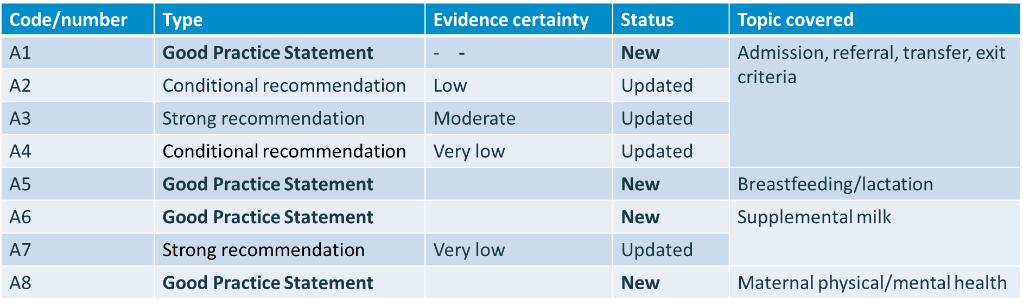
Management of infants <6 months at risk of poor growth and development
Set of indicators for infants 0 to 6 months proposed but not retained
NEXT STEP - Definition of a standard set of indicators for the new criteria(s) for admission, referral, transfer, exit - to be tested

Slide 53

Management of infants and children 6-59 months with wasting/ nutritional oedema: Screening
Screening for child wasting in a facility (infants and children 6-59 months of age)
1 for facility (outpatient & inpatient)
1 for community
Special attention for reporting
Facilities include locations providing both outpatient and inpatient care for which screening data needs to be reported.
Screening may occur at first presentation to the facility or at any time during their follow-up care which could be as an inpatient or as an outpatient
Emphasising importance of triage and overall health assessment
Child height/length measured
Child weight measured
Child oedema assessed
Child MUAC assessed

Slide 54


Management of infants and children 6-59 months with wasting/ nutritional oedema: Moderate Wasting
Treatment, Management, and Referrals (infants and children 6-59 months for age)
MAM Outpatient
Nutritional Supplementation ➔ MAM
Outpatient
MAM enrollment in Outpatient management centre (instead of SFP)
MAM Outpatient coverage
MAM Mortality
MAM Recovery
MAM Default
MAM Transfer or Referral (for SAM treatment – OPD or IPD)
Special attention for reporting
MAM cases being referred for SAM treatment should be officially recorded as exiting the programme for MAM.
e.g., if 60% of exits from MAM treatment programmes are referrals to SAM treatment programmes, it is likely there are issues with the MAM programme.
Exit: cases discharged and recovered, or due to death, defaulting, or transfers to other level/treatment facilities
Nutrient-dense home diet
Home diet supplementing
Notes:
Nutritional Supplementation ➔ MAM We are supplementing a child with MAM diet to meet their full nutrient needs for recovery – not providing SFFs to meet their full needs.
Nutritional Treatment ➔ SAM We are providing RUTF in an amount to meet their full nutrient needs for recovery. We are treating them.

Slide 55
Management of infants and children 6-59 months with wasting/ nutritional oedema: Severe Wasting
Treatment, Management, and Referrals (infants and children 6-59 months for age)
SAM In-patient & outpatient
Nutritional Treatment ➔ SAM
Outpatient | Inpatient
SAM enrollment | SAM admitted
SAM outpatient coverage
SAM mortality | SAM mortality
SAM non-response | SAM non-response
SAM default | SAM default
SAM recovery | SAM recovery or transferred (to OPD)
SAM referral (to IPD)
Special attention for reporting
Enrollment for outpatient vs admission for inpatients
Mortality – death of any cause
Most SAM IPD cases recovering will be transferred for OPD SAM
SAM OPD cases worsening referred to IPD treatment
Referrals: The number should not include infants and children who are seen in an admission unit or initially assessed in an outpatient centre and sent directly to inpatient care the same day.

Slide 56

New guidance for routine nutrition indicators reporting
First ever global recommendations on nutrition indicators for routine data collection
Provides standard set of routine nutrition indicators (core, additional and longitudinal).
To be collected by nutrition programmes at health facility and community levels.
Software agnostic: Designed to support programme managers who are implementing and improving the collection and use of relevant routine data to track status, performance, and trends.
DHIS2 NUT aggregate package developed and update based on the new guidance is in progress.

Slide 57
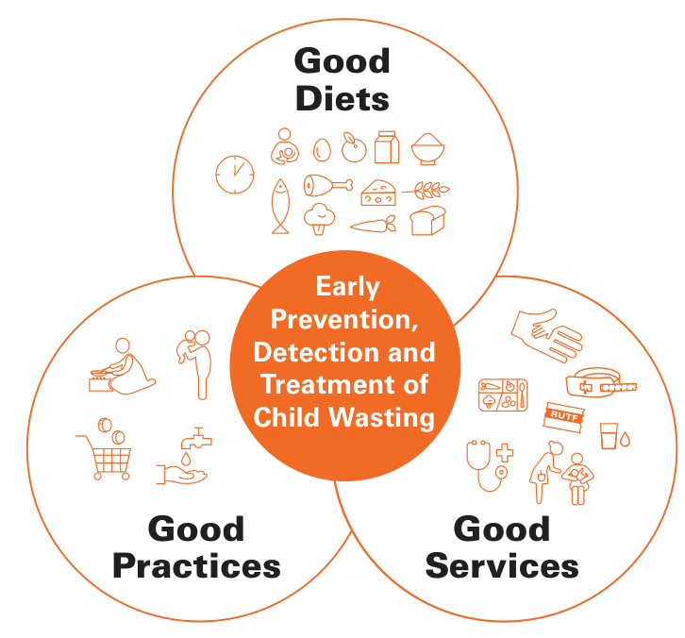
Development of guidance to monitor the Wasting Cascade
The Wasting Cascade refers to the continuum of population moving through the service pathway for the prevention, early detection, and treatment of child wasting.
With data gaps in both planning and implementation in most countries, programmes struggle to reach national scale.
A strategic shift is needed away from incomplete monitoring and irregular programme evaluations towards routine tracking of target populations, regular and effective programme reviews, and delivering services for all those in need.
The guidance will be developed in collaboration with global, regional, and national government and non-governmental partners and stakeholders to monitor the child population through the steps of prevention, early detection, and treatment of child wasting.
The guidance will include:
standard indicators,
a framework for their analysis, and
recommendations on the use of outputs for more appropriate and timely decision-making for programming

Slide 58
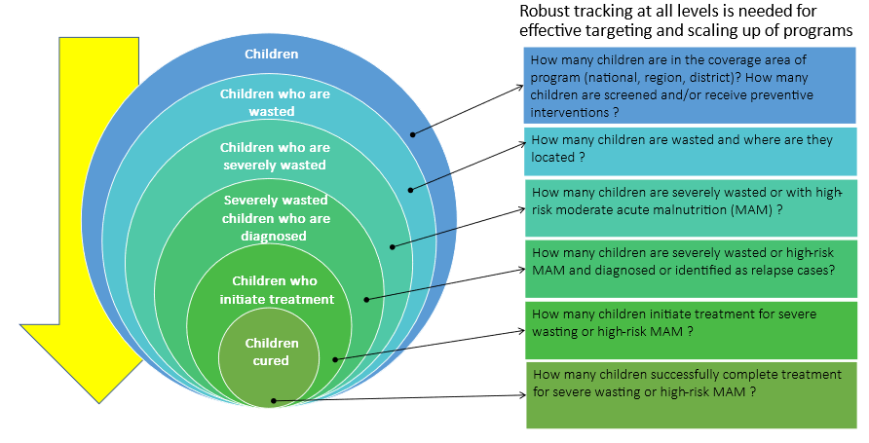
Effective tracking for improved programme implementation
Notes:
In most countries program data commonly starts only at admissions for severe wasting treatment.
We need to start from (1st circle in blue) – How many children are in the coverage area (national, region, district)
And continue…
The Wasting Cascade will provide the list of indicators and analysis framework to identify and address the outstanding data gaps to ensure comprehensive monitoring of preventive and treatment programs for all children in need.

Slide 59

Updates on SMART+ rollout in ESA Region
SMART+ Rollout continues in 2024
The aim is to graduate seasoned and currently active SMART survey managers to SMART+.
The first step has begun for ESA region with one regional training currently ongoing (Jan 15 – Feb 5) in Isiolo county, Kenya. Participants from Somalia, Kenya and South Sudan are engaged in both theoretical and practical training. This certified group of survey managers will be prepared to lead SMART+ surveys in their respective countries.
For any country without SMART+ expertise but interested in adopting the innovation, they must undergo training before implementing it in the field.
    Preliminary discussions ongoing for further training in May/June 2024 in Kenya, and also in Somalia and Mozambique; South Sudan and Zambia have also expressed interested but not begun discussions.
SMART+ in 2025
Much wider roll out of SMART+ in the region with a wide pool of experts to support a systematic roll out.

Slide 60
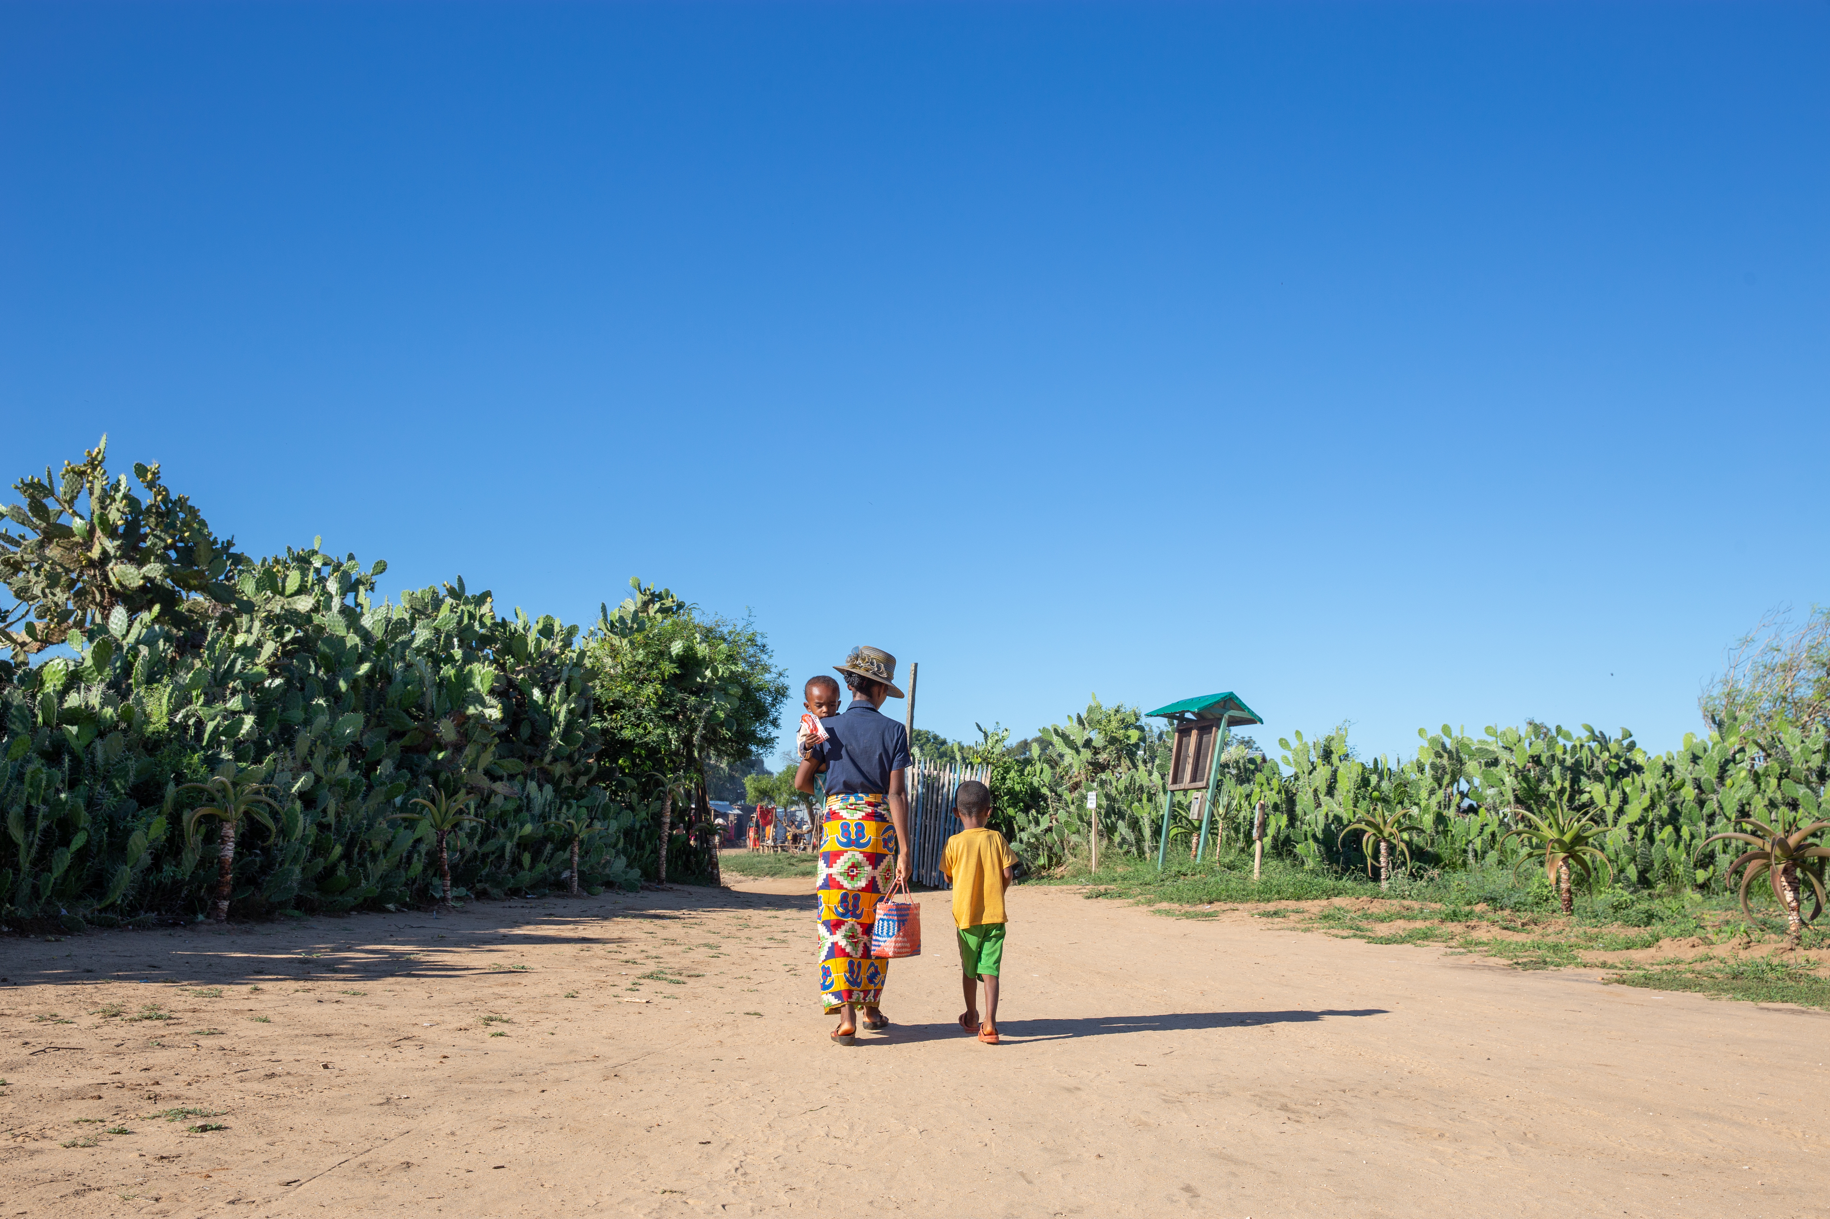

NuVAC – Nutrition vulnerability assessment in crisis
UNICEF / WFP Global Joint Initiative
Involving key nutrition actors
Grounded on a NIS Diagnosis Paper for Fragile and Conflict Situations (FCS)
A multi-year system strengthening approach (with support from BHA)
The NuVAC joint initiative is a step towards a more robust, responsible, & accountable nutrition information system in fragile and conflict situations.

Slide 61


NuVAC Overview
1 GOAL
In FCS, ensure predictable and reliable information on nutrition vulnerabilities is used for better and timelier decisions in humanitarian nutrition responses
3 Outcomes
Enhance nutrition security analysis by bringing more attention on drivers of malnutrition and how these evolve during crisis
Enable access to a predictable source of reliable nutrition information & analysis that has been reached by consensus
Influence decision making on resource allocations and strategic recommendations by providing information on where and when to focus

Slide 62

NuVAC Guiding Principles
Inclusion & Commitment for a COMMON AMBITION
Innovation & Optimization for ENHANCED NUTRITION ANALYSIS
Partnership & Complementarity for a SYSTEM STRENGTHENING APPROACH
Co-creation & Consensus for TIMELIER DECISION MAKING

Slide 63



NuVAC: Main findings of the NIS Diagnosis paper
Governance
Lack of clear governance, leadership, accountability & unclear localisation strategy
Unknow level of international investments
Strong, relevant & agile governance
Common vision & shared purposes
Mutually reinforcing activities
Analytics
Main focus on nutrition outcome (i.e., Nutritional Status)
Some focus on dietary Intake (i.e., Dietary quantity and quality)
Sectors not on Nutrition System
Reliable nutrition security analysis
Integrated use of needs assessment, situation assessments & programme monitoring
Reinforced analyses on availability, access, and utilisation of basic services, morbidity, and household nutrition-related behaviours
Communication
Focused on advocacy for funding or accountability
Focused on visual as opposed to getting the message across
Poorly disseminated and communicated
Better & timelier decision making
Clear messaging based on agreed-upon analysis
Communication & advocacy plans co-designed with targeted audience

Slide 64
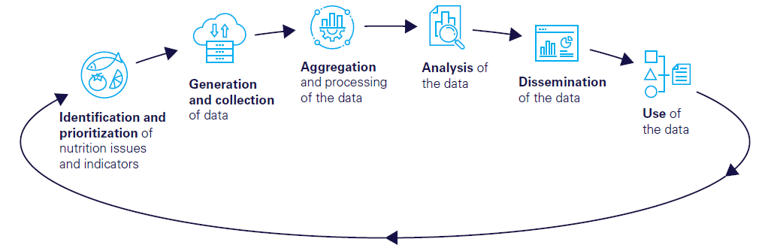
Nutrition Information Ecosystems
Nutrition information systems are characterized by a complex array of initiatives, activities, platforms, sectors, processes, and actors/stakeholders operating at country, regional and global level; in that sense, NIS should be characterized as an "NI-ecosystem".
A systemic view of the NI-ecosystem must ensure that we look not just at the “data value chain”, but also at how the ecosystem operates. We need to understand:
  How is governed?
  Funded?
  Connected to other emergency information systems?
  How from a localisation perspective it can be more resilient?
  How can it operate more effectively, efficiently, and equitably?

Slide 65


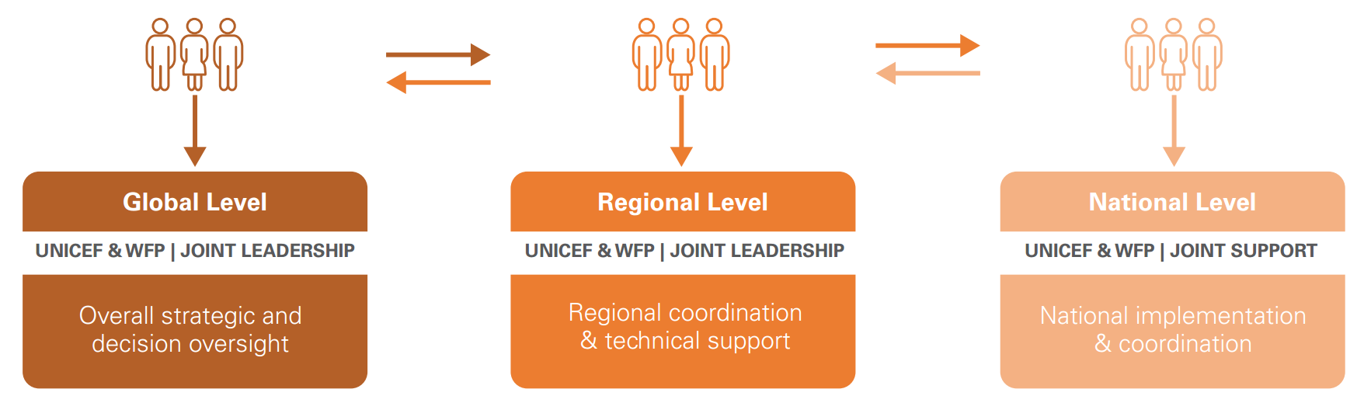


NuVAC: Strategic and technical discussions
Addressing strategic and technical discussions at global and regional levels
Linkages with existing mechanisms
Complement established mechanisms for nutrition situation analysis to better inform decisions making for timely actions
Phase 1 >> Governance structure involving relevant bodies and actors
Ensure alignment with strategic purposes of the IPC AMN to avoid duplication of efforts, promote complementary actions and guarantee the consistency of strategical & technical support
Propose formal, relevant and sustainable models that feed into and reinforce already established nutrition coordination and analysis mechanisms
High level & technical Nutrition Information Ecosystem expertise for:
A common ambition/vision
Shared purposes and measurement
Mutually reinforcing activities
Continuous communication
A backbone support
NuVAC joint initiative added value
Predictable and accessible mechanisms are set-up to improve data collection and processing based on a clearer understanding of decision makers/users needs
Continuous monitoring of nutrition vulnerabilities are produced to feed into and strengthen already established analyses for better decision making
Consistent messaging are produced “during & after” IPC AMN analyses to enhance global, regional and national influence on strategic and programatic recommandations
Learning from experience and building on it
Cross-functional Monitoring & Evaluation and Knowledge Management plans covering all levels as well as each sequenced phases of NuVAC implementation.

Slide 66


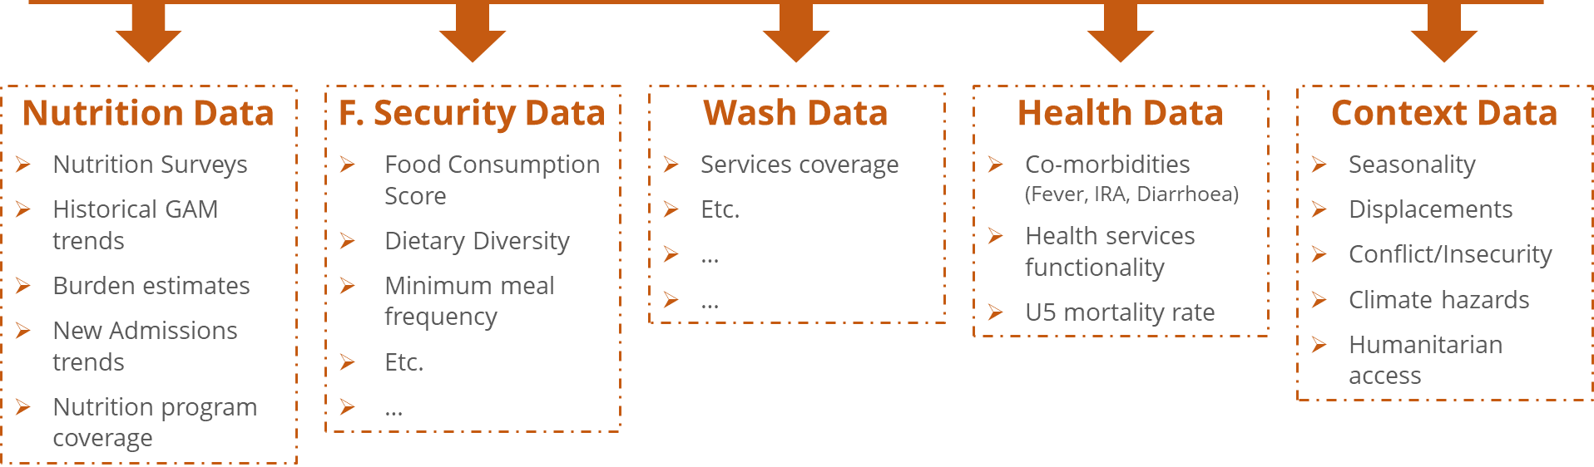
NuVAC: Analytics
Step 1
Mapping of Nutrition Information Ecosystem (Data, Tools, Approach, Systems, etc..)
Entry points for analytical frameworks
Acute malnutrition drivers
& nutrition outcomes
Already available resources
Basic services
(Availability, Access, Utilization)
Monitoring Risk
(e.g., Risk Monitoring Framework)
Step 2
Collation of routine data on drivers of wasting
Selection of indicators for monitoring
Morbidities
MERIAM 2.0 (ACF)
(Predictive modeling approach)
Household behaviours
(Diets & Care)
Step 3
Development of thresholds for monitoring routine data indicators to create an alert/early warning system
Inclusion of predictive modelling outputs of the prevalence of wasting
CCRI-DRM (UNICEF)
(Child Climate Risk Index-Disaster Risk Model)
Nutrition outcomes

Slide 67
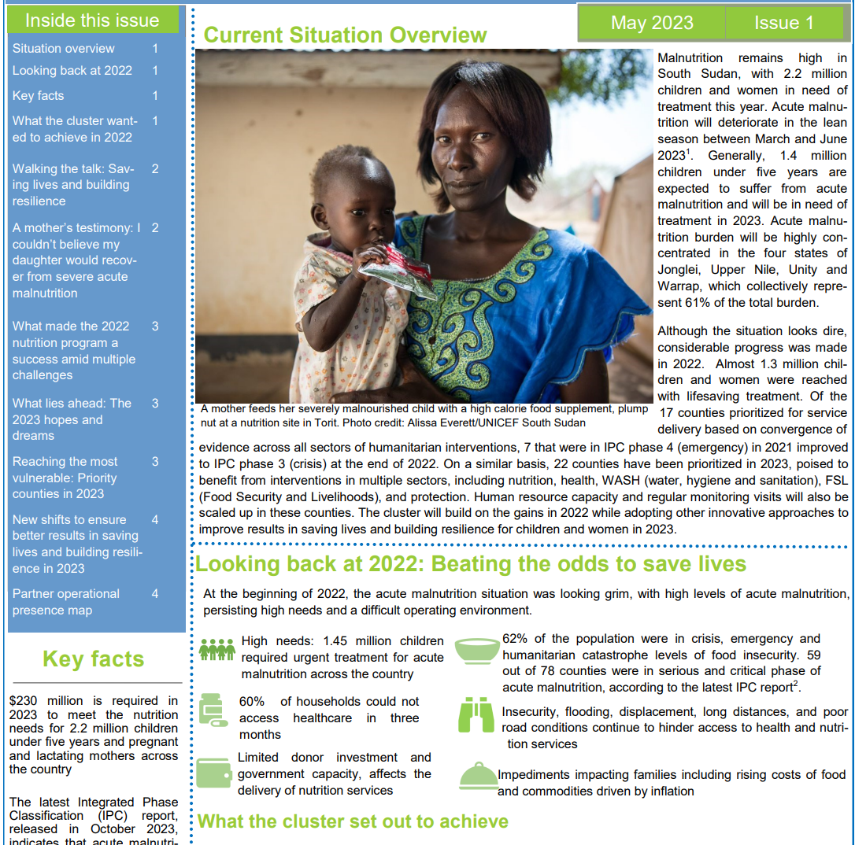
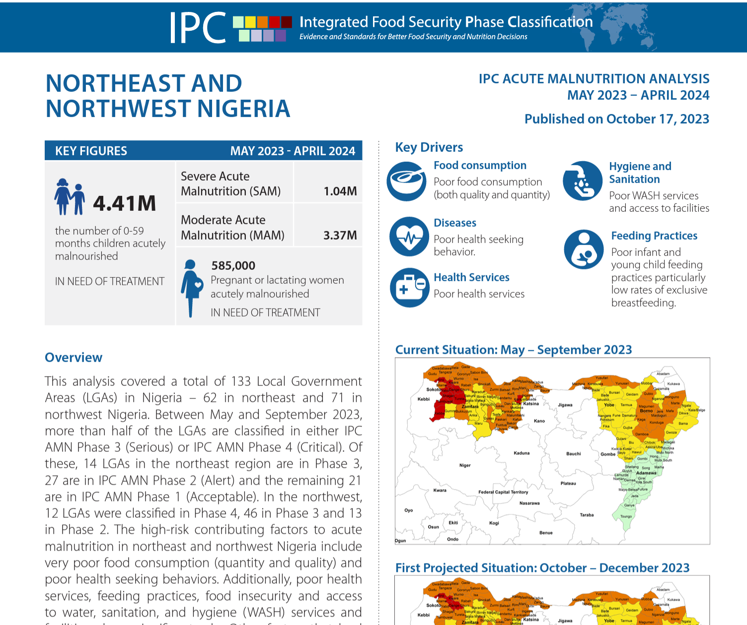
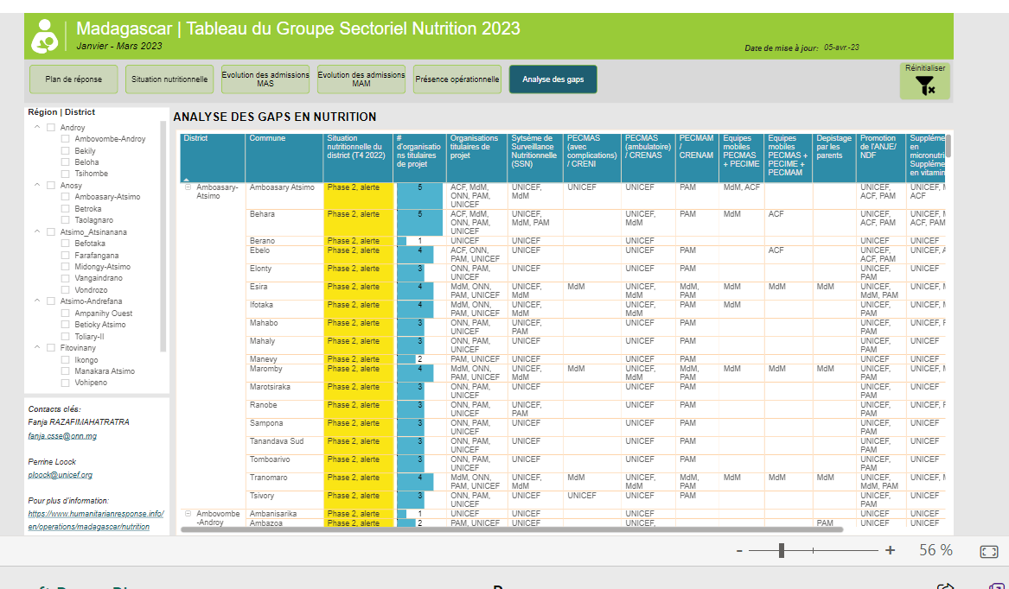
NuVAC: Understanding decision-makers/end-user needs for tailored communication
Step 1
Analysis of decision-makers and end-users needs and expectations in terms of nutrition information (all levels)
Step 2
Develop and test high-quality nutrition information products that respond to decision maker and end-user needs

Slide 68

Critical Thinking
What do we want to influence?
Who should be influenced? And how?
When and how often?
Through what format?
What information is missing?
What should be included?

Slide 69
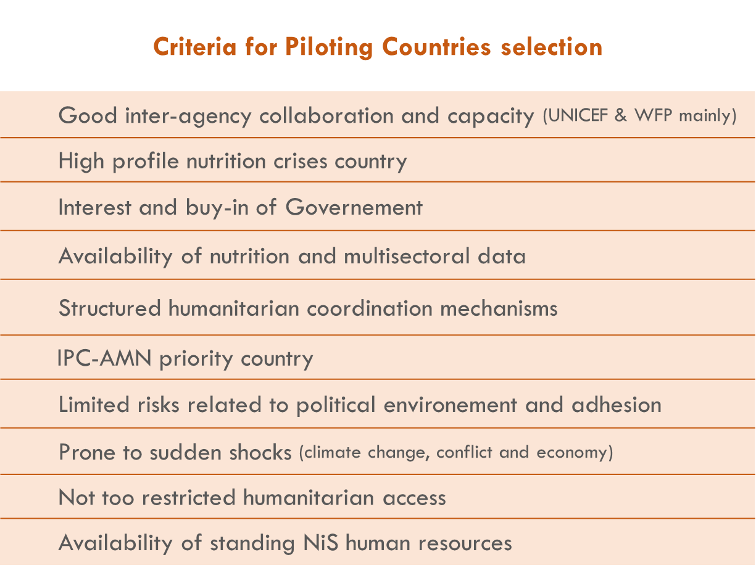

NuVAC Phased collaborative approach

Slide 70

NuVAC: Pilot country workplan overview
System strengthening & Capacity building
  Develop data access and sharing protocol btw UNICEF/WFP and national authorities
  Set-up a centralize repository for all the data (routine, survey), with clear guidelines
  Develop a capacity building plan for line ministries under the responsibility of MoH
Analytical framework
  Identify criteria for areas to be targeted for NuVAC 1 implementation
  Identify key indicators to be used for nutrition vulnerabilities monitoring
  Define thresholds to monitor contributing factors
Communication products
  Conduct interview with key stakeholders to understand their information needs
  Develop communication and advocacy plans, that involve other sectors as well as development partners.

Slide 71


NuVAC – Expected results in Phase I
Result 1 > Developed project plan informed by the NuVAC pilot implementation
Result 2 > Established global governance structure
Solid foundations for learning and strong engagement for next phases
Result 3 > Tested and improved frameworks for a more holistic analysis
Result 4 > Proposed high quality nutrition information and analysis products
Improved nutrition analyses for better decision making at all levels

Slide 72

NuVAC – Added value
Leverage on UNICEF and WFP leadership in global policy for nutrition, for more effective nutrition information systems in emergencies:
  Drawing a vision for a more robust NIS with shared purposes and clear accountability
  Streamlining approaches and schedules around data generation and processing
  Providing technical guidance to support data quality
  Reinforcing analytical capacities and building skills at all levels
  Leading consensus-based approach for analytics and communication to influence decision making

Slide 73

Thank you for your attention !

Slide 74



NuVAC
Pilot country updates
Madagascar
UNICEF/WFP Global Joint Initiative
Nutrition Vulnerability Assessement in Crisis
Notes:
20 minutes

Slide 75


Madagascar
NuVAC anchorage and links with the cluster
Vision for Madagascar
Promote a better understanding of nutrition by decision makers and other sectors leaders for a faster, more complete and more efficient response
Rely less on costly survey and better use of routine data, to increase the coverage (timely and geographically)
Use the NuVAC as an entry point for improving the national EWS / learning for other sectors
Integrate in existing structures/NIS working group for durability
Where does NuVAC fit into national system(s)?
Notes:
To review / rajouter (++ strategique/ messages cles)

Slide 76

Highlight 1 : NuVAC mission in Madagascar – July 2023
Step 1 : Nutrition Information System mapping
Step 2 : SWAO exercise
S → Strengths
Data value chain framework as an entry point
W → Weaknesses
A → Aspirations
O → Opportunities

Slide 77
Madagascar
Nutrition information ecosystem mapping
Prioritization
Creation & Collection
Curation
Analysis
Translation & Dissemination
Decision Making
MUAC measurement
Sentinel sites
Care practices
SMART surveys
Cluster Database
Cluster Dashboard
Cluster Bulletin
Nutrition Sector
National Response Plan
Anthropometry
National Health Information System
IPC-AMN
IPC Reports
New admissions
Nutrition Programs
Fundraising
(Global, Regional & National)
Institutional Reports
Health indicators
Health surveys
HNO/HRPs
Other Sectors
Food Sec. indicators
Food Sec. surveys
National FS System
IPC-AFI
WASH indicators
WASH surveys
National WASH system
Climate
Context
Displacements
Humanitarian access

Slide 78


Madagascar
→ SWAO exercise
1 – Prioritisation
4 – Analysis
Aspirations
Opportunities
Aspirations
Opportunities
National coverage
Harmonization / rationalization of data collection tools
Optimization of nutrition surveys planning
Clear leadership on data collection
Weaknesses
versus
Aspirations
Risk factor monitoring system, with defined thresholds / triggers
Reinforced capacity (all level)
Modelling approach for shocks anticipation
Accurate and contextual analyses covering the most at-risk groups
Integrated sectoral response and capacities at all level
Revision of DHIS2 with integration of dashboards to support decision making
Sub-cluster and technical working groups
IPC AMN Certification
Integration of formative research data into analyses
IPC GSU Monitoring of risk factors (with reflection in progress for the elements of collection and analysis)
Revision of DHIS2 + PSERAN indicators (registers)
Early Warning System (EWS) and Anticipatory Action (AA) Initiative
2 – Collection
Aspirations
Opportunities
Planning and localization (nutritional assessment plan)
Donor interest in nexus-oriented tools and processes
BNGRC Leadership (SAP)
New community health policy (including data collection)
Nutrition communication platform (ONN + other actors)
Upcoming surveys (KAP, MN)
5 – Dissemination & Communication
Better synergies and coordination between the ONN and the MSP (SNUT)
Digitalization of nutrition and nutrition sensitive data
Aspirations
Opportunities
Coordinated communication plan and advocacy strategy
Strengthened accountability aspects
ONN websites (Updating and systematic publication of docs) / Virtual library
Communications Guide
Training journalists
6 – Decision making
Aspirations
Opportunities
3 – Collation
Faster and more focused decisions based on good understanding, analysis and evidence
Inclusion of development stakeholders in the various forums
Decentralisation policy (long term)
SAP development
Aspirations
Opportunities
Notes:
S+O? or leave as W+A?

Slide 79


Highlight 2 : CONSULTATION WORKSHOP
01 to 03 November 2023 in Nairobi, KENYA
Take stock of the NuVAC joint initiative and co-design the strategic vision and technical linkages critical to its long-term success through exchanges between key actors at the global, regional and national levels. to its long-term success through exchanges between key actors at the global, regional and national levels.
Global level
UNICEF HQ
WFP HQ
Eastern and Southern Africa Region
UNICEF ESARO
IPC Regional Coordo (ESA)
National Level
UNICEF Madagascar
WFP Madagascar
Partners & Other Teams
IPC-GSE
GNC – TA
WFP RBN
WFP RBJ
WHO Nairobi
NCC Madagascar
ONN Madagascar
UNICEF Sud Soudan
WFP Sud Soudan
WFP Mozambique
N4D&Centre for Humanitarian Change
ACF Canada
ACF USA
BHA
UMD (Grand Challenge

Slide 80
Key recommendations – Nairobi workshop
Continue the consultation exercise to be able to collect the opinions of decision-makers on the following points: Data Used, Challenges, Data Needs, Advocacy and Decision-Making as well as Reporting (timeline: November – December 2023
Use the December "light" IPC AMN update to work more precisely on the different drivers, at the cross-sectoral level – more qualitatively at the level of the different regions and Have a real agreement on the risk factors to be monitored, and a monitoring plan with clear responsibilities (timeline: December 2023 – March 2024)
Conduct quarterly data analysis sessions, which lead to improved communication (possibly as part of the joint food security and nutrition bulletins, but to be discussed and confirmed) (timeline: Q4 2023 – Q1 to Q4 2024)
Strengthen coordination on CHISU/NPIN's more ambitious initiatives and projects, which will cover broader aspects of nutrition (timeline: Q4 2023 – Q1 to Q4 2024)

Slide 81

Highlight 3 : NuVAC integration during the IPC AMN Exercice – December 2023
Introduction to Risk Surveillance for Nutrition
Highlight 3: NuVAC integration during the IPC AMN (Exercise – December 2023) – Introduction to Risk Surveillance for Nutrition
Understand, prevent and mitigate any deterioration in the nutritional situation.
Regular monitoring of risk indicators provides critical data to guide interventions, assess program effectiveness, and proactively respond to emergencies. It helps identify trends, vulnerabilities, and population groups most at risk.
STEP 1: Understand the nutritional context (prevalence of acute malnutrition, historical trends, groups most at risk, underlying factors, etc.)
STEP 2: Have an overview of the available indicators and select a series of them based on different criteria (availability, origin, frequency, disaggregation, coverage, etc.)
STEP 3: Collect and analyse data on these specific indicators to better identify risk factors and quantify their impact on nutrition security.
IMPORTANT
By collecting and analyzing reliable data on specific indicators, decision-makers are better equipped to make informed decisions about financing strategy and planning nutrition interventions.

Slide 82
Multisectoral indicator list
Catégories | Indicator | Definition | Level of disaggregation | Frequency | Responsible | Sources
Nutrition | Admission CRENAS | Nombre d'enfants dépistés pour la Malnutrition Aiguë Sévère (MAS) et nouvellement admis au CRENAS | District | Mensuelle | UNICEF ou SNUT | DHIS2 ou RMA Nut
 | Admission CRENI | Nombre d'enfants dépistés pour la Malnutrition Aiguë Sévère (MAS) avec complication et nouvellement admis au CRENI | District | Mensuelle | UNICEF ou SNUT | RMA Nut
 | Admission CRENAM | Nombre d'enfants dépistés pour la Malnutrition Aiguë Moderée (MAM) et nouvellement admis au CRENAM | District | Mensuelle | PAM ou ONN | PAM ou ONN
Diseases | Number of malaria cases | Nombre de nouveaux cas de paludisme rapportés par les structures de santé | District | Mensuelle | SURRECA | DHIS2
 | Number of cases of diarrhoea | Nombre de nouveaux cas de diarrhée rapportés par les structures de santé | District | Mensuelle | SURRECA | DHIS2
 | Number of cases of ARD | Nombre de nouveaux cas d'IRA rapportés par les structures de santé | District | Mensuelle | SURRECA | DHIS2
Climate Risks and WASH | Prices of canisters | Prix moyens du bidon d'eau | District (Grand-Sud) | Mensuelle | UNICEF (Section WASH) ou DREAH
 | Precipitation Forecast/ Temperature | Prévision de précipitation et de température | District (National) | Mensuelle | DRM/NC
 | Groundwater levels - changes from normal | Niveau des nappes phréatiques | District (Grand-Sud) | Mensuelle | DRM/NC
Food security | Food Prices | Prix des denrées alimentaires | Région (Grand sud et grand Sud-Est) | Mensuelle | RTN | PAM/ FAO/ BNGRC/ INSTAT
 | Food Consumption Score | nombre de personnes ayant une consommation alimentaire insuffisante | Region | Mensuelle |  | PAM (mVAM)
 | Dietary Accommodations | nombre de personnes utilisant des moyens d'adaptation alimentaires en cas de crise ou au-delà de la crise | Region | Mensuelle |  | PAM (mVAM)
Locust resurgence | Infestation rate | Taux d'infestation acridienne | District | Mensuelle | FAO | FAO/PAM/MINAGRI

Slide 83





Madagascar
Misaotra tompoko !

Slide 84
ESA Regional
Meeting
Thank you

Slide 85

Notes:
Laura – 10 minutes

Slide 86
Preparedness, Anticipatory Actions, NiE and the Climate crisis
Cécile Basquin and Géraldine Bellocq
Domitille Kauffmann and Marjorie Volege
Diane Holland and Christiane Rudert
29th January 2024

Slide 87
Afternoon session programme
    Emergency Response Preparedness (ERP)
    Anticipatory Actions (AA)
    Nutrition in Emergencies (NiE) and the Climate crisis
Coffee break
Group work session:
Best practices
Challenges
New ideas and opportunities
ERP, AAs, NiE and Climate crisis
Date: 29/01/2024
ESA Regional
Meeting

Slide 88
Afternoon session overall objectives
To provide an overview of mechanisms and initiatives used to reduce the impact of crisis
To hear/learn country experience
To identify actions that can be taken collectively to make progress & need for support from regional and global levels
ERP, AAs, NiE and Climate crisis
Date: 29/01/2024
ESA Regional
Meeting

Slide 89

Shifting away from reactive humanitarian crisis
How can we ensure effective and coordinated Nutrition emergency responses are timely scaled up / implemented early on?
How can we shift from reactive crisis management to prevention, early actions and response?
NIS, ERP, AAs and Climate crisis
Date: 29/01/2024
ESA Regional
Meeting
Notes:
In the world today, communities are facing humanitarian crises at increasing frequency and severity, the climate crisis and its effects exacerbate nutrition vulnerabilities hence, the scale of needs will only continue to grow.
2030 Agenda for Sustainable Development, the Sendai Framework for Disaster Risk Reduction, all highlighted the need to shift from reactive crisis management to prevention and early actions.
How do we move away from the traditional approach to ensure nutrition emergency responses are implemented early / scaled up timely?
Scheme source: Adapted from the framework for UNICEF’s Anticipatory Actions, June 2023

Slide 90

Towards more timely and effective response
What does preparedness, and anticipated actions look like?
Disaster risk reduction,
prevention & mitigation
ERP planning & Anticipatory Actions
Preparedness
NIS, ERP, AAs and Climate crisis
Date: 29/01/2024
ESA Regional
Meeting
Notes:
Looking at the broader DRM cycle to build on long term / development strategies increasing national and local resilience to disasters
the humanitarian system has been using a more proactive approach to preparedness and response, the IASC developed a robust ERP guidance to increase the speed and volume of critical assistance delivered immediately after the onset of a humanitarian emergency
More recently, with the anticipatory actions initiative a priority has been put to undertake a set of interventions ahead of predictable shocks to prevent and mitigate their impact. The AA initiative is based on based triggers and pre-agreed funding arrangements for the implementation of the AAs once triggers meet thresholds.
All these mechanisms allow acting on risks instead of only reacting to needs. Such an approach reduces the humanitarian needs, helping to protect hard-won development gains and enhance resilience” (OCHA, 2022).
Adapted from the framework for UNICEF’s Anticipatory Actions, June 2023

Slide 91

Clarifying concepts
The IASC defines ERP as an approach to optimize the speed and volume of critical assistance delivered immediately after the onset of a humanitarian emergency.
Nutrition ERP enables timely and coordinated Nutrition responses for the effective protection of the nutritional status of vulnerable populations affected at time of crisis.
NIS, ERP, AAs and Climate crisis
Date: 29/01/2024
ESA Regional
Meeting
Notes:
the aim of ERP is to increase the speed and volume of life-saving assistance delivered in the first three to four weeks of an emergency. That is in theory the time it takes for external support to arrive. So, a plan must be in place, based on the available in-country capacities, to deal with the initial phase of an emergency
ERP is an approach to enable the humanitarian system to improve collective actions undertaken to strengthen emergency preparedness and in turns, to augment the readiness to respond timely and effectively
Adapted from the framework for UNICEF’s Anticipatory Actions, June 2023

Slide 92
Clarifying concepts
OCHA defines AA as “actions that are taken in response to a trigger before the manifestation of humanitarian needs”
It means Nutrition interventions preventing the deterioration of the nutritional status of vulnerable people must be implemented prior a predicted shock, prior an expected peak of malnutrition
NIS, ERP, AAs and Climate crisis
Date: 29/01/2024
ESA Regional
Meeting
Notes:
AA are a set of interventions taken ahead of a hazard to reduce or mitigate its impact on people. It complements preparedness actions and is based on a forecasting approach (or triggers) that help understand when to act
In a subsquent presentation we will mearn more about this mechanisms and what is means for the nutrition sector; hear examples of preventive nutrition interventions to consider
Adapted from the framework for UNICEF’s Anticipatory Actions, June 2023

Slide 93
Interlinked concepts
Natural hazards,
Conflicts
epidemics
Climate Crisis
Nutrition surveillance, Nutrition information system
NIS, ERP, AAs and Climate crisis
Date: 29/01/2024
ESA Regional
Meeting
Notes:
Insist on the interconnectedness
Reiterate key principles (partnerships, localization, risk informed, data and evidence driven) and coordinated actions to reduce the impact of crisis on vulnerable children and women through a pro active and protective approach.
Adapted from the framework for UNICEF’s Anticipatory Actions, June 2023

Slide 94

Emergency Response Preparedness (ERP)
The Global Nutrition Cluster (GNC) Strategy includes a strong focus on ERP to improve Nutrition Clusters/sectors’ capacities not only to respond but to become better prepared for emergencies
To strengthen Nutrition Clusters/sectors’ Preparedness capacities, and to standardize and systematize the ERP approach
The IASC ERP guidance was expanded into a step-by-step approach
ERP
Date: 29/01/2024
ESA Regional
Meeting
Notes:
ERP sessions starts
GNC strategy and ERP step by step approach in brief

Slide 95
Emergency Response Preparedness (ERP)
Key objectives of the GNC ERP step by step approach
To identify main hazards, perform disaster risk analysis, predict crisis scenario, estimate needs of vulnerable groups
To map existing capacities
To undertake response analysis and design (for immediate response delivery), to anticipate any obstacles that could slow down and hinder the timely implementation of the humanitarian response, to identify prioritized interventions,
To plan for operational arrangements required to scale up/implement early
To define preparedness actions
To develop a multi risk ERP plan
ERP
Date: 29/01/2024
ESA Regional
Meeting

Slide 96


Emergency Response Preparedness (ERP)
The GNC ERP toolkit
Step-by-step guide
ERP plan template
Preparedness actions workplan template
ERP online forms for dashboard
ERP workshop package
eLearning modules on Agora GNC Learn
ERP
Date: 29/01/2024
ESA Regional
Meeting
Notes:
Share about the ERP resources guidance tools developed in 2022 and achievement made to support nutrition clusters advancing on ERP
Link to the ERP toolkit page: https://www.nutritioncluster.net/emergency-response-preparedness-erp
short course for eLearning on ERP: 7 modules are currently hosted on the GNC Learn platform
In 2022: 3 global virtual ERP workshops to coach Nutrition Cluster Coordination teams on ERP, reaching 87 personnel from 38 countries

Slide 97
Emergency Response Preparedness (ERP)
Status of Nutrition ERP in the region
Questionnaire online for expression of interest sent out in September 2023
Support from regional and global level
https://ta.nutritioncluster.net/request-support
Focal point on ERP within the GNC, working in coordination with RO
 | Existing ERP plan and needs for revision | Need for ERP orientation to partners | Need for ERP blended training
Somalia | Yes, end 2023/early 2024 | Yes, before revision of ERP | Yes, March 2024
South Sudan | No | Yes | Yes
Other countries?
ERP
Date: 29/01/2024
ESA Regional
Meeting
Notes:
Where do we stand now? Share an overview of where do we stand in the region on ERP from a GNC perspective

Slide 98
Emergency Response Preparedness (ERP)
Remaining challenges
ERP tends to be seen as a single / one time activity
Nutrition specific contingency plan do not result in early response implementation
Few countries have a comprehensive Nutrition ERP plan that guides preparedness and early response
Preparedness actions tend to rely on availability of supplies only
ERP
Date: 29/01/2024
ESA Regional
Meeting
Notes:
Cite some of the main challenges

Slide 99
Country experience on erp approach
Q&A:
What is the status of your Nutrition ERP?
Why are we not so advanced on ERP as we should be?
What opportunities do you see for making progress on ERP in the future?
Who needs to be involved? Who can be your best allies?
What can you commit to advance ERP at your level in the 2024?
ERP
Date: 29/01/2024
ESA Regional
Meeting
Notes:
This is for a Q&A session
Asking the audience as well as selected country colleagues who received the questions in advance
Why is is so hard to be prepared for disaster?
What is the status of your Nutrition ERP process in your country?
Have mapped you existing response capacities (partners? Trained personnel? necessary guidance and protocols? Supply stock mapping?)?
Are your operational arrangements anticipated? (for coordination, IM, assessment and response provision)?
Do you have an early nutrition response plan for the initial phase of a crisis
Do you have a preparedness actions workplan?
Do you have a multi-risk Nutrition ERP plan?

Slide 100
ESA Regional
Meeting
Thank you

Slide 101

IMAGE TO BE REPLACED AS NEEDED
Anticipatory Actions and Nutrition
Domitille Kauffmann (WFP) and Marjorie Volege (UNICEF)
29 January 2024

Slide 102
Session outline
Definition and key characteristics
Global overview
Anticipatory Actions and Nutrition
Regional Experience

Slide 103


Slide 104







What is ANTICIPATORY ACTION?
Anticipatory Action (AA) is defined as
“acting ahead of predicted hazards to prevent or reduce acute humanitarian impacts before they fully unfold”.
Key characteristics
Time bound
Protective & mitigatory intent
Pre-agreed & risk-informed
triggers
No-regrets approach
Pre-arranged financing
Notes:
Triggers/parameters for action : developed based on forecasts to monitor the risks and determine when to intervene.
Pre-agreed interventions : Set of activities planned based on the identified threats & developed considering the risks and impact on people.
Pre-arranged financing: funding committed at the planning phase and ready for disbursement to enable activities to be undertaken in a timely manner.

Slide 105








Understanding the concept - FRAMEWORK
Preparedness, Anticipatory Action and Response
In anticipation of the crisis …
… after the crisis
Early warning
PP & CP
Readiness
Anticipated actions
Crisis impact / shocks
Needs assessment & Response
Preparedness & Contingency Plan
Anticipatory/Early Actions
Early Response
Crisis
Response
Session Title: Anticipatory Actions and Nutrition
Date: 29 January 2024
ESA Regional
Meeting
Notes:
Contingency plans, Preparedness and AA
Refers to the preparedness activities (Monitoring and analyzing risks, developing contingency plans, conducting simulation exercises and preposition stockpiles), do not fall under the humanitarian response.
AA sits between preparedness and response, in a window of opportunity between an early warning (or another trigger for action) and the onset of a crisis.
Early Response, Humanitarian Response and Anticipatory Action
Early response: no trigger mechanisms, but undertaken at the early stage of the emergency
Traditional response: based on the assessed needs (long process)

Slide 106


Understanding the concept – How is it different?
Anticipatory action is different from traditional humanitarian response in three ways:
Timing: before rather than after a shock or, at a minimum, before the manifestation of humanitarian needs.
Targeting: people whose lives are at imminent risk rather than only people who are already in acute need.
Objective: to mitigate the impact of a shock to reduce a crisis and its humanitarian impact rather than respond to a fully evolved crisis and its humanitarian consequences
What does Traditional Response look like ?
What does Anticipatory Action look like ?
Notes:
Preparedness is crucial:
Early warning systems in place, impact based forecasting, triggers and monitoring
Set of activities to mitigate the identified risks, beneficiaries to target (context based) and readiness (prepositioning)
Funding piece: money should be ready for disbursement

Slide 107

Understanding the concept – OUTCOMES AND IMPACTS
Effective : substantial savings in time and money by acting in advance of emergencies.
Dignified way to assist people: enhance people’s dignity while protecting them from further exposure to shocks.
Nexus approach: contribute to the triple nexus with humanitarian interventions that are at the intersection of peace and climate action.
Photo credit: WFP

Slide 108


Anticipatory action – Global overview 2022
Active anticipatory action framework around the world
4.7 million people
covered by AA Plans
Source: Anticipation Hub, Anticipatory actions in 2022: A global overview

Slide 109


Anticipatory action – Global overview 2022
Anticipatory action frameworks activated in 2022
Source: Anticipation Hub, Anticipatory actions in 2022: A global overview

Slide 110

*As of March 2023
Source: https://www.unocha.org/our-work/humanitarian-financing/anticipatory-action
Notes:
As of December 2022
Total frameworks : 12 + South Sudan (Early Action)
UNICEF engagement: 11 frameworks, and Mozambique which is in development/discussion
Sectoral engagement: WASH, Health and Nutrition, Child protection, Education

Slide 111

WHY ANTICIPATORY ACTION & Nutrition?
1
Climate change is a main driver of food insecurity and malnutrition, and complex emergencies.
Exposures to excessive rainfall, extreme temperatures, floods and droughts are risk factors for wasting and stunting
2
3
Ever increasing and more intense climate shocks, increasing humanitarian needs and costly responses
4
Need to shift from a reactive to a more forward-looking humanitarian system
5
Notes:
WFP has deep field presence, knowledge of local contexts, and technical expertise

Slide 112









INTEGRATING NUTRITION INTO THE ANTICIPATORY ACTION SYSTEM
ASSESS RISKS AND IMPACTS
ESTABLISH
CRISIS TIMELINE
DECIDE WHEN TO ACT BY DEVELOPING TRIGGER MECHANISM
2
1
Ensure the risks and impacts analysis and the crisis timeline consider the following questions:
Has the type of hazard possible diet and nutrition impacts? Direct or indirect? Would the hazard impact determinants of malnutrition that can be monitored? Is it captured in the crisis timeline built for the AA plan?
When can we expect the impacts on diets and nutrition to occur and how severe can we expect them to be?
Who is affected? Are nutritionally at-risk groups more at risk (incl. exacerbating existing nutrition issues)? Is it reflected in the analysis?
Supply side: have availability and physical access to nutritious foods and to basic health and nutrition services been assessed (incl. for most at-risk)? How will the hazard impact them?
Triggers and thresholds to be developed with nutrition situation/data, and the cost and availability of nutritious foods in mind – “impact-based triggers”
Notes:
Assess risks and impacts: to better understand the potential impact of extreme weather events on food- and nutrition insecure people, including nutritionally vulnerable groups, to inform the design and targeting of anticipatory mitigation actions
Decide when to act by developing trigger mechanisms: together with national disaster management actors to determine the magnitude of an extreme weather event that can lead to high, moderate and low-level impacts

Slide 113




INTEGRATING NUTRITION INTO THE ANTICIPATORY ACTION SYSTEM
DEVELOP ANTICIPATORY ACTIONS
DESIGN SOPs
MONITOR FORECAST, ACT AND MEASURE IMPACT!
Choice of the type of actions highly dependent on the type of shock-i.e.; rapid- or slow-onset
Assess the need for nutrition-specific actions? Is it already covered by other partners? Is a clear timeline specified?
Make sure that early warning messages integrate messaging on nutrition, healthy dets, hygiene, and leverage on existing community-based platforms and SBC activities to also reach caregivers and other community members
Consider providing prevention of malnutrition package (e.g.;. cash top-ups coupled with GFA / through SRSP; prepositioning of nutritious items / temporary fresh food markets; ….)
Maximize diet and nutrition outcomes of other actions (e.g.; nutrient-dense drought-resistant / early maturing crops)
Consider including nutrition-sensitive indicators in M&E framework and adding questions related to diet and nutrition outcomes in after-action reviews/impact evaluations
Notes:
Develop anticipatory actions : Based on multi-stakeholder consultations, risk and historical post- disaster assessments, identify high, moderate, and low-risk actions that can be completed in the window between forecast and extreme weather event
Design SOPs: SOPs outline the actions, along with the actors, costs, thresholds, triggers, and predetermined funds to be mobilized in anticipation of an extreme weather event. The SOPs should be aligned with national disaster risk management plans and validated together with key actors through simulations
Monitor forecasts, act and measure impact: In response to a high, medium or low-level trigger, coordinate with key stakeholders to implement anticipatory actions as per the SOPs. Analyze impact, assimilate lessons learned and generate the necessary evidence to scale up

Slide 114

Predicted El Niño Impact – Southern Africa
El Niño Southern Oscillation (ENSO) is a significant predictor of seasonal performance in Southern Africa and given the prevalence of rainfed agriculture in the region → seasonal performance has critical implications for food security
Predictions:
    Decreased precipitation during the 2023/2024 rainfall season (Oct-Mar)
    Leading to below average crop prospects for the 2024 harvest (Mar/Apr)
    Inducing an earlier and deeper 2024/2025 lean season (Sep-Mar)
The most recent severe El Niño event started in May 2014 and ended in June 2016, leaving more than 40 million people food insecure and in need of humanitarian assistance across the southern Africa region (WFP, 2016)

Slide 115




Anticipating El Niño Impact – Status of Activations
Madagascar
WFP, FAO
Malawi
FAO
Mozambique
WFP, FAO
Lesotho
WFP, Red Cross
Zimbabwe
WFP, FAO, Red Cross
ESWATINI
Red Cross
Regional Overview:
Funds disbursed
USD 17.56 million
People reached
843.500

Slide 116



Anticipatory Action Along the El Niño Timeline - Droughts
DRY SEASON
ENSO Alert
El Niño
PLANTING
GROWING
HARVESTING
DROUGHT RESPONSE
2015/16 El Nino Example:
SADC Declaration of Regional Emergency and launch of appeal
CONTINGENCY
PLANNING
JUN JUL AUG SEP
OCT
NOV
DEC
JAN
FEB
MAR
APR
MAY
JUN
JUL
AUG
SEP
OCT
NOV
READINESS
SUB-SEASONAL MONITORING
ANTICIPATORY ACTION, e.g.:
Early warning dissemination and climate information services
Provision of safe and potable water (e.g. water catchment/storage systems)
Provision of drought-tolerant agricultural inputs
Anticipatory cash transfers
FORECASTING WINDOW
Forecast-based readiness trigger
Forecast-based activation trigger
AUTOMATIC DISBURSEMENT
OF PRE-ALLOCATED FUNDS

Slide 117

EXAMPLE OF ETHIOPIA FRAMEWORK – GETTING AHEAD OF DROUGHT
src OCHA, CERF pilot
Notes:
Somalia example:
UNICEF’s work in Somalia with $4M of CERF-allocated funding in anticipation of severe drought across the country.
Interventions: provision of safe water, critical nutrition services, child protection support, immunization and emergency health care to drought-affected children and caregivers.
Impact: Anticipatory rehabilitation and upgrading of boreholes improved household finances, strengthened mental health, kept livestock healthier, reduced disputes related to water sources, and mitigated migration.

Slide 118




RAPID-ONSET AA TIMELINE - FLOODS
HARVESTING
DRY SEASON
HURRICANE/FLOOD SEASON
DAYS TO IMPACT
-11 -10 -9 -8 -7
-6 -5 -4 -3 -2 -1
0
READINESS
ANTICIPATORY ACTION
EARLY RESPONSE
(CRISIS ONSET)
MONITORING
FORECASTING
WINDOW OF INTEREST
WFP – Anticipatory Action: The Basics

Slide 119
EXAMPLE – AA TO MITIGATE EL NINO’S FLOOD IMPACT IN SOMALIA
WFP and the Somali Disaster Management Agency (SoDMA)
7 districts prone to floods in Somalia, namely Beletweyne, Bulo Burto, Jalalaqsi, Jowhar/Mahaday, Baardhere, Luuq and Afgooye.
Multi-year funding and investment in Anticipatory Action systems by the Government of Germany.
Objective: to safeguard the lives and livelihoods of people in anticipation of floods by:
                increasing the awareness and access to timely and useful early warning information and advisories related to floods
                maintaining improved food and nutrition consumption status,
                incurring minimal damage/loss of lives.
Notes:
Dissemination of Early Warning Messages (EWM) to 442,209 people through loudspeakers and radio broadcasts. SoDMA augmented this effort with an automated flood early warning message for all mobile phone users. All messages were translated into the local language to enhance people’s understanding and prompt action. The messages aimed at informing households about the possible risk from floods, giving them 1) guidance on flood risk reduction measures, 2) what to do during the flood and 3) recovery measures and advice on preventing future damage.
• Distribution of unconditional anticipatory cash transfers to 218,718 people who were most vulnerable to the floods. USD 81 per household was provided to meet basic food needs and other priority needs to reduce floods impacts. Out of the people reached with cash, 59% were women, enhancing their involvement in decision making.
• Strategic pre-positioning of nutrition commodities and boats to ensure efficient delivery of essential food and nutrition assistance to potentially flood-affected communities.

Slide 120


EXAMPLE – AA TO MITIGATE EL NINO’S FLOOD IMPACT IN SOMALIA
Anticipatory Action Plan for floods developed
Minimal preparedness actions
Alert
Anticipatory Action implemented
Triggers thresholds based on river risk levels (4.5 to 7.5 m) established by the Somalia Water and Land Information Management’s Flood and Response Information Management System
community engagement, HHs’ targeting and registration, esp. involving minority groups, and development of early warning messages
flood forecasts indicated that the trigger for readiness and activation of AA would be reached within 10 days in the target districts.
Dissemination of Early Warning Messages to 442,209 people through loudspeakers and radio broadcasts.
Distribution of unconditional cash transfers to 218,718 people (incl. 59% women)
Strategic pre-positioning of nutrition commodities and boats
First semester of 2023
Sept 2023
10 Oct 2023
12th to 24th Oct 2023
Notes:
Dissemination of Early Warning Messages (EWM) to 442,209 people through loudspeakers and radio broadcasts. SoDMA augmented this effort with an automated flood early warning message for all mobile phone users. All messages were translated into the local language to enhance people’s understanding and prompt action. The messages aimed at informing households about the possible risk from floods, giving them 1) guidance on flood risk reduction measures, 2) what to do during the flood and 3) recovery measures and advice on preventing future damage.
• Distribution of unconditional anticipatory cash transfers to 218,718 people who were most vulnerable to the floods. USD 81 per household was provided to meet basic food needs and other priority needs to reduce floods impacts. Out of the people reached with cash, 59% were women, enhancing their involvement in decision making.
• Strategic pre-positioning of nutrition commodities and boats to ensure efficient delivery of essential food and nutrition assistance to potentially flood-affected communities.

Slide 121
Progress made so far
Anticipatory Action (AA) Framework
Evidence of the impact of crisis on malnutrition
Donor engagement
AA included in the scope of preparedness
Specific training modules
Work is in progress for integration of AA into EPP and emergency procedures.
Technical support being provided on AA

Slide 122

In groups
In each of the tables
Share suggestions on the key nutrition anticipatory action priorities
What opportunities and entry points do we have for nutrition anticipatory at the country level?

Slide 123



ESA Regional
Meeting
Thank you

Slide 124

IMAGE TO BE REPLACED AS NEEDED
Nutrition in Emergencies and the Climate Crisis
Christiane Rudert (UNICEF ESARO)
Diane Holland (GNC)
30 Jan 2024
Notes:
Diane-
Acknowledgement and appreciation for opportunity of the session, and co-facilitation between Christiane Rudert (UNICEF ESARO) and myself (working for GNC).
The objectives of this presentation
To ground participants in a common understanding of nutrition challenges in the context of the climate crisis globally (evidence, commitments, gaps) and regionally,
To share efforts to help prioritize what NIE in the context of the climate crisis means regionally and globally,
And in the working group session after the break:
To hear/learn country experience on NIE in context of climate crisis,
To identify priority asks for regional and global efforts for NIE in the context of climate crisis action. (which will happen during the group work session)
Acknowledge that this is a brief session, and that some terminology and approaches may differ between countries and agencies, so will aim to offer clarity where it is available, and also acknowledge that part of the reason to have this session is to identify ways to bring diverse perspectives together around this critical issue.

Slide 125
Our context: Overlapping climate and environmental hazards, shocks and stresses
Map 1: Climate and Environmental Hazards, Shocks and Stresses
Sensitivity and adaptive capacity
Seasonality, shocks, long term stressors
Session Title: NIE and the Climate Crisis
Date: 30 Jan 2024
Figures from The Climate Crisis is a Child Rights Crisis:: Introducing the Children’s Climate Risk Index. New York: United Nations Children’s Fund (UNICEF), 2021.
ESA Regional
Meeting
Notes:
Diane to set the stage- climate change has changed the landscape of climate and environmental hazards shocks and stresses.
A 2021 report by UNICEF presented this collective challenge. The analysis included sudden onset events (heatwaves, cyclones, riverine flooding, coastal flooding), slower onset changes (water scarcity and vector-borne diseases) and environmental degradation and stresses (air pollution, tied to fossil fuel combustion) and lead pollution.
As the map on the left shows (with red representing greater than or equal to 5 of these challenges, and orange representing 3), we can see that much of the global is facing overlapping climate and environmental hazards, shocks and stresses, which is concerning.
“Droughts, floods and severe weather, coupled with other environmental stresses, compound one another. These hazards can not only exacerbate each other, but also marginalize pockets of society and increase inequality. They also interact with other social, political and health risks, including COVID-19. Overlapping hazards ultimately make certain parts of the world even more precarious and risky places for children – drastically reducing their future potential.”
When we look at this overlap at the level of the child (on the right), we see that almost every child on earth is facing at least one of these, and that 1.2 billion are facing at least three, and almost 80 million children are facing at least 6 of these challenges.

Slide 126
Our context: an evolving nutrition crisis and overlapping nutrition risks for children
FIGURE 1.9 | Number of countries with overlapping forms of childhood stunting, wasting, overweight and anaemia
FIGURE A.1 | Prevalence of children under 5 who are not growing well (stunted, wasted or overweight), 2018
Sensitivity and adaptive capacity
Seasonality, shocks, long term stressors
Session Title: NIE and the Climate Crisis
Date: 30 Jan 2024
Figures from UNICEF (2019). The State of the World’s Children 2019. Children, Food and Nutrition: Growing well in a changing world. UNICEF, New York.
ESA Regional
Meeting
Notes:
Diane
Similarly, we are facing overlapping challenges in relation to nutrition. In 2019, UNICEF introduced a new indicators of “children not growing well- e.g. children who are free from stunting, wasting, overweight or combinations of stunted, stunted and overweight, or stunted and wasted. At that time, “Globally, at least one in three children under the age of 5 was stunted, wasted or overweight and, in some cases, suffers from a combination of two of these forms of malnutrition. Further, at least one in two children suffers from hidden hunger due to deficiencies – often not visible – in vitamins and essential nutrients, which can harm survival, growth and development at every stage of life.” We are learning more and more about how overlapping forms of malnutrition in children contributes to less optimal growth and development and increases in mortality risk.
At the level of countries, on the left, we can see that (from left to right) 101 countries with at least medium stunting prevalence, 77 with at least medium overweight, 124 with at least moderate anemia prevalence and 62 with at least medium wasting prevalence, using the updated WHO thresholds.
That is worrying enough- when we look more closely at how these overlap at country level, we see
22 COs with stunting, wasting, overweight and anemia
35 countries with stunting, wasting and anemia,
14 with stunting and anemia
0 with only wasting- which often times, for better or worse, is often the largest funding programming intervention in humanitarian crises. This data reiterates the importance of collective situation analysis of the nutrition situation and driving factors- to look at all forms of malnutrition.
When we look at the global distribution of this overlapping nutrition crisis (the map on the right, where red represents more than 60% prevalence not growing well, and dark orange 50 to less than 60% prevalence,) we see that some countries are more impacted than others.
When it comes to global trends- reduction in stunting over the last 20 years, with wasting prevalence remaining persistently stable
And at the same time, acknowledge there are data gaps in nutrition of other age groups

Slide 127
FIGURE 4: Number of acutely malnourished pregnant and breastfeeding women in 12 countries affected by the food and nutrition crisis, 2020 and 2022
Our context: an evolving nutrition crisis and overlapping nutrition risks for
adolescent girls and women
Sensitivity and adaptive capacity
Seasonality, shocks, long term stressors
Session Title: NIE and the Climate Crisis
Date: 30 Jan 2024
Figures from United Nations Children’s Fund (UNICEF). Undernourished and Overlooked: A Global Nutrition Crisis in Adolescent Girls and Women. UNICEF Child Nutrition Report Series, 2022. UNICEF, New York, 2023.
ESA Regional
Meeting
Notes:
Diane
“Progress on adolescent girls’ and women’s nutrition is too slow and under threat. More than one billion adolescent girls and women suffer from undernutrition (including underweight and short height), deficiencies in essential micronutrients and anaemia, with devastating consequences for their lives and wellbeing. Since 2000, there has been no change in the prevalence of underweight in adolescent girls (8 per cent) and only a small decline in the prevalence of underweight in women (from 12 to 10 per cent). The prevalence of anaemia remains high and unabated (30 per cent), and more than two-thirds of girls and women (69 per cent) suffer from micronutrient deficiencies. “
“No region is on track to meet the 2030 global targets to reduce anaemia in adolescent girls and women by half and low birthweight in newborns by 30 per cent. The current global food and nutrition crisis could slow progress even further; we estimate that the number of acutely malnourished pregnant and breastfeeding women increased by 25 per cent between 2020 (5.5 million) and 2022 (6.9 million) in 12 countries that are hard hit by the current food and nutrition crisis.”
Number of acutely malnourished pregnant and breastfeeding women in 12 countries affected by the food and nutrition crisis, 2020 and 2022
“UNICEF has been tracking the nutritional status of pregnant and breastfeeding adolescent girls and women in the most affected countries in the Horn of Africa, central Sahel and other countries in crisis. Most of these countries assess the number of acutely malnourished pregnant and breastfeeding women in need of treatment at least once a year, usually based on survey estimates of the percentage with low mid-upper arm circumference. We find that the estimated number of acutely malnourished pregnant and breastfeeding adolescent girls and women increased by 25 per cent between 2020 (5.5 million) and 2022
(6.9 million) ”

Slide 128

Our context: overlapping crises compounding risks and impacts
Session Title: NIE and the Climate Crisis
Date: 30 Jan 2024
ESA Regional
Meeting
Notes:
Diane – Climate change is influencing disaster risk and compounding other risks such as conflict, residual influence of COVID-19, and outbreaks
This is also an important pause to propose a focus for our discussions- since this is about nutrition in emergencies.
The climate change sphere, and stakeholders, is incredibly wide. For this session, propose to take a climate crisis lens- including
Where climate variability (e.g. seasonality of rains) impacts nutritional risk (e.g. hunger seasons)
Climate and weather shocks- like flood, drought, extreme heat, cyclones,
Longer term stressors (changes in temperature, rainfall, sea level rise) that ultimately impact communities and their ability to nourish themselves in a sustainable way.
Background notes:
WGII_AR5_Fig19-1.jpg (2147×1291) (ipcc.ch) image
Step 2. Assessing climate change risks and vulnerabilities (europa.eu) source
Climate risks depend on three different factors (see figure):
Climate-related hazards - The current climate conditions and how they will change in the future. These conditions will determine the likelihood of an area being affected by either extreme events, such as heatwaves, or slow onset events such as sea-level rise.:
Vulnerability - The tendency of the exposed system and its components to be adversely affected. Vulnerability is a product of:
Sensitivity - The degree to which a system or species is affected, either adversely or beneficially, by climate variability or change. The effect may be direct (e.g., a change in crop yield in response to a change in the mean, range, or variability of temperature) or indirect (e.g., damages caused by an increase in the frequency of coastal flooding due to sea level rise).
Adaptive Capacity - the ability of people, sectors, or systems to adjust to potential damage, to take advantage of opportunities, or to respond to consequences. Adaptive capacity will differ between risks and sectors, for example, a region that is well prepared to cope with floods may be taken aback by a heat wave.
Exposure – The presence of people; livelihoods; infrastructure; and assets; or species and ecosystems in places and settings that could be adversely affected. For example, the exposure of vulnerable populations to heat or expansion of residential and economic areas in floodplains.
While hazards are directly determined by climate change, vulnerability and exposure depend on socio-economic factors.

Slide 129

A collective and potentially escalating challenge
Increased frequency, severity and duration of climate-related emergencies
Around 1 billion children (50%) worldwide, live in countries at extreme risk of climate change impacts
Est. 250,000 additional premature deaths per year from malnutrition, mataria, diarrhoea and heat stress
Est. 30 million people internally displaced each year
3 billion people cannot afford healthy diets and 1.5 billion cannot meet their basic nutrient needs
Sensitivity and adaptive capacity
Seasonality, shocks, long term stressors
Session Title: NIE and the Climate Crisis
Date: 30 Jan 2024
ESA Regional
Meeting
Notes:
Diane
Increased frequency, severity and duration of climate-related emergencies
A 41% increase in countries explored to intense climate extremes in 2015-2020 v 2000-2004 (WFP)
According to the IPCC, global greenhouse gas emissions need to be halved by 2030 and cut to zero by 2050 to avoid the worse impacts, but most countries are not on track to meet these targets.
Exposure
Around 1 billion children, or nearly half of all children worldwide, live in countries at extreme risk of the impacts of climate change (UNICEF)
Impacts
Costs to life: Without urgent action, climate change is expected to result in approximately 250 000 additional premature deaths per year from malnutrition, malaria, diarrhoea and heat stress (IPCC, 2022b)
Cost to households and communities: 30 million people internally displaced by climate and weather-related events each year (WFP)
Costs to systems- for example the direct damage costs to health (excluding costs in health-determining sectors such as agriculture and water and sanitation) is estimated to be between US$ 2–4 billion per year by 2030 (WHO)
Looking ahead: Climate variability and extreme weather events are among the main factors behind the recent increase in hunger, and are predicted to push over 100 million additional people into extreme poverty by 2030. (UN Nutrition)
Vulnerability
735 million (10%) of the world’s population is undernourished.
3 billion people cannot afford health diets and 1.5 billion cannot meet their basic nutrient needs
Photo credit UNICEF UNI308285 “A father carrying his young child near the Turkey-Greece border, at Pazarkule, in Edirne district in Turkey on 3 March 2020. Amid reports about reported clashes at Greek and Bulgarian borders, children and families on the move are in Edirne and along Turkey’s border with Greece. As of early March 2020, escalating violence in Idlib province in the Syrian Arab Republic has displaced more than 575,000 children.

Slide 130
A collective architecture to address the climate and nutrition crises, though gaps remain to be addressed
United Nations Framework Convention on Climate Change (UNFCC)
Paris Climate Agreement
Nationally Determined Contributions (NDCs)
National Adaptation Programmes of Action (NAPAs) and National Adaptation Plans (NAPs)
Conference of Parties (COP)
Intergovernmental Panel on Climate Change (IPCC)
Sustainable Development Goals (SDGs)
An urgent opportunities to link the climate crisis and nutrition crisis agendas, indicated by limited nutrition & climate overlap in only:
2% of National Determined Contributions
16% of National Action Plans
1% of official development assistance
Sensitivity and adaptive capacity
Seasonality, shocks, long term stressors
Session Title: NIE and the Climate Crisis
Date: 30 Jan 2024
ESA Regional
Meeting
Notes:
Diane –
“The United Nations Framework Convention on Climate Change (UNFCCC) is the main international, intergovernmental mechanism for addressing climate change. The Convention has currently been ratified by 197 nations. “
“The Paris Climate Agreement, adopted in 2015, ushered in a new era in the response to climate change and is the world’s first widely supported agreement.1 The agreement aims to keep the global rise in temperature this century at less than 2°C above pre-industrial levels and to pursue efforts to limit this even further, to 1.5°C. The agreement identifies the right to health as central to national climate action and recognises the social, economic and environmental value of voluntary mitigation actions, as well as their co-benefits for adaptation, health and sustainable development. “
“At the core of the Paris Agreement are Nationally Determined Contributions (NDCs). The NDCs lay out national plans to reduce greenhouse gas (GHG) emissions to meet the goals of the 2015 Paris Climate Agreement and are renewed every five years. They reflect self-defined adaptations by countries to climate change impacts, while improving their resilience to climate change.
Under the UNFCCC, countries have also been developing cross-sectoral National Adaptation Programmes of Action (NAPAs) and, more recently, National Adaptation Plans (NAPs), which allow countries to identify priority actions to adapt to climate change. While NAPAs and NAPs usually identify health, agriculture and food security as priority sectors, they often do not consider nutritional aspects “
“The Conference of the Parties (COP) is the supreme decision-making body of the Convention, at which all states that are Parties to the Convention are represented. “
“The IPCC is an independent, scientific body founded by World Meteorological Organization and the United Nations Environment Programme. It regularly reviews and assesses the most recent scientific, technical and socioeconomic information related to climate change. The IPCC outputs and data are used by the UN as the foundation for making science-based decisions on climate change. “
“While UNFCCC is the primary international forum for coordinating action on climate change, the Sustainable Development Goals (SDGs) also include climate-related commitments. “
Governance:
just 2% of Nationally Determined Contributions (NDCs) and 16% of National Action Plans (NAPs) include distinct plans to mobilize resources for action connecting climate and nutrition, while 60% of NDCs and 21% of NAPs did not make the connection between nutrition and climate.(I-CAN).
Only 1% of official development assistance funding to climate in 2019– 2021 explicitly mentioning nutrition. (I-CAN)

Slide 131
A systems approach to addressing the crises of climate and nutrition
Session Title: NIE and the Climate Crisis
Date: 30 Jan 2024
ESA Regional
Meeting
Notes:
Diane or Chris
From a recent report in 2023- (Climate action and nutrition pathways to impact ICAN FAO)
Evidence shows that looking closely at systems that impact nutrition can provide important guidance for responding jointly to climate change and malnutrition, in ways that go beyond only looking at impacts on agrifood systems.
◗ Four key systems linking climate and nutrition are: agrifood, water, social protection, and health.
◗ Across all systems, there are many options for jointly addressing both climate and nutrition. Efforts should focus on scaling these responses, while generating more evidence to identify ways to achieve maximum impact.
◗ Taking action across these four systems to address climate- and nutrition-related challenges will help reduce overall gender inequities, improve livelihoods and access to water and sanitation for women, and boost social protection and health services for women.
At the same time, the evidence base for the pathways to work with other systems to address nutrition risks in the context of the climate crisis varies- Chris will share further on what we know about the food system.
cc8415en.pdf (fao.org) This is a different representation of the FAO 2023 report

Slide 132

Spotlight: Food Systems:
bi-directional relationship between nutrition and climate change
Mitigation
Reduce the net release of greenhouse gases
Adaptation
Adjust to expected and actual effects of climate change to reduce vulnerabilities
-Diets
-Food
-Feeding/care
-Environmental health and health & nutrition services
Session Title: NIE and the Climate Crisis
Date: 30 Jan 2024
ESA Regional
Meeting
Notes:
Chris
Bidirectional relation
Food systems are major drivers of climate change (1/3 of GHG related to food systems). E.g. EAT Lancet;-> Global Syndemic
Consumption of healthy and sustainable diets presents major opportunities for reducing GHG emissions from food systems and improving health outcomes (high confidence)
Reduction of food loss and waste could lower GHG emissions and improve food security (medium confidence)
One model projects that by 2050, climate change will lead to per-person reductions of 3·2% (SD 0·4%) in global food availability, 4·0% (0·7%) in fruit and vegetable consumption, and 0·7% (0·1%) in red meat consumption. These changes will be associated with 529,000 climate-related deaths worldwide (95% CI 314,000-736,000), representing a 28% (95% CI 26-33) reduction in the number of deaths that would be avoided because of changes in dietary and weight-related risk factors between 2010 and 2050 (Springmann 2016).
Increases in atmospheric CO₂ will decrease growth in the global availability of nutrients by 19·5% for protein, 13·6% for iron, and 14·6% for zinc relative to expected technology and market gains by 2050 (Beach 2020).

Slide 133
Spotlight: Food Systems:
Effects of climate change on child nutrition
Direct
Effects
Social
dynamics
Effects on diets, services,
practices, and diseases
Effects on diets, services,
practices, and diseases
Inadequate quantity and/or
quality of food consumed
Undernutrition
Climate
change
Water, food and financial
insecurities
Child feeding and
care practices
Micronutrient
deficiencies
Overweight
Environmental health and
access to health and
nutrition services
Session Title: NIE and the Climate Crisis
Date: 30 Jan 2024
ESA Regional
Meeting
Adapted from Met Office and WFP, 2012; Fanzo 2018
Notes:
Chris

Slide 134


Effects of nutrition and diets on climate
The challenges facing action on obesity, undernutrition, and climate change are closely aligned with each other. Bringing them together under the umbrella concept of The Global Syndemic creates the potential to strengthen the action and accountabilities for all three challenges. Our health, the health of our children and future generations, and the health of the planet will depend on the implementation of comprehensive and systems-oriented responses to The Global Syndemic
Transformation to healthy diets by 2050 will require substantial dietary shifts, including a greater than 50% reduction in global consumption of unhealthy foods, such as red meat and sugar, and a greater than 100% increase in consumption of healthy foods, such as nuts, fruits, vegetables, and legumes. However, the changes needed differ greatly by region.
Willet et al. Lancet 2019
Notes:
Chris
Could this be spoken to in the earlier slide?

Slide 135
An opportunity to amplify decades of experience addressing climate shocks and building climate-resilient NIE
Disaster risk reduction
Resilience building
Risk-informed programming
Disaster risk management
Preparedness
Emergency Response Preparedness
Anticipatory action
Contingency planning
Risk analysis
Early warning/early action
Humanitarian development peace nexus work
Flood response
Cyclone response
Famine risk prevention
Programming for La Nina and El Nino
Pandemic or outbreak preparedness and response
Addressing the hunger gap
Preventing negative coping strategies to climate shocks
Recovery programming
Impact based forecasting
Session Title: NIE and the Climate Crisis
Date: 30 Jan 2024
ESA Regional
Meeting
Notes:
Diane- This is an opportunity to amplify decades of collective experience addressing climate shocks and risks- predictable and unpredictable- through development of ways of preparing for and responding to emergencies through the humanitarian planning cycle.
For example (and yes, this is a long list- and not exhaustive- just to emphasize that there is a lot of work to draw from, learn from, and link to)- which is why we put this afternoon session together.
Depth is experience includes
Responses to cyclones, droughts, and other climate shocks,
Multisectoral work to prevent famine,
Expansion of early warning, anticipatory action, preparedness and contingency for nutrition in emergencies

Slide 136




An opportunity to amplify organizational and collective commitments for NIE and the climate crisis
Session Title: NIE and the Climate Crisis
Date: 30 Jan 2024
ESA Regional
Meeting
Notes:
Diane- not exhaustive- sharing some examples of
GNC policy shift to address climate
Range of policy briefs, technical guidance, research across GNC partner agencies and across governments

Slide 137


UNICEF global agenda on climate and nutrition
Five-point agenda on nutrition and climate:
Response. Protect the nutrition rights of children affected by climate shocks.
Adaptation. Prevent child malnutrition amidst a worsening climate crisis
Mitigation. Ensure food environments protect children’s right to nutrition and a liveable planet.
Transformation. Build a global generation of youth champions for nutrition and climate justice.
Measurement. Measure and track child nutrition, programme results and climate expenditure
Session Title: NIE and the Climate Crisis
Date: 30 Jan 2024
ESA Regional
Meeting
Notes:
Chris- Suggest to frame this as you can speak to UNICEF’s approach, and we look forward to hearing more about other agencies and clusters work in the group work session

Slide 138

Nutrition and the climate crisis in ESA
Nutrition impacts of climate change already felt in the region, for example:
Directly via drought, cyclones, floods
Exacerbated by overlapping shocks
Conflict/insecurity
Public health emergencies
Macroeconomic challenges including the socio-economic impacts of COVID-19, food price increases/inflation
Contributing to
Worsening malnutrition
Deepening food insecurity and child food poverty
Strained social protection systems
Session Title: NIE and the Climate Crisis
Date: 30 Jan 2024
ESA Regional
Meeting
Notes:
Chris
Nutrition in the context of the climate crisis- regional perspectives on what the issue looks like (specific dynamics, capacities, actions, expanding on the regional perspectives session on the morning).
The Eastern and Southern African Region has been facing repeated climate-related disasters that increase malnutrition including drought, floods, and cyclones. In the Horn of Africa, particularly eastern Kenya, southern Somalia, and certain Belg-receiving areas of Ethiopia, have already experienced four consecutive poor rainy seasons, resulting in below-average crop production, poor rangeland conditions, and rising cereal prices across affected areas. This is contributing to worsening food insecurity in a region already struggling with multiple other shocks (e.g., conflict/insecurity, macroeconomic challenges including the socio-economic impacts of COVID-19, and desert locusts). In the three HOA countries alone (Ethiopia, Kenya and Somalia) an estimated 35.7 million people are faced with high levels of food insecurity (IPC Phase 3+), including 230,000 people in Somalia facing Catastrophic levels of food insecurity (IPC Phase 5). Acute malnutrition is also alarmingly high with over 7.4 million children under five years of age estimated to be wasted in the HOA countries. Southern Africa has also been affected by droughts for most of 2021, and early 2022. OCHA’s report indicated that parts of southern Africa faced the worst droughts in four decades, causing humanitarian needs to spike alarmingly. In the Grand Sud of Madagascar in 2021, a devastating combination of drought, pest infestations and sandstorms caused up to 60 per cent of crops losses and left more than 1.14 million people severely food insecure (IPC 3 and above), including 14,000 people facing famine-like conditions (IPC 5). In southern Angola, over 1.3 million people—nearly 50 per cent of the population analyzed in the 17 southmost municipalities—were in Crisis (IPC 3) or Emergency (IPC 4) in August 2021, according to the Integrated Phase Classification (IPC) analysis. Admissions for severe acute malnutrition were higher than in the previous four years.

Slide 139



Nutrition and the climate crisis: regional action – UNICEF ESARO
Green Climate Fund (GCF) facility with the Development Bank of Southern Africa: $750m
Climate landscape analyses and country profiles
Technical support for developing climate funding proposals – UNICEF and Government
Session Title: NIE and the Climate Crisis
Date: 30 Jan 2024
ESA Regional
Meeting
Notes:
Chris- can you speak to how this will be supporting the collective?

Slide 140
Regional action – UNICEF ESARO
NutritionWorks contract on climate and nutrition:
Undertake evidence generation/analysis: on how climate change has been impacting on food security and malnutrition outcomes; livelihoods, choice of diets and feeding habits, childcare; assess climate risks to food security and maternal and child nutrition services
Develop a climate change and nutrition programme framework and strategy for ESAR
Introduction to climate financing and framing nutrition as a core element to be included within the strategies, plans and proposals to be funded with climate financing
Further refine the surge approach and other shock-responsiveness approaches
Support country offices to integrate climate-sensitive nutrition within their program documents, AWP/RWPs, donor proposals, and PCAs with partners
Contribute to the UNICEF climate and resilience agenda through nutrition’s engagement in multi-sectoral climate change programming with relevant sections (WASH, Health, Social Protection, Emergency, ECD).
9 ESAR focus countries most affected by climate change according to the Child Climate Risk Indicator: Angola, Eritrea, Ethiopia, Kenya, Madagascar, Malawi, Mozambique Somalia, South Sudan
Session Title: NIE and the Climate Crisis
Date: 30 Jan 2024
ESA Regional
Meeting
Notes:
Chris
Multi-disciplinary contract with NutritionWorks – documenting impact, scoping of strategies and development of a strategic framework; and a narrative on pitching child food and nutrition security for climate financing - aiming to elevate the profile of nutrition in the climate agenda including climate financing.
Undertake evidence generation/analysis: on how climate change has been impacting on food security and malnutrition outcomes; livelihoods, choice of diets and feeding habits, childcare; assess climate risks to food security and maternal and child nutrition services
Develop a climate change and nutrition programme framework and strategy for ESAR
Introduction to climate financing and framing nutrition as a core element to be included within the strategies, plans and proposals to be funded with climate financing
Further refine the surge approach and other shock-responsiveness approaches that aim at improving the elasticity of systems to absorb climate-induced nutrition shocks.
Support country offices to integrate climate-sensitive nutrition within their program documents, AWP/RWPs, donor proposals, and PCAs with partners
Contribute to the UNICEF climate and resilience agenda through nutrition’s engagement in multi-sectoral climate change programming with relevant sections (WASH, Health, Social Protection, Emergency, ECD).

Slide 141
GNC action: NIE and climate crisis (Jan-June 2024)
Scoping NIE and climate crisis
Position paper
Case studies
Communication materials
Amplified conversation
Prioritized action
Improved positioning, legitimacy and resourcing
User needs
GNC Climate and Nutrition Working Group
Session Title: NIE and the Climate Crisis
Date: 30 Jan 2024
ESA Regional
Meeting
Notes:
Diane
Main points- this builds off of the work that we collectively have been doing
Aims to identify where we can align collectively in addition to what individual agencies are doing
This will be an iterative process- data collection, desk review, KIIs, and discussions
Resulting in position paper case studies and communication materials
Aim to discuss position paper at GNC meeting at end of March
And as a result of this work, amplify the GNC’s conversation to date on NIE and climate crisis, have prioritized collective action, and support for improved positioning (partnerships, comparative advantage), legitimacy and resourcing
And that this is being facilitated through the GNC Climate and Nutrition WG- co leads Andi and Domi-
Will explore how the GNC partners in this region and others:
•collective conceptual understanding of how the climate crisis and NIE is linked, including impacts and future trends
•
•working definition to classify NIE and climate crisis work
•GNC members’ institutional capacities, commitments and positioning in relation to major climate and nutrition stakeholders?
•Who is doing what where for nutrition and climate by GNC members (CO, RO, HQ levels)?
•
•priority user needs at CO, RO and global levels from the GNC in relation to NIE and climate crisis programming and coordination
•
•how other clusters addressing their sector in emergencies work and the climate crisis? What might be useful to explore within the GNC?
•
•What data do we have to define our baseline and monitor our ambition? Where are the data gaps?
•
•Donor interests, commitments, and opportunities, including climate financing
Purpose: To facilitate the positioning of nutrition in emergencies (coordination and programming) in the climate crisis agenda by:
Taking stock of initiatives by nutrition cluster and partners,
Scoping options for engagement for the collective through the GNC TA,
Developing communication and advocacy assets
strategic positioning (scoping report/position paper),
communication (internal and external slide decks),
knowledge transfer for programming (2 case studies, scoping summary for Field Exchange),
global/RO/CO advocacy (key messages and advocacy document) and
resource mobilization materials (issue, action, impact material and opportunities)
Supporting the Nutrition and Climate Change Working Group in workplanning to deliver on selected options.

Slide 142

NIE and the climate crisis: GNC action
How to engage:
Technical discussions in Feb/March (invitation in GNC Jan newsletter) in the GNC Climate and Nutrition Working Group
Feeding into surveys via country nutrition clusters for 1) mapping of who is doing what where in Feb (using a working definition) and 2) what are priority needs in areas that the GNC can support (which will build off of this meeting)
Sharing your experience- eg through follow up from this region, and stay tuned for other opportunities from the GNC Climate and Nutrition WG
Discussion at GNC annual meeting
Session Title: NIE and the Climate Crisis
Date: 30 Jan 2024
ESA Regional
Meeting
Notes:
Diane

Slide 143
ESA Regional
Meeting
Thank you

Slide 144
Coffee Break

Slide 145

Group Work Session

Slide 146
Day 1 group work session
In the room |  |  |  |  | Online
Themes | Tables | Facilitators | Notetakers |  | Themes | Facilitators | Notetakers
NIS | 1 | Alina | Isaac |  | AA | Domitille | Marie
 | 2 |  | Amadou |  | Climate | Diane | Briony
ERP | 3 | Geraldine | Cecile
 | 4 |  | Rasha
AA | 5 | Marjorie | Shabib
 | 6 |  | Faith
Climate | 7 | Chris | Etel
 | 8 |  | Victoria
Group work
Date: 29/01/2024
ESA Regional
Meeting

Slide 147
Day 1 group work session
Objectives
To reflect on best practices, challenges and new ideas/opportunities to move forward on NIS, ERP, AA, NIE and Climate
To formulate actions to be taken collectively to make progress
To identify areas that may require support from regional and global levels
Group work
Date: 29/01/2024
ESA Regional
Meeting

Slide 148
Day 1 group work session
Instructions
Rose, bud, thorn reflection: Participants in their respective group, share and exchange on one of the 4 themes in relation to:
  A rose - a highlight, success, small win or something positive
  A thorn - a challenge in this area where support is needed
  A bud - new ideas that have blossomed or activities that are beginning and you look forward to developing in the near term.
Each group identify a moderator and a spokesperson
Assigned notetakers use the doc online to capture reflections
To chose a 10-word statement to summarize group’s discussion outcomes
Group work
Date: 29/01/2024
ESA Regional
Meeting

Slide 149
Day 1 group work session
Guiding questions
    What are the biggest challenges you currently face in moving ahead
    What are the most impactful opportunities you see to move forward in the coming year?
    What would help you from the country level? From the regional level to move forward?
    What would help you from the global level? From the GNC (toolkits? case studies? advocacy notes? trainings?)
Group work
Date: 29/01/2024
ESA Regional
Meeting

Slide 150
Day 1 ERP session – Key messages
  Preparedness has proven benefits. Investing in ERP saves time and money in the humanitarian response. Time saved in response implementation is critical in emergencies since the speed of response implementation has direct implications on lives saved.
  ERP is a continuous and dynamic process. The ERP plan needs to be maintained and adapted to reflect emerging risks, evolving hazards, and the changing Nutrition situation. It is also an incremental process, meaning the more preparedness actions taken, the stronger the level of Preparedness achieved.
  ERP planning is not a standalone process. Elements of preparedness planning must be mainstreamed in all phases of the HPC and become an adopted mindset in the regular day to day workstreams of the Nutrition cluster.
  Build on what you have and use ERP to overcome challenges from previous responses. In HRP countries that are facing recurring crisis, it is important to develop an ERP approach to scale up rapidly and bring a surge response in case additional needs arise (beyond the HNO/HRP). In those cases, what worked well for a quick response should be kept and integrated in the ERP. Then put the focus on finding solutions and preparedness actions to overcome what did not work.
ERP session
Date: 29/01/2024
ESA Regional
Meeting

Slide 151
Day 1 ERP session – Key messages
  The ERP approach must be collaborative. Joint ERP planning reinforces collaboration and contributes to build stronger alliances and partnerships that will be instrumental later on for timely scale up / effective implementation.
  The Nutrition specific ERP plan must complement and align to national plans. Information from existing organization specific plans can be use and and feed into a multi-sectoral ERP plan.
  Use risk analyses to develop a crisis scenario. In most countries, hazard identification and risk analysis already exists and as a Nutrition cluster/sector, these can be used to build crisis scenario with a nutrition lens.
  For more information, please see the GNC ERP step by step guide (available in English, Spanish and French): https://www.nutritioncluster.net/resources/erp-step-step-guide
ERP session
Date: 29/01/2024
ESA Regional
Meeting

Slide 152

ESA Regional
Meeting
Thank you
See you tomorrow...

