Slide 2


Photo credit: Save the Children
MAMI BREAKFAST MEETING
07TH JUNE 2022 – KAMPALA, UGANDA

Slide 3




Schedule
Time | Activity | Responsible person
7:30 – 8:30am | Arrival, registration and breakfast
8:30 – 8:40am | Participant Introduction | Nutrition Coordinator
8:40 – 9:10am | Opening remarks | Nutrition Coordinator Assistant Commissioner Nutrition Division
9:10 – 9:40am | Presentation from GNC on MAMI Approach | GNC Technical Support Team MAMI Advisor
9:40 – 10:00am | Presentation from AAH on MAMI Implementation in Uganda | Nutrition Coordinator
10:00 – 10:30am | Q&A
10:30 – 10:45am | Tea Break
10:45 – 11:20am | Discussions | Nutrition Coordinator
11:20 – 11:30am | Closing Remarks | Assistant Commissioner Nutrition Division
Advice | Guidance | Expertise | Learning

Slide 4
Objectives
To provide background to national stakeholders on the MAMI Approach
To inform participants on Action Against Hunger’s pilot of MAMI in Uganda
To stimulate a dialogue around the MAMI approach in Uganda
Advice | Guidance | Expertise | Learning

Slide 5

What is MAMI?
Management of small & nutritionally At-risk Infants under 6-months & their Mothers
Notes:
SAY:
•MAMI stands for the management of small and nutritionally at-risk infants under 6-months and their mothers.
•As the name suggests, the population focus of MAMI is small and nutritionally at risk infants under 6 months of age.
•This includes infants who were born with low birth weight, are underweight, wasted or stunted or are failing to grow well, have feeding problems or other specific risk factors.
•The focus for MAMI is not just the infant, but also includes the mother or caregiver of these infants who might require nutrition, health, mental health or social support themselves. The health of a baby is closely linked to the health of his/her mother so we must also consider their needs.
•MAMI doesn't just focus on nutrition, but also health, nurturing care for early child hood development and maternal mental health and wellbeing.

Slide 6

Why is MAMI needed?
Adapted from a slide produced by the MAMI GN
Measurement | Global (z < -2) | Moderate (z -2 to -3) | Severe (z <-3)
Underweight (WAZ) | 20.1% | 11.9% | 8.1%
Wasted (WHZ) | 21.3% | 11.7% | 9.6%
Stunted (HAZ) | 17.6% | 9.2% | 8.4%
Low birth weight | 17.8% | 12.5% | 5.3%
Notes:
SAY:
These are the results of an analysis done in late 2018 of DHS data from 54 countries over the last 10 years (75,804 infants).
They reflect a high burden of underweight, wasted and stunted infants under six months globally.
Approximately 1 in 5 infants <6 months are born low birth weight
Approximately 1 in 5 infants <6 months are underweight, are stunted, are wasted
Infants can be born nutritionally at-risk e.g. low birthweight, preterm, or and nutritionally at-risk, or may become at-risk due to various sub-optimal circumstances in early life.
All of these infants are at increased risk of death, sickness, malnutrition, poor growth and development, in the short and long term
For example, LBW newborns have a higher risk of morbidity and stunting in childhood and long-term mental and physical ill health.

Slide 7
Why MAMI?
Gaps in Care
Newborn care
IYCF, possible inpatient care
CMAM
(inpatient & outpatient)
1
2
3
4
5
6
6-59
Months
Weak links
Weak links
Limited tailored outpatient support
Limited monitoring
Notes:
SAY:
Some of these infants may be picked up in existing services, but many others are not.
We are missing many of these infants within health systems globally. We are not identifying them routinely, or supporting them as best we could.
Often we only identify these infants when they present as very sick, or not at all until they reach 6 months and are picked up through IMAM
It's important we do something to improve their identification and care.
There are existing services available for infants and mothers, such as newborn care, postnatal care, IYCF, treatment of malnutrition, integrated management of childhood illness amongst others for these infants and their mothers, but we see:
1. Limited continuity of care for at-risk new-borns
2. Insufficient community-based support for at-risk infants 0-6 months
3. Many at risk infants are currently being missed
We see that there needs to be a bridging intervention between newborn care and those appropriate services that start at 6 months of age.
We need to leverage key elements of, and create stronger links with, newborn care.
We need to ensure a continuity of care between one and two months of age and filling the care gap with nutrition and health support and maternal mental health services up to six months of age.
It is not possible, necessary or appropriate (may carry risk of infection, may not offer the support they need) for them all to these infants to go to inpatient care, so services need to be available in the community.
Services are dis-jointed, and we can and must do better by working together.

Slide 8
MAMI Vision
Every small and nutritionally at-risk infant u6m and their mother is supported to survive and thrive
Notes:
Say: The MAMI Global Network’s vision is that every small and nutritionally at-risk infant less than 6 months and their mother is supported to survive and thrive

Slide 9




MAMI Care Pathway Package Overview
Adapted from a MAMI GN slide
Notes:
SAY:
To help put the MAMI vision into action and help fill the critical care gap for vulnerable infants under six months and their mothers, the MAMI Global Network developed the MAMI Care Pathway Package
The MAMI Care Pathway was developed to help support the care of small and nutritionally at-risk infants <6-months and their mothers especially in outpatient health centers and in the community.
The package provides healthcare practitioners with a resource to screen, assess, and support small and nutritionally at risk infants under 6 months and their mothers.
So what does the MAMI Care Pathway involve in practice? Let’s take a look…

Slide 10


Guiding principles
Slide produced by the MAMI GN
Operationalizes WHO guidelines (2013)
Integrated care pathway
Uses existing services → what do you already have?
Bridges interventions
Development and emergency
Notes:
SAY:
The Care Pathway helps put the 2013 WHO guidelines for the management of severe acute malnutrition in infants under six months of age into practice.
The MAMI Care pathway is modelled on an integrated care pathway approach.
This means that it works with the services that exist and connects them together so that the mother and baby get the support the need from birth to 6 months of age. It makes more sense to work with what already exists and look how to do it better.
The MAMI approach always considers the needs of the mother and supports the mother and infant together, bridging interventions.
How this looks in practice will depend on the particular situation or context - one size does not fit all - meaning it can also be applied, and is intended to be applied, to both humanitarian and development contexts

Slide 11
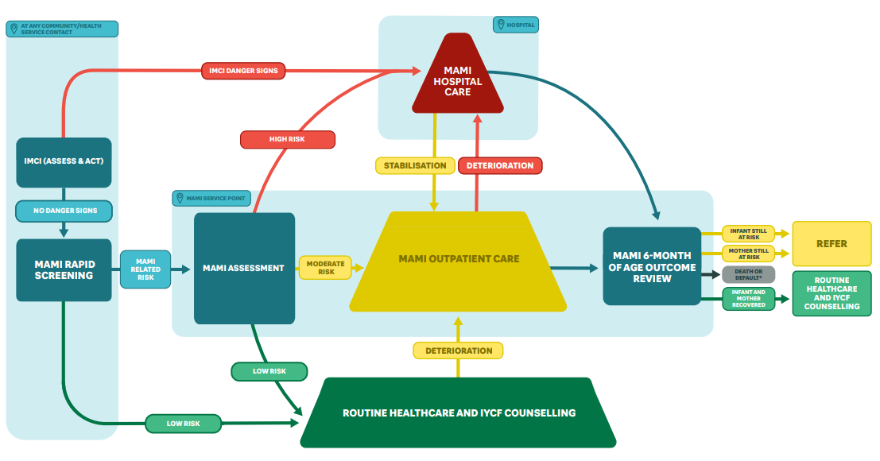
MAMI Care Pathway ‘flow’
Slide produced by the MAMI GN
Notes:
SAY:
“So what does the MAMI Care Pathway involve in practice?”
“There are three key phases: screening, assessment, and management.”
“Screening is a quick assessment that takes place at any contact point with infants and mothers, like vaccinations or growth monitoring visits to cast a wide net for identifying at risk infants.”
[click next]
“If a high risk infant is identified, they will be referred for urgent hospital care.”
[click next]
“Most infants will have no problems and will be referred to routine healthcare and IYCF counselling.”
[click next]
“If a potential risk is identified at screening, then the infant and mother are referred for a more in-depth assessment by someone who has more specialised training. At this point, they would be classified into one of three situations:”
[click next]
“They might end up being low risk and be referred to routine healthcare and IYCF counselling.”
[click next]
“They may be high risk and need referral to hospital or inpatient care.”
[click next]
“Or they may be moderate risk but can be safely treated in an outpatient or community setting.”
“If infants in routine healthcare develop issues, they can be referred into MAMI programming.”
“The focus of MAMI care is those infants who are high risk or at moderate risk but medically stable. These are the infants who are followed up in MAMI care until 6 months of age.”
“At 6 months of age, infants and mothers have an outcome review and are either deemed recovered or referred on for continued support in other programmes.”

Slide 12

Nutritional risk of infants <6months
MOTHER’S MENTAL HEALTH
FEEDING PRACTICES
MAMI RISK FACTORS
INFANT’S NUTRITIONAL STATUS
INFANT’S CLINICAL STATUS
Notes:
SAY:
To determine low risk, moderate risk or high risk we need to assess the full picture. Therefore the MAMI Assessment includes assessment of:
Infants nutritional status
Infants clinical status
Feeding practices
Mother’s mental health
MAMI risk factors – such as LBW, premature birth, multiple births, adolescent mothers, maternal malnutrition.
Infant’s Clinical Status:
If an infant has an underlying illness or clinical issue, this will impact their ability to properly grow and develop and they will be nutritionally at risk.
Feeding Practices:
If an infant is not being fed adequately, their growth and development will be negatively impacted and they will be nutritionally at risk.
Mother’s Mental Health:
Low moods and excessive worrying can lead to poor attachment and care practices, and challenges with breastfeeding
Poor maternal wellbeing can have negative impacts on child health and development
Therefore if a mother has a mental health illness, the infant is nutritionally at risk, as well as the mother needing support for her own wellbeing.
Infant’s Nutritional Status:
Poor nutritional status of the infant shows us whether there is already poor growth – we need to ‘treat’ these infants. Ideally we want to detect infants before they get to this stage, so we can ‘prevent’ poor growth. The MAMI Care Pathway aims to both treat and prevent malnutrition.
MAMI Risk factors
These are evidence-based risk factors that have been found to impact on an infant’s growth outcomes, therefore if the infant-mother pair have any of these risk factors they have an increased risk of being small and nutritionally at-risk.

Slide 13
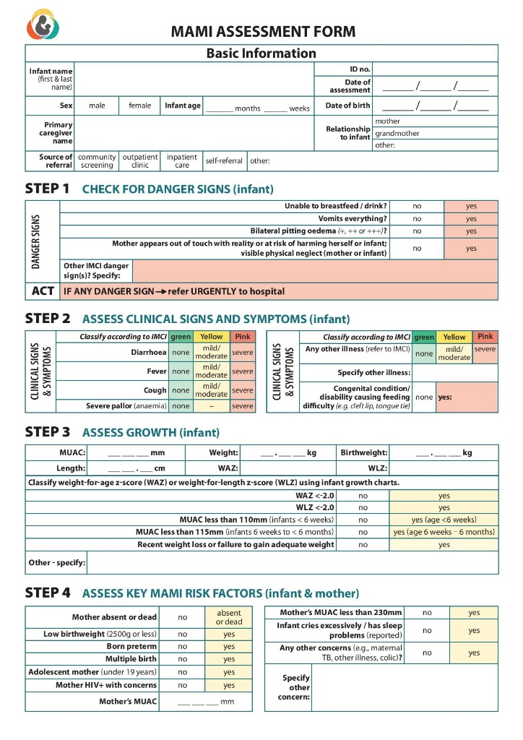
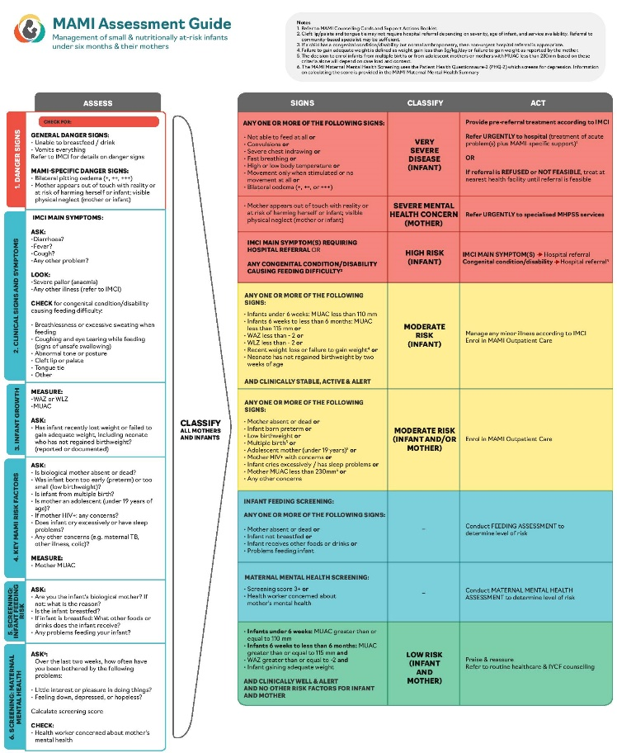
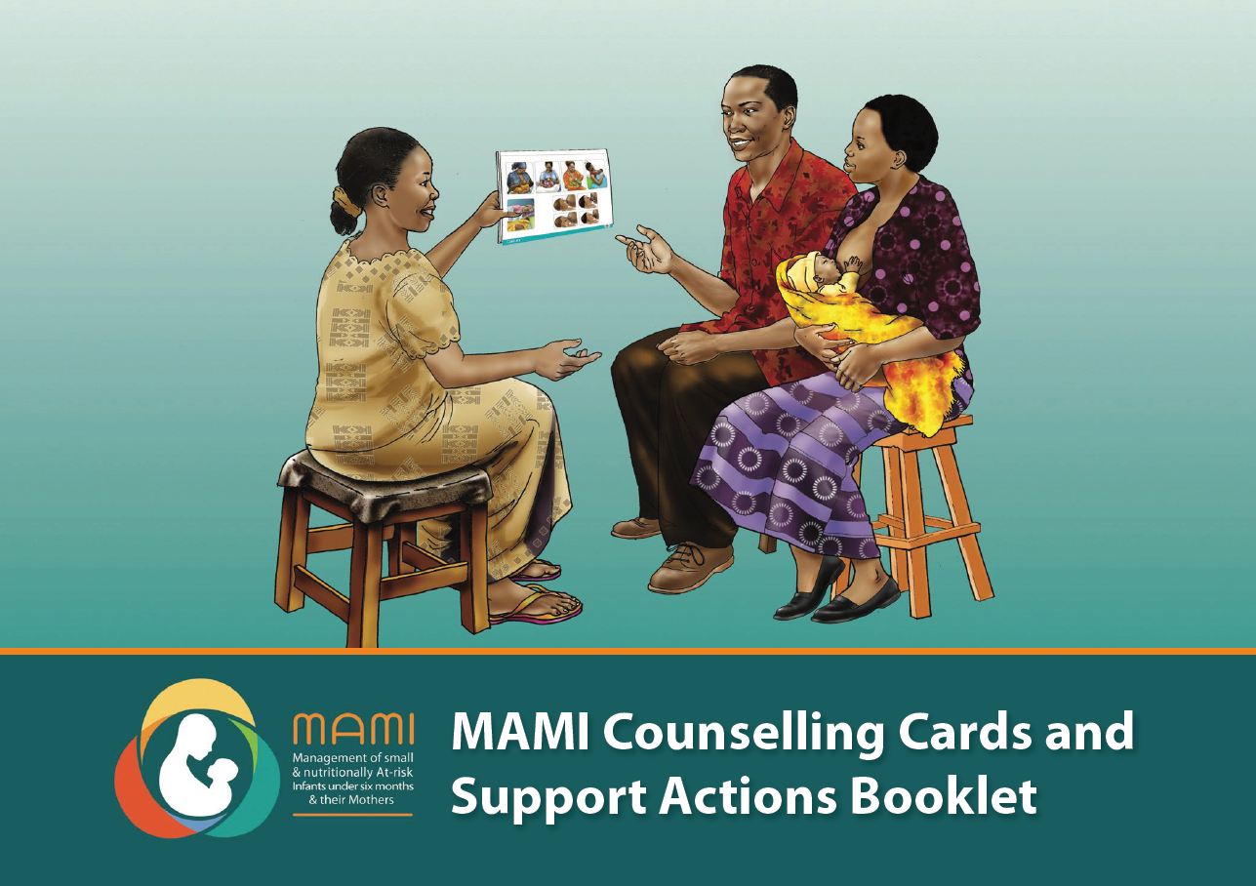
The MAMI care pathway package
Slide produced by the MAMI GN
Forms
User guides
Counselling Cards and Support Actions Booklet
Notes:
Say:
The three core materials in the package are:
1. User Guides, which can serve as training materials or references and are formatted in the IMCI style
2. Forms to guide the assessment, enrolment and monitoring of the mother and infant
3. Counselling Cards and Support Actions Booklet for frontline use by health workers: there are MAMI specific Counselling Cards and Support Actions in the package but you can also utilize the existing IYCF counselling tools and materials that you have and health workers are familiar with. There are 3 sections: breastfeeding support, support for the non-breastfed infant, and Core Topics.

Slide 14
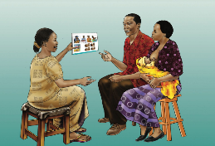
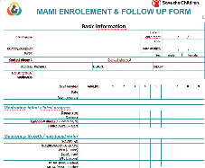
Support Package
Components of MAMI care
Slide produced by the MAMI GN
Counselling on core topics for all enrolled pairs.
Tailored counselling and actions to address specific risk factors and problems as required.
Referral of mother-infant pairs to other relevant services as required.
Continuous monitoring of the mother-infant pair’s progress and wellbeing at each visit with visit frequency reduced or increased as considered appropriate by the health worker and mother.
Notes:
SAY:
There are 4 aspects to the support package:
Counselling on core topics
Tailored counselling and actions
Referral of mother infant-pairs
Continuous monitoring and follow up to 6 months of age

Slide 15

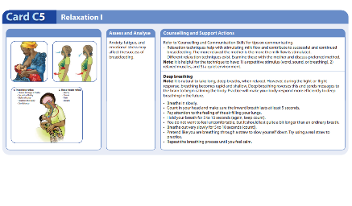
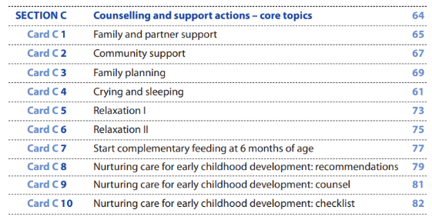
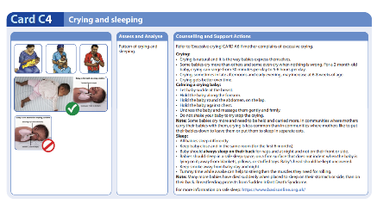
Support Package
Counselling on core topics for all enrolled pairs.
Notes:
SAY:
Component 1 of the support package: counselling on core topics for all enrolled pairs
The core topics include:
Family and partner support
Community support
Family planning
Crying and sleeping
Relaxation
Introduction of complementary feeding
Nurturing Care
These are topics that will be supportive and helpful to all caregivers of infants and they are therefore termed ‘Core Topics’
Each Core Topic has MAMI Counselling cards to aid health workers in providing support for this area

Slide 16
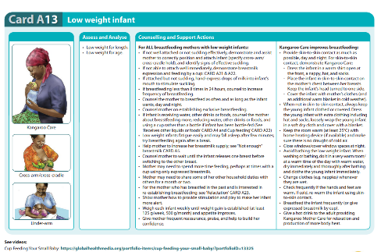
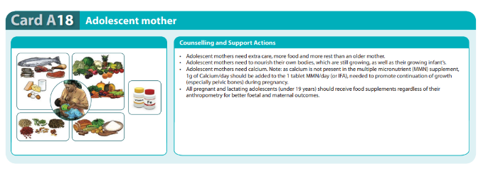
Support Package
2. Tailored counselling and actions to address specific risk factors and problems as required.
Notes:
SAY:
Component 2 of the support package: Tailored counselling and actions to address specific risk factors and problems
This is the 1-1 counselling we are likely familiar with in IYCF/ MIYCN programmes.
This is where health workers provide specific counselling for challenge and risk factors identified during the MAMI assessment.
For example, if incorrect position and/or attachment during a breastfeed is noted in the MAMI Assessment, you would provide targeted 1-1 counselling to support the mother to overcome this challenge and correct the position and attachment for an improved breastfeeding practice

Slide 17
Support Package
3. Referral of mother-infant pairs to other relevant services as required
How can we make the most of other services?
Notes:
SAY:
Component 3 of the support package: Referral of mother-infant pairs to other relevant services as required
There may be mother-infant pairs who have challenges we identify that we are not able to address in our services
In this case, we need to do our best to refer them to appropriate services to address that need or challenge

Slide 18
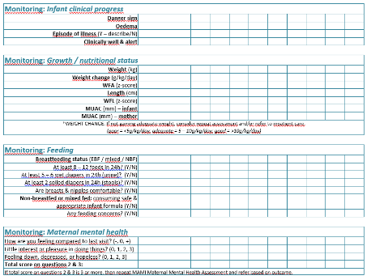
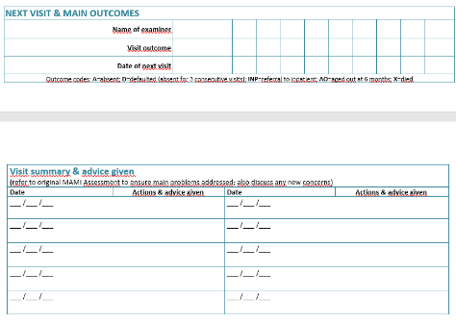
Support Package
4. Continuous monitoring of the mother-infant pair’s progress and wellbeing at each visit..
Notes:
SAY:
Component 4 of the support package: Continuous monitoring of the mother-infant pair’s progress and wellbeing at each visit.
One key element is that the MAMI Care Pathway acts as a follow up service – which is secondary prevention – for those infants at higher risk of adverse outcomes such as infants born with a LBW and for early intervention for those who develop growth failure in the first six months of life.
At each visit, we monitor how the infant and mother are progressing and assess for any new risks
At each visit, we provide targeted counselling to the mother or caregiver on the challenges that we have identified in the initial assessment, and/or on any new challenges that have been identified during the follow-up visits.
How often we see the mother and infant depends on how they are progressing.

Slide 19
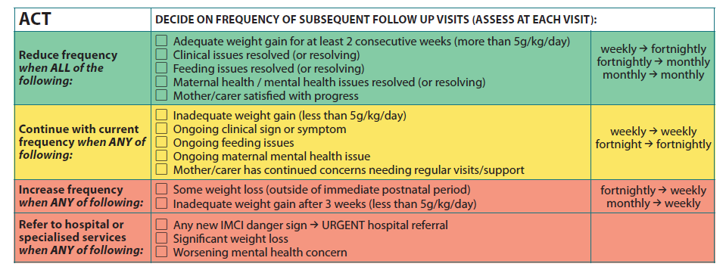
Support Package
Monitoring: de-escalation of care
Notes:
SAY:
At each visit we determine the progress of the mother and infant and adjust the frequency of follow-up visits accordingly: if they are doing well, then we can see them less often, if they begin to deteriorate you may increase the frequency and if at any point they develop complications, they will be referred to inpatient care
The helps for MAMI to not put a great time and effort burden on the health worker or on the mother of family
We determine whether they are doing well or not by the criteria listed in this table
We look at the weight gain, in g/kg/day, and whether there are any issues that are not yet resolving

Slide 20
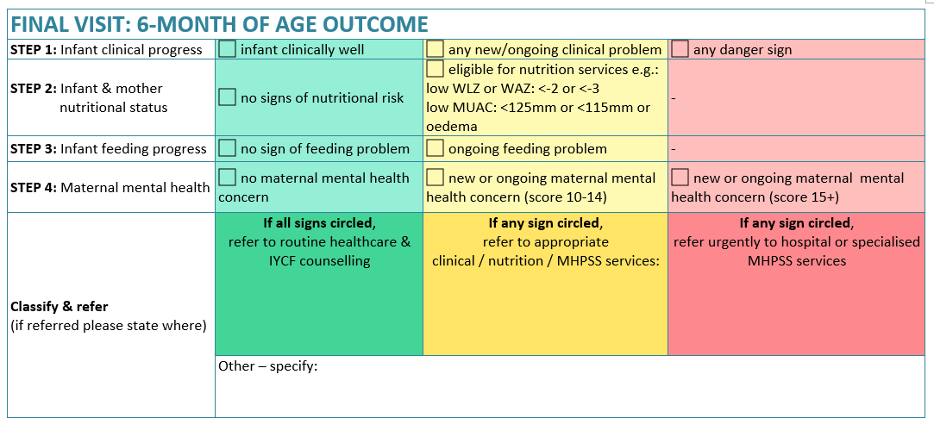
Support Package
6-month of age outcome review
Notes:
SAY:
At 6 months of age, each infant and mother will have their final visit to the MAMI programme and undergo a ‘6-month of age outcome’ assessment
This is to decide if there is any continuation of support needed for the infant or for the mother – are either still at risk?
For example if at 6-months the infants WLZ is <-2.0 then we would refer them to the IMAM programme for assessment and admission.
As well as ensuring continuum of care, the 6-month of age review data also allows us to assess the impact of the MAMI programme by seeing the outcome of the infant and mother at the point of exit from the programme

Slide 21
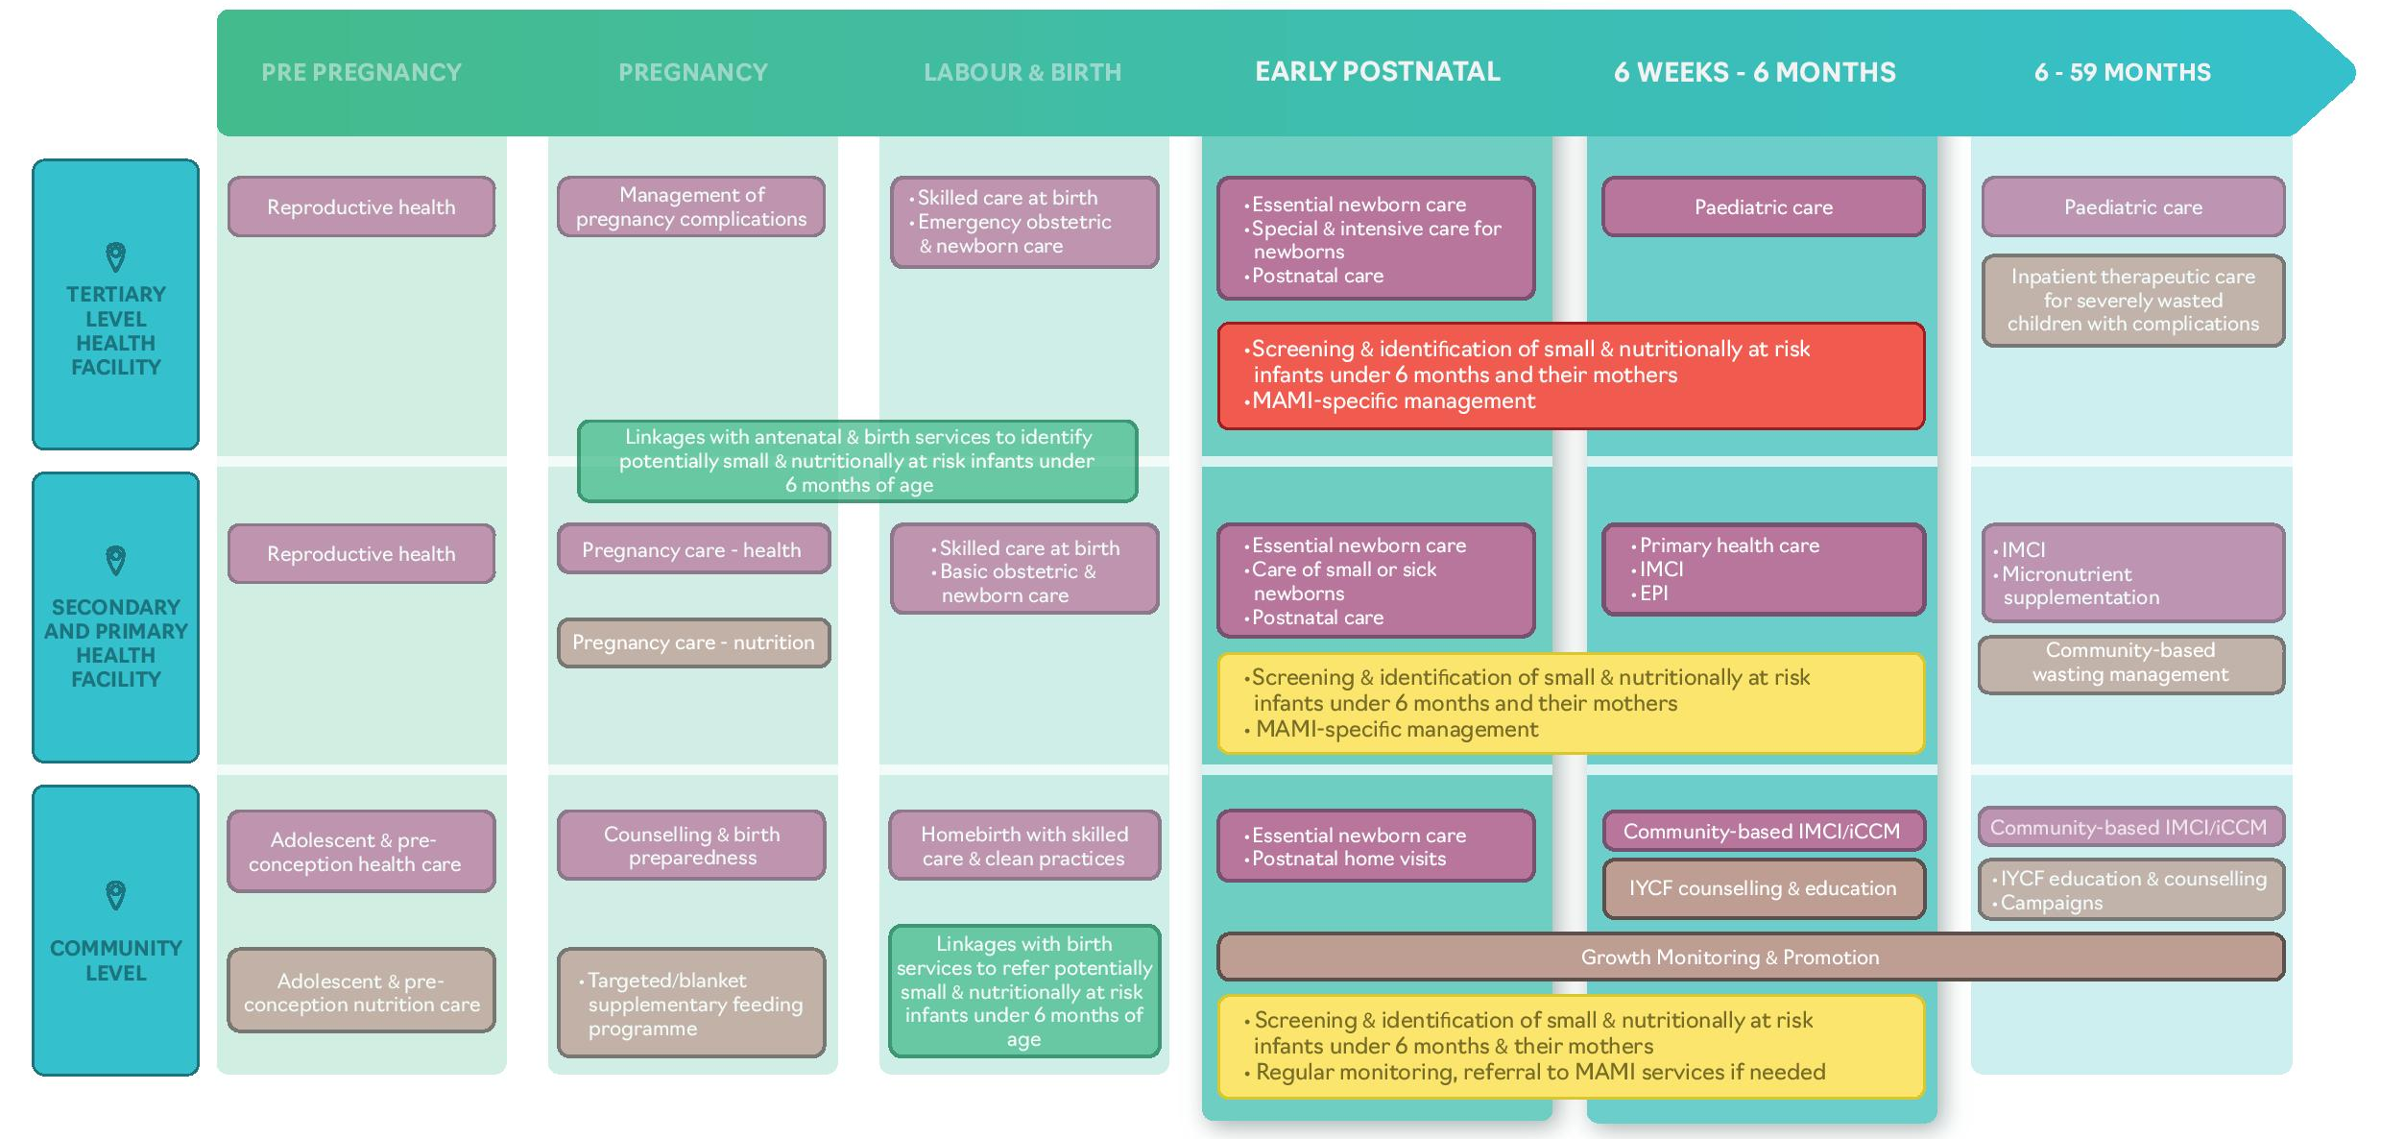
Where does MAMI fit in the health system?
Slide produced by the MAMI GN
IDENTIFY
IDENTIFY

Slide 22

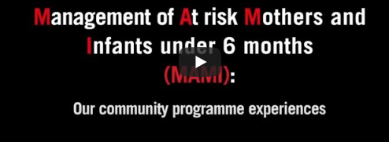
Community Programme Experiences
https://www.youtube.com/watch?v=Lyk60Yxm-xI
Notes:
5:50 minutes
Back up link: https://youtu.be/q3EUk2c1skc

