Slide 1

Nutrition Sensitive Interventions
Webinar
Danka Pantchova, GNC Integration Help Desk
Yara Sfeir, GNC Technical Help Desk
October 2019

Slide 2
Outline
Welcome and Introductions
What are the Nutrition-specific and Nutrition-sensitive Interventions?
In country tips to improve inter-cluster integration
ICNWG and GNC initiatives to improve inter-cluster integration
Discussion

Slide 3
What are the Nutrition Specific and Sensitive Interventions?
The Lancet Maternal and Child Undernutrition Series 2008
  Need to focus on the crucial period from conception to a child’s second birthday—the 1000 days
  Greater priority for national nutrition programmes
  Stronger integration with health programmes and enhanced intersectoral approaches
  More focus and coordination in the global nutrition system of international agencies, donors, academia, civil society, and the private sector.
Notes:
The 2008 Series identified the need to focus on the crucial period from conception to a child’s second birthday—the 1000 days in which good nutrition and healthy growth have lasting benefits throughout life. The Series also called for greater priority for national nutrition programmes, stronger integration with health programmes, enhanced intersectoral approaches, and more focus and coordination in the global nutrition system of international agencies, donors, academia, civil society, and the private sector.

Slide 4
What are the Nutrition Specific and Sensitive Interventions?
The Lancet Maternal and Child Nutrition Series 2013
  Double burden of malnutrition in women and children
  Consequence of nutrition through adolescence in girls to pregnancy to childhood
  Covers the evidence supporting nutrition-specific interventions
  Examines nutrition-sensitive interventions and approaches and their potential to improve nutrition
  Discusses the features of an enabling environment that are needed to provide support for nutrition programmes
Notes:
5 years after the initial series, we re-evaluate the problems of maternal and child undernutrition and also examine the growing problems of overweight and obesity for women and children and their consequences in low-income and middle-income countries (LMICs). Many of these countries are said to have the double burden of malnutrition— continued stunting of growth and deficiencies of essential nutrients along with the emerging issue of obesity. We also assess national progress in nutrition programmes and international efforts toward previous recommendations.
The first paper6 examines the prevalence and consequences of nutritional conditions during the life course from adolescence (for girls) through pregnancy to childhood and discusses the implications for adult health. The second paper7 covers the evidence supporting nutrition-specific interventions and the health outcomes and cost of increasing their population coverage. The third paper8 examines nutrition-sensitive interventions and approaches and their potential to improve nutrition. The fourth paper9 discusses the features of an enabling environment that are needed to provide support for nutrition programmes, and how they can be favourably influenced. A set of Comments10–15 examine what is currently being done, and what should be done nationally and internationally to address nutritional and developmental needs of women and children in LMICs.

Slide 5
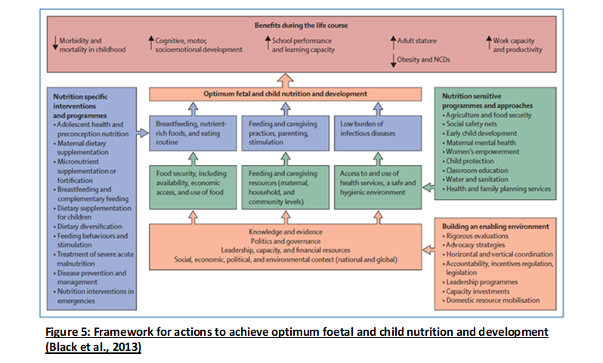
Notes:
HINIs are in line with the nutrition specific interventions described in paper number 2 of the maternal and child nutrition Lancet series

Slide 6
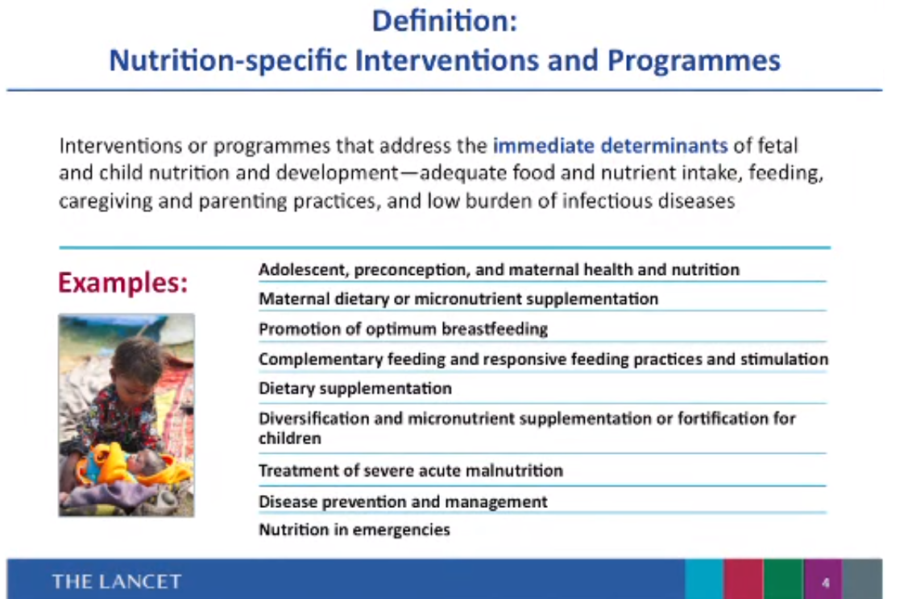

Slide 7
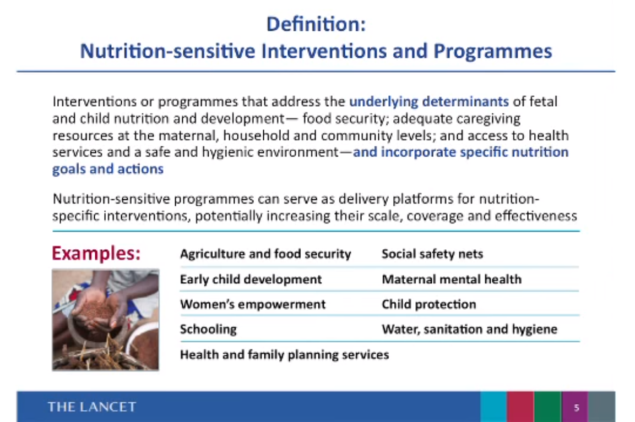

Slide 8

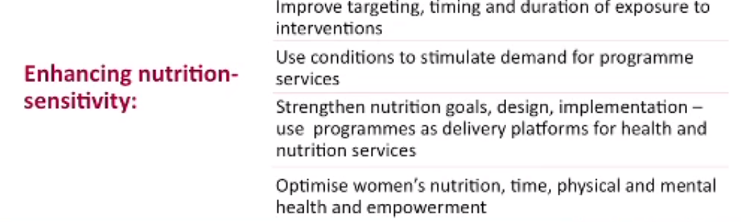

Slide 9
Multiple questions around "nutrition-sensitive"
How to prove effectiveness knowing the multitude of adaptations possible in relation to the needs of populations or the context?
Lancet mentions broad areas of activities (ex. Agriculture) but which ones are "sensitive" to nutrition?
Can we talk about nutrition-sensitive activities in acute emergencies?
How to work with other sectors to make their activities nutrition sensitive?

Slide 10
Notes:
HINIs are in line with the nutrition specific interventions described in paper number 2 of the maternal and child nutrition Lancet series

Slide 11
Nutrition-sensitive interventions mean WORKING WITH OTHER SECTORS and the communities/ local authorities
Coordination, coherence and synegies with other sectors for a better integration
Consult affected communities, their perceived needs, in order to align with their priorities.
Always combine nutrition specific activities with nutrition sensitive activities in a holistic way
Anchor activities in existing systems and practices
Advocate for sustainable change in strategies, policies, building local capacity.
Routine analysis of activities in relation to gender, "do no harm" and cultural acceptability.

Slide 12
Somme good practices…
Level of integration | Examples
Coherence | Routinely screening sectoral humanitarian response plan to be coherent with plans of other sectors; Taking into account existing development programs, when planning humanitarian response;
Convergence | Agreeing on common indicators for Joint analysis; Prioritization of humanitarian needs and consequences; Identification of common questions to lead HRP;
Complementarity | Joint assessments Joint targeting (ex. most vulnerable households, population sub-groups); Joint response plan; Joint preparedness plan;
Synergy | Joint evaluation; Setting Comprehensive package of services covering all basic needs while reinforcing existing systems;

Slide 13
Steps That Can Be Adapted To Support Assessment/Analysis, Response Planning, Resource Mobilization, Implementation And Monitoring (I.E. Humanitarian Programme Cycle –HPC)
Step 1
The ISWC
Provides platform for multi-sector joint needs analysis during the HNO process
It requires every sector to avail sector specific data for such analysis
Step 2
The Nutrition Sector
Presents the analysis into the UNICEF conceptual Framework of Malnutrition
Identify linkages and gaps in data
Calls for a joint analysis meeting to refine the analysis and conceptual framework
Step 3
All Sectors
Refine the multi-sectoral analysis
Update and refines the conceptual framework using all the sector specific information
Step 4
All Sectors
Agree on package of intervention and undertake analysis of who is doing what where, how etc. (5Ws)
This will facilitate identification of actions being undertaken
It can also identify gap geographically and programmatically from an integration lenses

Slide 14
Steps That Can Be Adapted To Support Assessment/Analysis, Response Planning, Resource Mobilization, Implementation And Monitoring (I.E. Humanitarian Programme Cycle –HPC) Continuous -----
Step 5
All Sectors
Nutrition Sector develop nutrition specific intervention to address current gaps and scale up plan base of High Impact Nutrition interventions
The plan should have clarity on possible integration using platforms of other sectors to deliver HINI and actions that will strengthen health systems
Other related sectors should develop nutrition sensitive actions to address area of gaps requiring actions to improve Nutrition outcome
Step 6
All sectors
Ensure those actions are costed in the respective sector plans
Step 7
All sectors
Jointly identify areas where joint/integrated response will take plan
Agree on few key indicators of success
Step *
All Sectors
Create platform for coordination and regular update
It will be important to be clear on the role of the sectors and ISWG within the framework
Explore options for join resource mobilization, through joint proposal writing and joint programming

Slide 15
Current activities/available support
ICNWG action plan
Integrated Training Package for nutrition outcomes.
GFSC, gWASH, GHC & GNC working group
Case studies
GNC Helpdesks
GTAM

Slide 16
Discussion
Do you develop this type of work in your countries?
What feasibility?
What will facilitate?
How to strengthen integrated and joint work according to you?
What support is needed?

