Slide 1

GBV and Nutrition
Key linkages, activities and guidance for integrated programming

Slide 2
Session Learning Objectives
By the end of this session, participants will:
Explain the linkage between GBV and Nutrition.
Identify specific activities for the integration of GBV and nutrition interventions

Slide 3
Definition: Gender-based violence
Gender-based violence is an umbrella term for any harmful act that is perpetrated against a person’s will and is based on socially ascribed (i.e. gender) differences between males and females. It includes acts that inflict physical, sexual or mental harm or suffering, threats of such actions, coercion and other deprivations of liberty.
GBV includes rape, sexual violence, physical violence, emotional violence, deprivation of opportunities and services, intimate partner violence etc.
Notes:
IASC GBV guidelines definition.

Slide 4
How does GBV integrated Nutrition services look like?
Quality, Safe and accessible nutrition services
Reach to the most vulnerable populations
Safe/dignified access and use of nutrition services
Ethical nutrition services/programming
Survivor-centered GBV referral
GBV integration
Safe and meaningful participation of women, girls and other at risk groups throughout the HPC .
GBV integration is one of strategies to achieve quality, safe and accessible nutrition services.
Notes:
GBV integration = GBV risk mitigation means ‘safe/dignified access and use of humanitarian services’, which means that services including facilities are safe and culturally acceptable so that the affected population i.e. women and girls can safely access and use humanitarian services. ‘ethical humanitarian services/programming’ which includes basic ethics i.e. PSEA, and GBV referral, all frontline workers are ready to refer a survivor who seek support to GBV services or other services in survivor-centered way. Then all these should be defined by participation of women/girls and other at risk group.
All these will contribute to quality programming and also help sector to reach the most vulnerable. GBV integration is a strategy to improve quality of programming and reach to the most vulnerable populations by considering these aspects. These aspects are also common to four key principles of protection mainstreaming: 1)Prioritizing safety and dignity and avoid causing harm, 2) ensuring meaningful access, 3) accountability and 4) participation and empowerment.

Slide 5
Definition
GBV integration ≠ GBV programming
GBV integration = good pragramming
By integrating GBV, nutrition programmes can improve quality of nutrition response, mitigate risks of malnutrition, reach to the most vulnerable and prevent and mitigate risks of GBV of the affected population

Slide 6
Linkage between GBV and Nutrition
GBV is one of drivers of malnutrition.
Gender/power dynamics in the home have major implications for effectiveness of nutrition interventions and uptake of the services.
Lack of food as a driver for forced marriage + increased risk of sexual exploitation and abuse.
Location and timing of nutrition services/distribution points can increase GBV risk
Caregiver’s experience of GBV can have negative implications for child nutrition outcomes

Slide 7
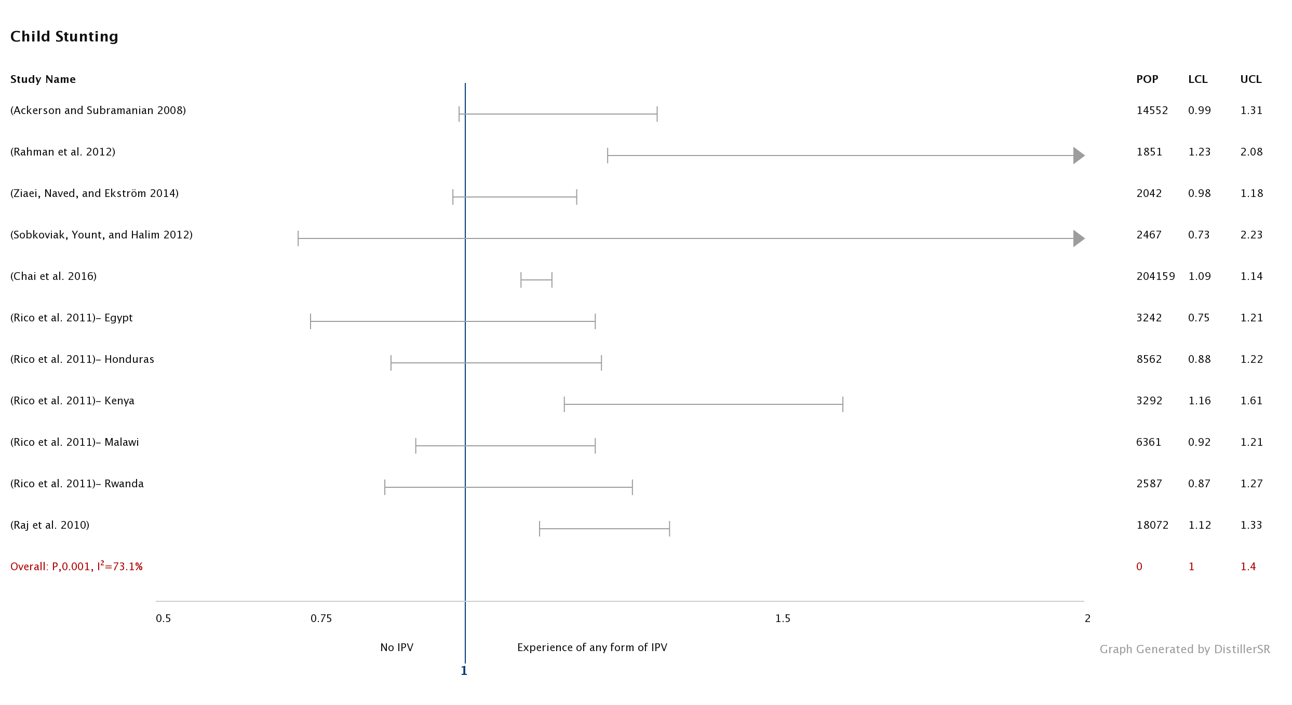
GBV increases the risk of Stunting
Women who experienced any form of IPV were more likely to have stunted children
Notes:
Our review finds 12 studies examining the association between GBV and child malnutrition (See table 1). Studies were from both low and high-income countries and examined the association of GBV with child underweight, stunting, wasting (moderate to severe and severe), and low BMI. Most of the studies were based on Demographic Health Surveys or National Surveys with a few studies using observational study designs. All of them show a positive association between maternal exposure to physical, sexual, verbal or emotional abuse by their partners and child nutrition indicators. Stunting – low height of age- is a well-established risk marker of poor child development and predicts poorer cognitive and educational outcomes in later childhood and adolescence. Acute Malnutrition in the form of wasting can have long-term consequences for linear growth, depending on the severity, duration and recurrence, particularly if there is insufficient nourishment to support recovery. A significant association between stunting and maternal exposure to IPV was seen in countries like Kenya, India, Bangladesh and Malawi

Slide 8
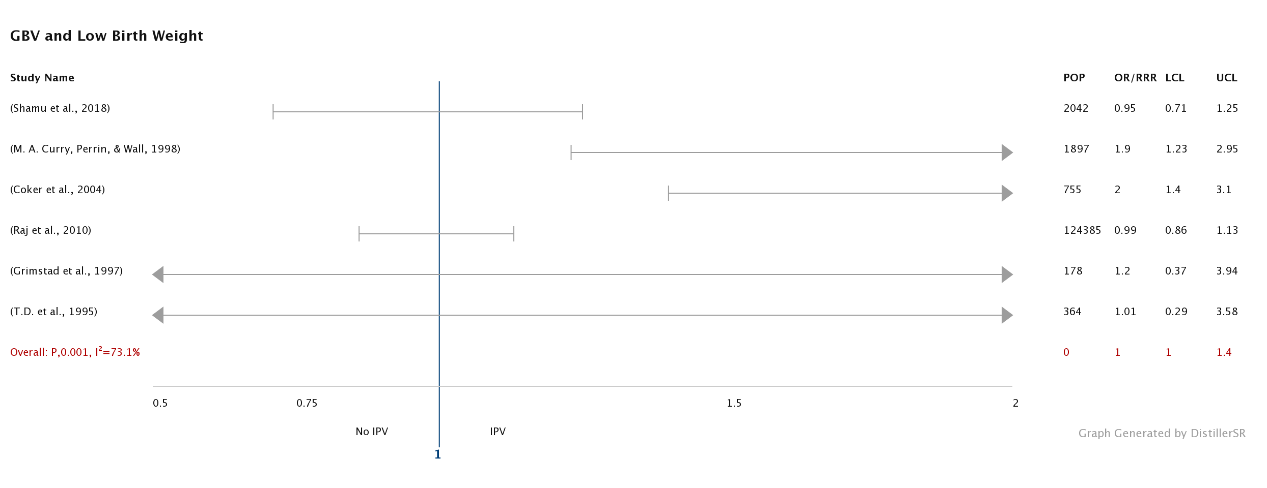
GBV affects fetal growth and development
Women experiencing any form of IPV during or before pregnancy were more likely to have Low Birth Weight (LBW) children or children who were too small for their gestational age.
Notes:
The review found 10 studies examining the association of LBW with exposure to IPV. Studies show that there is a positive association between LBW and the outcome. Low weight at birth (less than 2500 grams) is strongly associated with child malnutrition, neonatal mortality, cognitive and neurological impairment, and stunting as adolescents and adults. LBW is also associated with other outcomes like hypothermia, small for gestational age, low immunity and consequent morbidity. LBW may also have intergenerational effects as LBW girls who survive tend to be undernourished when pregnant with relatively high incidence of LBW children(Alderman & Behrman, 2004).

Slide 9
GBV increases the risk of early cessation of breast feeding
Immediate Initiation of Breast Feeding
  Mothers who were exposed to IPV had a greater likelihood of feeding their children liquids within 24 hours of birth compared to those who were not.
Exclusive Breast Feeding
  Women who experienced any form of IPV during pregnancy were more likely to stop exclusive breast feeding within 6 months after birth.
Notes:
Interventions towards infant and young child feeding are critical for improving nutrition during emergencies. Immediate initiation of breast feeding, exclusive breast feeding for 6 months, timely initiation of complementary feeding at 6 months, minimum dietary diversity and minimum feed frequency (age appropriate) are recommended for child health and nutrition during the first 2 years of life. Our review found 11 studies that explored the impact of GBV on child feeding. Women who experienced any form of IPV during pregnancy were more likely to stop exclusive breast feeding within 6 months after birth. There was an association between IPV and immediate initiation of BF. Misch et al found that Indian mothers who were exposed to IPV had higher odds of feeding their children liquids within 24 hours of birth compared to those who were not (OR 0.74, 95% CI 0.58–0.95). The results show that psychological abuse was strongly associated with negative feeding behaviors.

Slide 10
Barriers and enablers
Health/Nutrition facilities are too far/in a dangerous location.
Women and girls do not receive information because: limited to community leaders; non-child friendly
Common areas where GBV risks are present in Nutrition sector sent
Materials do not cater to the needs of the girls/women
Distribution – a long waiting line, overcrowded, lack of female distribution staffs
Participation of Women and Girls
Location of facilities
The dissemination of information and awareness
Human Resources – gender, skills, attitudes
The delivery of material support
Design/ layout of facilities – security, privacy and dignity
Social norms
Not adequate no. of female nutrition frontline workers.
Lack of female leaders in Nutrition.
Girls , boys, women and other at risk groups are not consulted in assessment, design and M&E systematically.
Nutrition facilities do not reflect the culture or needs of the affected population.

Slide 11
Integrating GBV and Nutrition-How
Programmatic entry points
Entry Point!
Women and girls themselves
Identify GBV risks in the environment and their barriers to accessing services
Identify priorities
Assessment Analysis and Planning
Resource Mobilization
Implementation
Coordination
Monitoring and Evaluation
Entry Point!
Articulate GBV risks related to nutrition response.
Include GBV risk mitigation measures.
Entry Point!
Monitor GBV risks
Safety audit
Safety perception
SADD
Entry Point!
Safe and dignified access to services.
Ethical programming.
Participation
Safe and ethical referral

Slide 12


Barrier analysis: Availability, Accessibility, Acceptability and Quality (AAAQ framework)
Accessibility
Physical Accessibility: Location, route, safety, other physical barriers
Availability: Is the service available ?
Financial Accessibility: User fees, transportation cost.
Acceptability: Is the service acceptable to the affected population (M/F different age and abilities)
Administrative Accessibility: Civil documents, procedures i.e. mandatory reporting, administrative complication to access the service. Language.
Social Accessibility: Social norms ( e.g. women can only talk to women, men has to approve women’s access to the service), cultural belief, social exclusion, stigma to access the services etc.
Quality: Do service providers possess the necessary skills/training? Are there adequate supplies? Are the facilities safe and sanitary? Quality also extends to the way people are treated before, during and after accessing services.
Information Accessibility: availability of the information of the service. Who receive the information, language, style of communications,
Notes:
Handout: AAAQ framework
Availability: Whether the service in question is available? For instance, is the health service available?
Accessibility: Whether the service is accessible i.e. women and girls? Are there any groups of people who cannot access to the service due to the accessibility barriers (physical, financial, admin, social, information). For example, a refugee woman from conservative countries may not be able to access health service where there are no female health staff and may not have enough money to pay the health services, may not have an insurance to access the health service and her husband may not allow her to access to the health service provided by male doctors, and may not have any information about the service or cannot read the information she received.
Acceptability: Even if there are no accessibility barriers, if the service is not acceptable to the intended user due to their culture or norms, people still cannot access to the services.
Quality: Even if people access to the service, if the quality is not up to standards, the users may not receive what s/he needs to receive or have negative impact.

Slide 13
Examples - Ethiopia
A GBV case worker stays in IYCF centers and provide information on GBV to the users.
Any people who want to access GBV services can seek support from the GBV case worker or directly access to services.
More women access Women Friendly Space.
More survivors of GBV seek support through the case worker.
A simple collaboration like this can save life. When women receive adequate care, there is positive effect to nutrition outcome of children and the women.

Slide 14
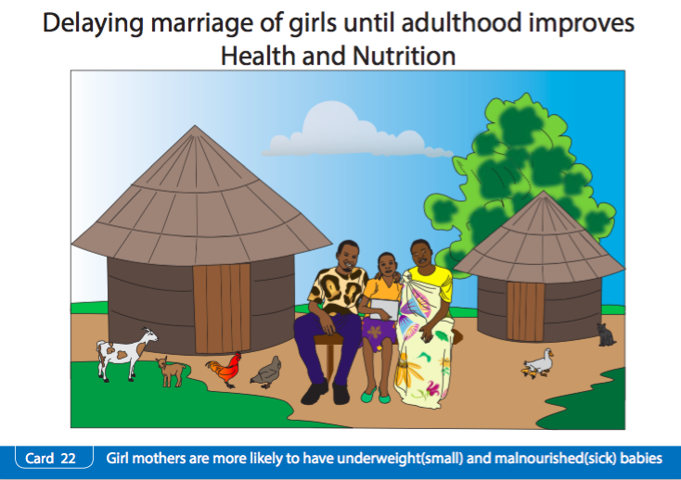
Examples – South Sudan
Integrating GBV messages into IYCF card.
Nutrition has bigger and different outreach from GBV actors. This integration can disseminate critical message.
Notes:
UNICEF supported the South Sudan Ministry of Health to incorporate key messages on the linkage between child marriage/early pregnancy and nutrition outcomes into their standard Infant and Young Child Feeding IEC materials.

Slide 15
Integrating GBV and Nutrition – tools
IASC GBV Guidelines – Thematic Area Guide for Nutrition
Key consideration to integrate GBV interventions in Education in 5 areas:
  Assessment, Analysis and Planning
  Resource mobilization
  Implementation
  Coordination
  M&E
Essential Action Sheet
Other accompanied resources:
Donor advocacy tools
Pocket guide – how to support survivors of GBV when a GBV actor is not available in your area.
www.gbvguidelines.org
Notes:
15

Slide 16

Integrating GBV and Nutrition – tools
GBV pocket guide and Cash and Voucher Assistance and GBV compendium
Step by step guide for non-GBV specialists
Key messages that you can use to the survivor
Special consideration for child survivors.
Ethiopian version is being developed.
Practical guidance on how to mitigate GBV risks in cash and voucher assistance.
GBV pocket guide mobile app is available in google play and iTune store. Search “GBV pocket guide”
Notes:
It’s important for nutrition frontline workers to know how to refer GBV survivors because nutrition frontline workers meet very vulnerable women who likely experience some forms of GBV. Nutrition frontline workers can establish trust with those women and they might seek support from nutrition frontline workers.

Slide 17
Take Home Messages
GBV is one of drivers of malnutrition.
Nutrition services could exacerbate GBV risks without identifying and addressing GBV risks related to nutrition services.
By integrating GBV risk mitigation, nutrition services can improve quality of services & access to services for the most vulnerable.
Talk to GBV actors to identify good ways of working/collaboration

