Slide 1

Global Technical Assistance Mechanism for Nutrition
What does a good Infant and Young Child Feeding in Emergency intervention look like?
From assessment, to implementation and monitoring
Advice. Guidance. Expertise. Learning.
17th April 2019

Slide 2
Agenda
What type of assessments are recommended to collect data on IYCF-E?
What are the key indicators for IYCFE data collection?
How to be prepared for an IYCF-E response?
The checklist to run through once the emergency hits
Key aspects of an appropriate IYCF-E response
Monitoring tips and tools
Questions and answers

Slide 3

IYCF Assessments in Emergencies
Overview: Assessing IYCF-E Needs?
Type of Assessments
Key Considerations when Conducting an IYCF Assessment

Slide 4
Overview: Assessing IYCF–E Needs
Invest in gathering reliable, accurate, systematic and coordinated data and information
Triangulate Information Sources; Review, Analyze and Report
Use information to plan, monitor and implement relevant IYCF programmes
Linking Information to Action
Preparedness
Situational Analysis
Notes:
As part of preparedness it is essential to invest in systems that continuously and systematically gather information on IYCF programme monitoring and coverage.
This is helpful as a baseline in emergencies- whether they are acute or slow onset emergencies.
As there are various sources of IYCF data it would be important to triangulate and synthesize this information – conducting a situation analysis that considers all data available- e.g. the policies available and being used in the country, the status of key IYCF indicators e.g EBF, MDD and MAD, bottle feeding, the CODE etc.
Develop a clear story of this data and come up with a situation analysis, this will help inform the programmes on the key areas to prioritize.
The data reported and the information shared should be linked to response- it is important to work closely with IYCF programme colleagues to ensure that the data and information is used in response

Slide 5

Consider Pre-Crisis Background Information…
Contextual Data
Policy environment
Child nutritional status
IYCF Data
Pre emergency Feeding Practices
KAP regarding IYCF
Population Security and Access
Estimated Caseloads of Children under two
Prevalence Reports of Higher Risk Infants
Household Food Security
Health Environment
Capacity and Availability of Potential Support
Complementary Feeding Practices
Acceptability and Feasibility of wet nursing
Disability and care feeding practices
Feeding Difficulties
Untargeted distribution or donations of BMS
Notes:
Pre Emergency Feeding practices- EBF, early intiation, non-breastfed infants, breastfeeding, BMS use bottle feeding
KAP studies that address the why? Understanding the reasons behind practices and attitudes help to address targeted response and support for IYCF programmes- thi sincludes e.g what are the practices of feeding during illness, cultural practices, how are decisions made on feeding, feeding difficulties, etc
IYCF data can be gathered from a number of sources- MICS, DHS, IYCF assessments etc this data should also be understood in the context of routine programme data e.g IYCF counselling coverage, monitoring of the CODE etc.
Information on policies helps to inform and guide the response team, this data on available policies for breastfeeding, complementary feeding etc should be well understood. The background information such as the nutritional status of the children, key drivers of malnutrition e.g dietary intake and household food security, morbidity and access to health services and WASH (clean water and sanitation basic services) also useful to understand the situation and context of the population and will help in the development of IYCF response programmes.

Slide 6
General guidance for IYCF indicators…
How is the indicator linked to the question you are trying to answer?
Which is the information gap to fill?
Are you able to collect the data?
What are the resources required (human, material, financial)? What are the potential risks associated with collecting the data?
Is there an existing data source for the information you are looking at?
Who will collect the data and how often do you need the information updated?
Notes:
It is critical to consider the above key points when reviewing the data we need. This will help us to collect information that will be useful to the programming to avoid duplication and also to collect data in a sustainable and efficient manner. This also helps contributes to the quality of the data collected and linking information to action.

Slide 7
Type of Assessment will be informed by…
Data Gaps
Type of Emergency
Access to Population
Resources and capacity available
Notes:
Collect information only on the data gaps identified. The type of assessment will be dependent on the type of emergency- is it acute or slow onset both may have different approaches based on the amount of information available prior to the assessment, if the population has been displaced, are there in camps etc. Access to the population could be in camps or for example in slow onset emergencies in normal settings. The resources and capacity that are available both technically and financially are also a key factor to consider to ensure that we collect quality data that can be used to inform response.
Try and draw on other sector needs assessments to collect information- WASH, Health
Ensure to collect disaggregated data where possible ad also data on PLW- consider ethnicity, location context etc.
Inform strategic decisions- target population, geography, type of problem, scale of problem, individuals affected, operational decisions

Slide 8
Concerns that need immediate investigation
General distribution of infant formula and milk products, and/or bottles and teats
Mothers reporting difficulties in breastfeeding or stopping breastfeeding due to the crisis situation.
Reports of infants under 6 months who are not breastfed
Reports of increased diarrhoea in infants under 12 months
Poor availability of food for complementary feeding in the markets/food aid provided.
Mothers reporting difficulties feeding their children

Slide 9

Early Needs (Rapid) Assessment
Inform strategic decisions- who, where, scale, number to inform operational decisions
Where representative survey is not feasible use alternative opportunistic means- FGDs, Kis, transit walks etc.
Use standard indicators
Develop context specific indicators when necessary- consult with the IFE team
Consider key indicators as a guide for further investigation- IMR, U5MR, high GAM, artificial feeding practiced pre-emergency, reports of BMS donations etc.
Notes:
Humanitarian indicator guide; WHO IYCF guide
UN- SENS survey module has a module on IYCF

Slide 10
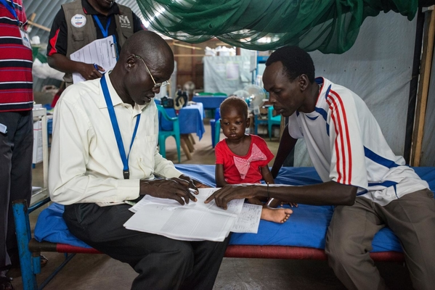
Protracted Emergencies
Representative surveys- IYCF surveys, KAP surveys
The sampling procedure should also consider the disaggregation of the different age groups
Use standard indicators – breastfeeding, complementary feeding, bottle feeding,
If possible include qualitative information
Triangulate results with other information- anthropometry, health, WASH etc
.
Notes:
Humanitarian indicator guide; WHO IYCF guide

Slide 11
Key Points to Consider during assessments ..
Common errors | Examples | Solution
Wrongly assessing age eligibility of the child | Completing the IYCF interview on a child that is 24 months of age and has reached his / her second birthday. | Ensure that the inclusion and exclusion birthdates and months are clear to the surveyors. Provide the team leader with an age guide where inclusion and exclusion dates are provided for children 0-5 months and 6-23 months.
Respondents feel embarrassed to answer the questions | Women may not feel comfortable answering questions if the enumerator is male. | Investigate the likelihood of this being a problem prior to the survey and ensure that there are female interviewers.
Respondents do not understand the questions or the information is too difficult to report | High percentage of ‘don’t know’ categories. | Review questions and translation. Ensure that the respondent is the main caregiver of the child.
Inconsistencies in data collection – lack of logical responses | The child has never been breastfed (response no to ‘ever breastfed’) but the child was breastfed yesterday. | The supervisor must check the questionnaires; either in the field or at the end of the day and rectify any errors as quickly as possible.
Surveyor does not understand the question well enough | The surveyor thinks that a clear broth is a solid or semi-solid (soft, mushy) food as opposed to a water-based liquid. | The training needs to ensure that surveyors are well prepared so that they can explain this question to the respondents in a standardised fashion.
The respondent does not understand the reasons for the survey | The respondent thinks it will entitle them to additional food and hence overestimates the age of the children, biasing the answers. | The training needs to ensure that surveyors understand the purpose of the survey and explain it well to respondents.
Small sample size | Sample size not calculated with IYCF parameters including for the disaggregated sub groups | Ensure that sample size is calculated for all the age groups
Notes:
Borrowed from SENS module…

Slide 12
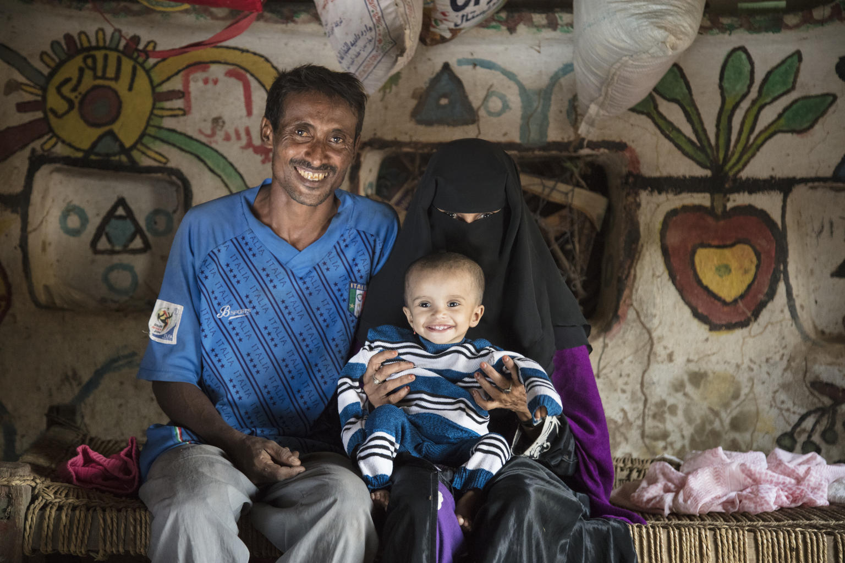
Monitoring
Include process/output indicators to measure the quality, coverage, and utilization of services and programmes. E.g. number of women that received individual counselling at least X time
Outcome indicators to determine the effect of the interventions
Use standard indicators agreed upon including with the IYCF-E colleagues
Monitor IFE against global indicators e.g in the SPHERE
Monitor CODE violations

Slide 13
Useful References for Indicators
IYCF- E- Operational Guidance for Emergency Relief Staff and Programme Managers
WHO-UNICEF Indicators for Assessing IYCF Practices. Part 1: Definitions
The SPHERE Standards
SENS Module

